Slide 1
Showcase Your Skills

Slide 2
Skills
Order skills to reflect your career objective
Relate skills and experiences to the stated career objective
Demonstrate diversity and acquisition of skills

Slide 3
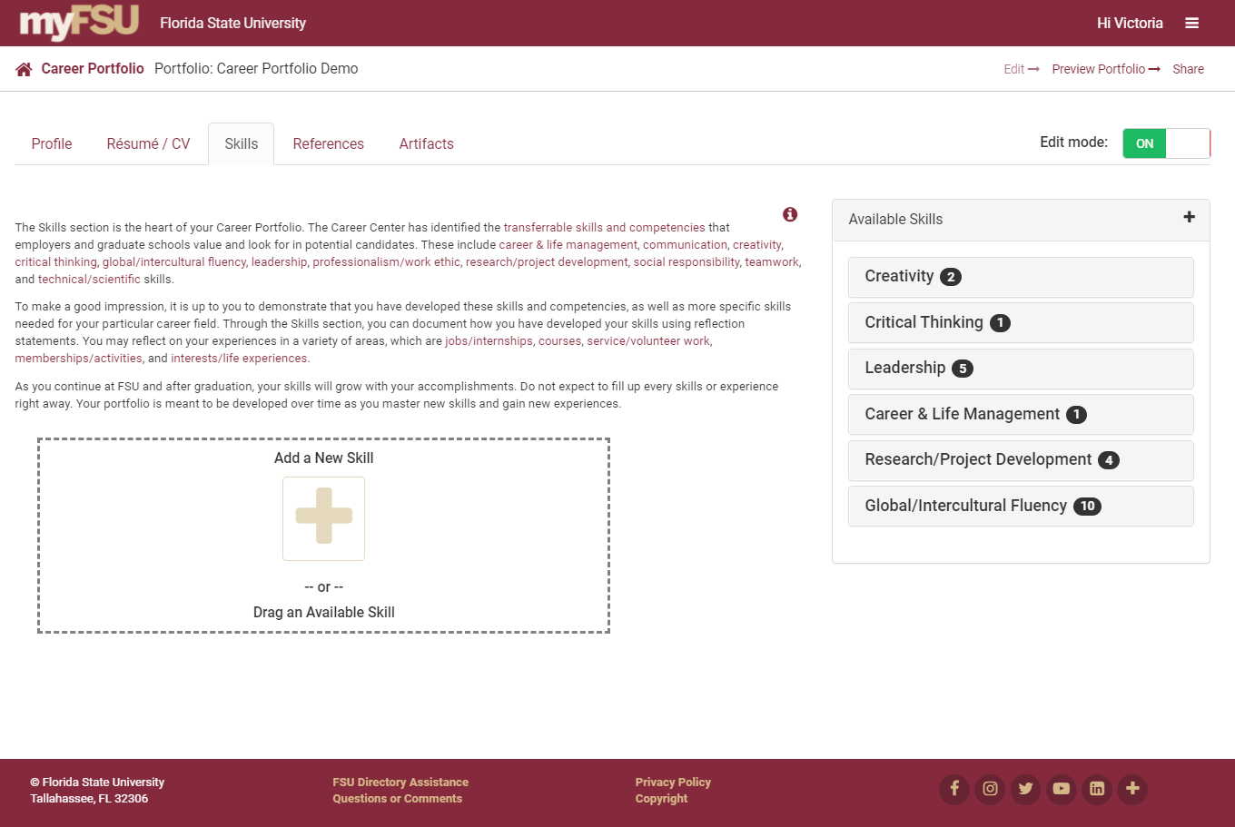
Add Skills

Slide 4
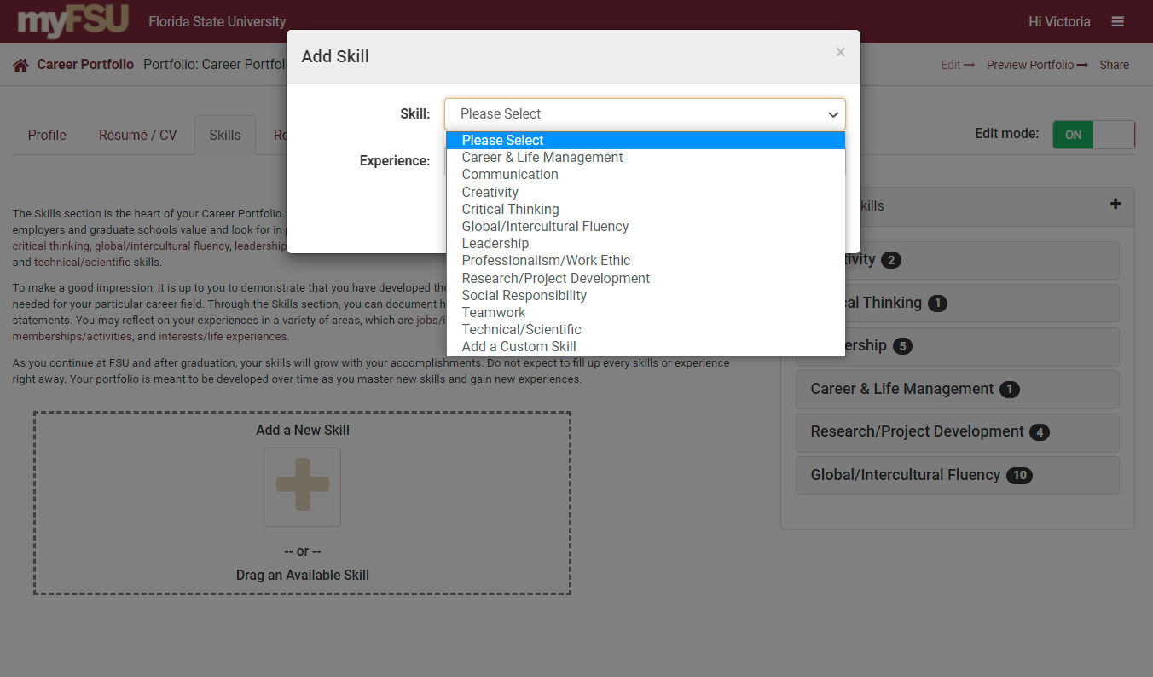
Add a New Skill

Slide 5
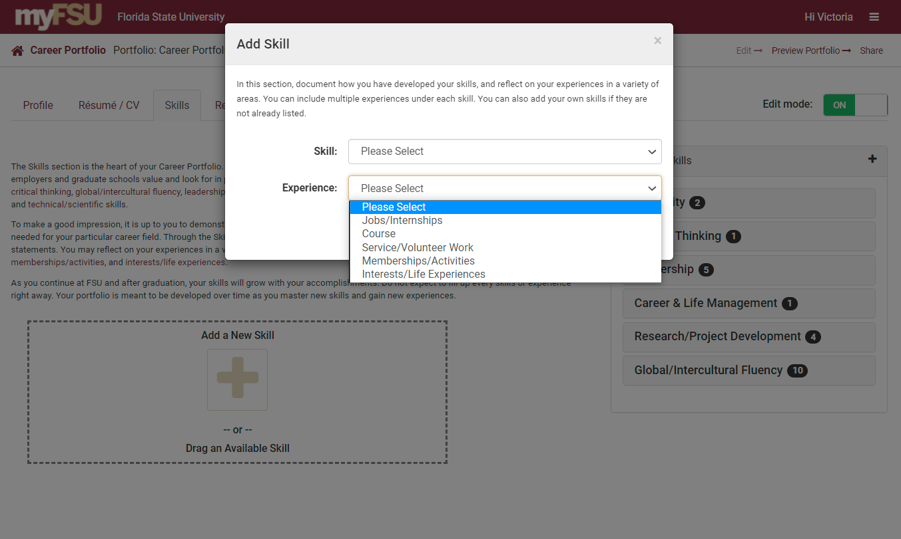
Add a New Experience

Slide 6
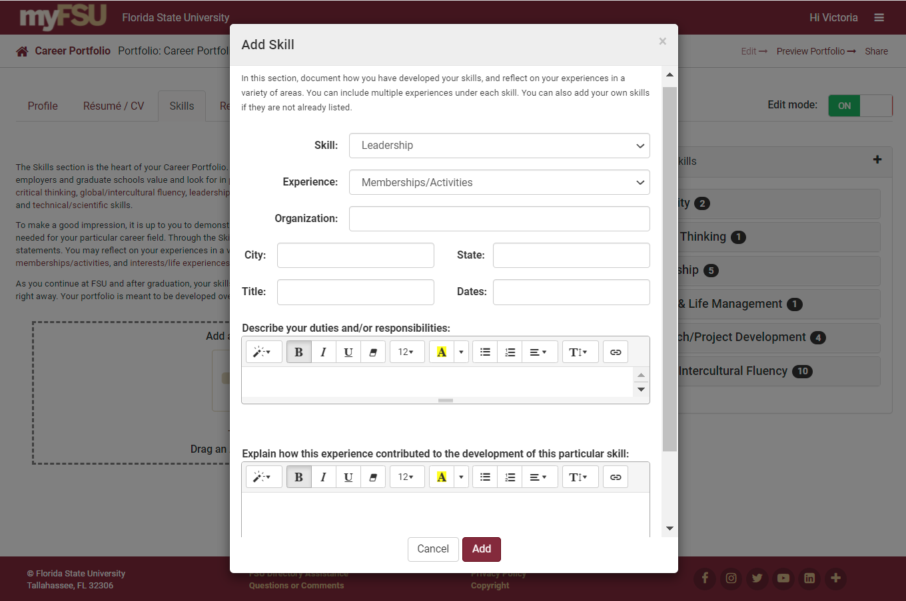

Slide 7
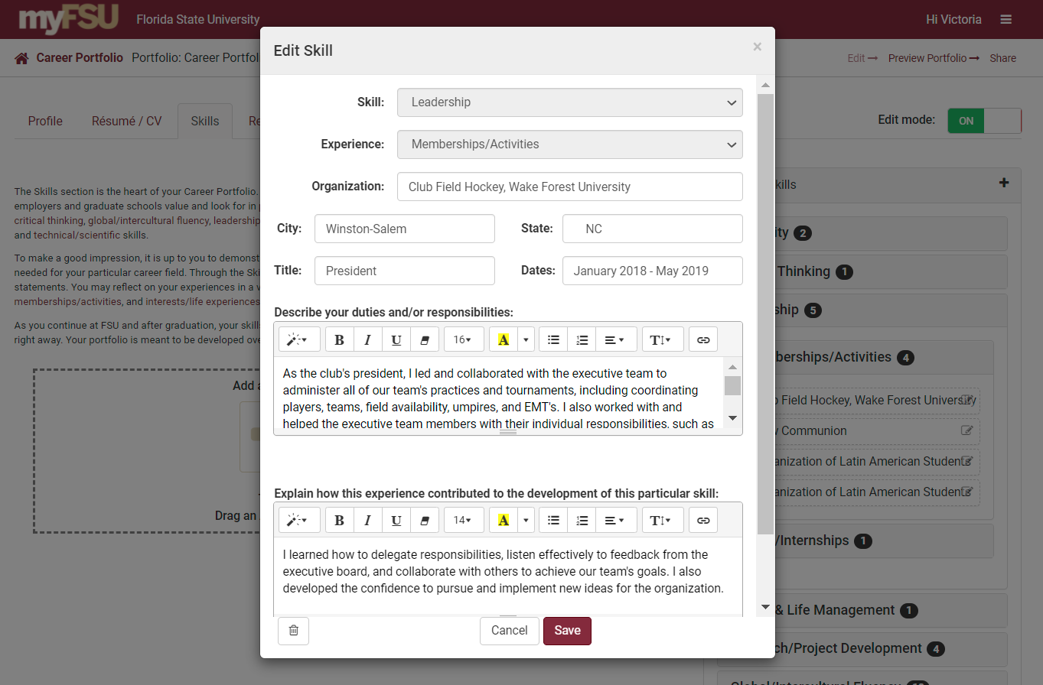
Edit and Save Skills

Slide 8
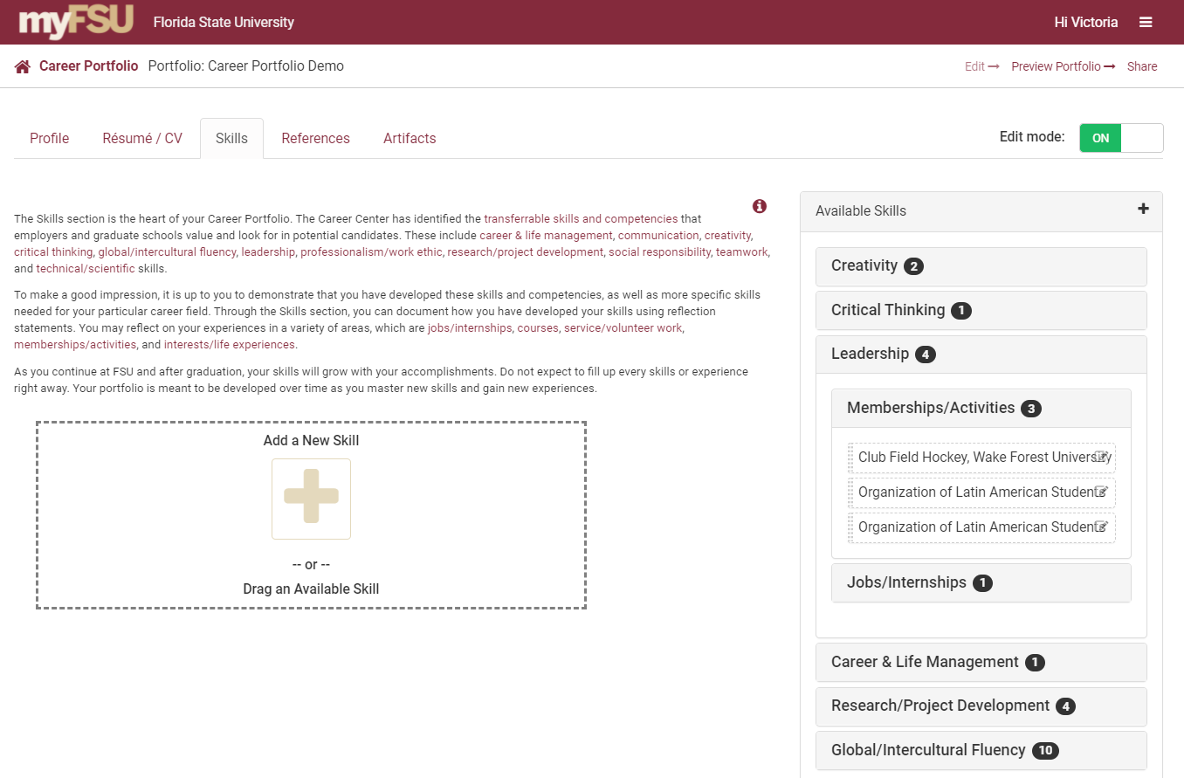
Drag Skills
Drag relevant skills from your “Available Skills” to add them to your portfolio.

Slide 9
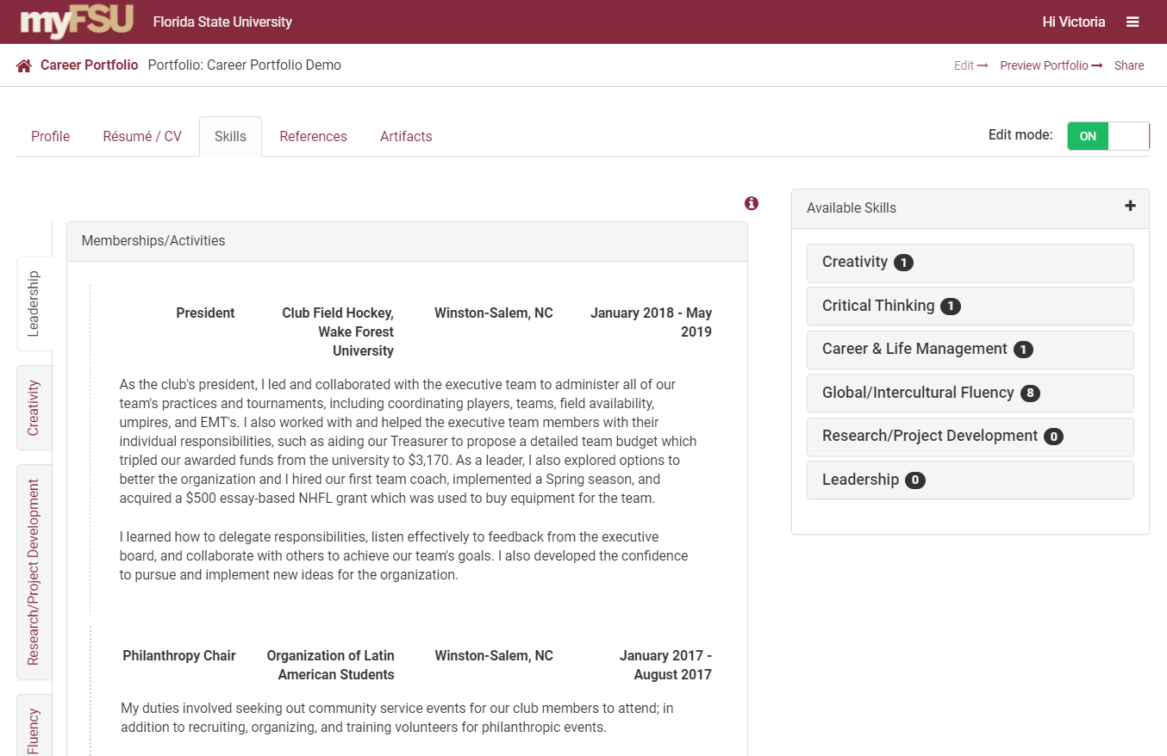
Reorder Your Skills
Reorder your skills and experiences by clicking on and dragging them.

Slide 10
Preview Your Portfolio

Slide 11
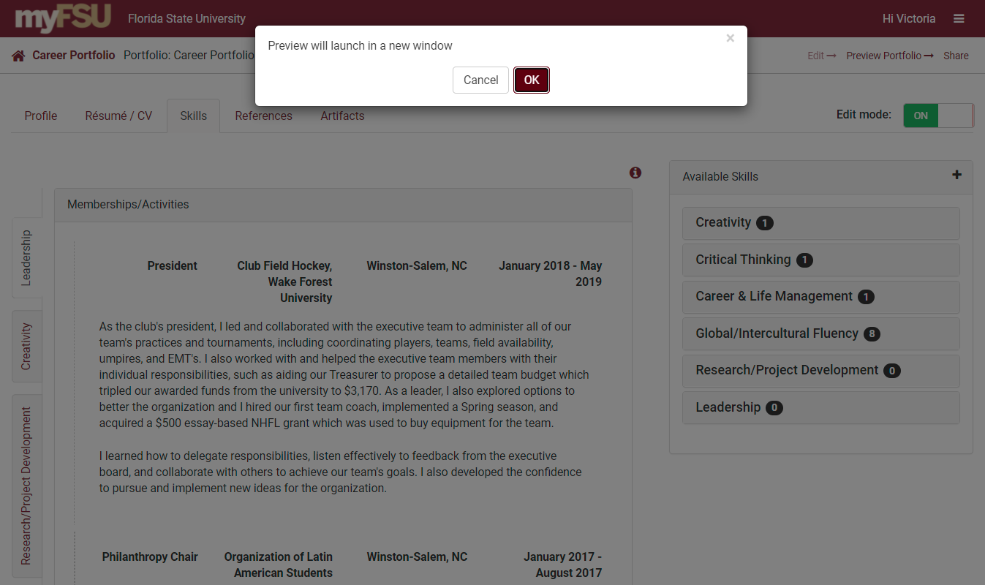
Preview Your Portfolio

Slide 12
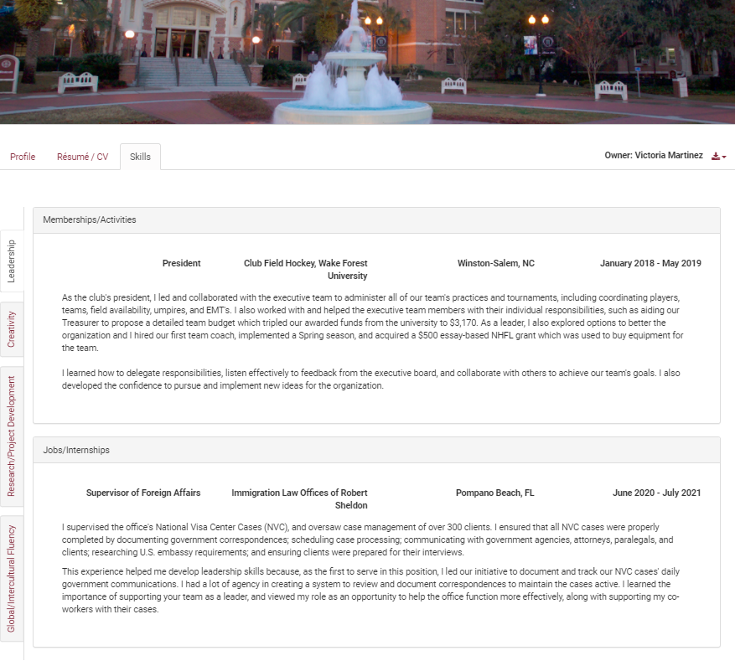
Preview of Your Portfolio

