Slide 1

Providing Career and Mental Assistance to a Diverse Population: Using Theory to Inform Practice
Janet Lenz, Ph.D.
Robert Reardon, Ph.D.
Debra Osborn, Ph.D.
Florida State University

Slide 2

FSU “Tech Center”
Focus on the connection between career and mental health issues in the context of theory, research, and practice

Slide 3
Career, Work, and Mental Health
Individuals seeking career counseling often present a complex array of issues …
Difficult for counselors to separate career satisfaction and development from other mental health issues…
Zunker, V. (2008). Career, work, and mental health. Thousand Oaks, CA: Sage.

Slide 4
Career and Mental Health Issues are Inextricable in Many Cases
Linda is depressed because she has not done well in high school and she has been very discouraged about her options after she graduates. Is this a career problem or a depression problem?
Alberto is worried about getting into medical school. He is not sleeping well at night and has become upset because his family and girlfriend are putting pressure on him. Is this a career problem or a relationship problem?
Fred returns home after work each day with high stress; he suffers verbal abuse from a punitive supervisor, is experiencing anxiety attacks, and high blood pressure. Is this a career, mental health, or medical problem?
(Adapted from Krumboltz, 1993)
Notes:
Would you feel comfortable as a career services professional treating Linda, Greg, or Fred for the unique ways their work and personal struggles affect their quality of life?
The everyday problems that clients encounter are not “either-or” and by conceptualizing treatment in this way we can do a disservice to our clients by compartmentalizing rather than helping them view the various manifestations of psychological dysfunction within a more holistic context.
4

Slide 5


FSU Career Center Mission
Provide comprehensive career services
Train career service practitioners
Conduct life/career development research
Disseminate information about life/career services and issues to the university community, the nation, and the world.

Slide 6


Organizational factors to consider in combining career and mental health assistance: The institution
Institutional culture, policies, & procedures
Administrative structure
Space
Records
Tools & resources
Notes:
Career and mental health counseling connections can occur in terms of philosophy, theory, and research, but the most difficult barriers to connections occur at the point of program implementation. Today’s presentation is about one practical way to connect mental health and career counseling, but I want to focus upon some of the realities of making this happen.
Institutional history. On most campuses the counseling center and career center have distinct and separate histories, and they have unique origins and constituents. These distinct histories probably mitigate against collaboration in career and mental health counseling and it would seem to require unusual circumstances or powerful leadership to overcome the influence of the past. Perhaps you can share experiences about this matter latter in the discussion.
Policies and procedures. Connecting mental health and career counseling on a campus requires administrative approvals at the highest levels of the institution, which means that political forces within the institution will become energized about the issue. The development of carefully worded written statements will be needed, which can take time and resources. Administrative leadership and true collaboration would probably be needed to make this happen on a campus.
Administrative structure. One can imagine a variety of organizational charts and unit names that would configure units providing seamless mental health and career counseling. This structure and naming has important implications for program marketing and public relations. If the name and identity of the unit is too “clinical” will this be a nonstarter for persons with career problems? Conversely, if the image is too “vocational” will this reduce the credibility of the unit for those in psychological distress. Is it two distinct offices joined by finely tuned referral systems and joint committee structures, or is it one office?
Space. In thinking about facilities for mental health and career counseling, one can imagine one waiting room, or is it two? If the career services are comprehensive in nature, will students seeking internships or jobs be mixed with those seeking mental health care?
Records. Issues about space, including the waiting room, leads one to wonder about the nature and formality of intake procedures or the provision of drop-in services and the kinds of records that would be needed. How might readiness for various types of services be assessed? Would different kinds of records be needed for mental health versus career counseling, or the same for both?
Tools & resources. Finally, one can wonder about the kinds of materials and assessments that would be needed in an agency providing career and mental health services. Could some career assessments be used in mental health counseling? Would fees be charged for career assessments but not mental health assessments?

Slide 7

Factors to consider in combining career and mental health assistance:
Staffing, training, & supervision
Professional identity
Staff credentials
Supervision & training
Liability
Specializations
Notes:
Professional identity. Do the staff have professional identities in psychology, mental health counseling, professional counseling, social work, other fields, or all of the above? Are these identities compatible or reconcilable? How will accrediting agencies view the staffing patterns in organizations that combine career and mental health counseling? Recent inspection of the Journal of College Counseling failed to turn up articles related to educational or career counseling. On the other hand, career journals frequently report articles with implications for mental health counseling. Do professional affiliations need to be in all sectors, e.g., ACA, APA, AMHCA, NCDA, NACE?
Staff credentials. Student paraprofessionals are frequently used in career services for assistance in employability skills development and resource location. Is there a role for such staff in mental health counseling services?
Supervision & training. Is professional development and training provided in both mental health and career counseling for all staff and all graduate students? Do career staff supervise mental health personnel, and vice versa? Do such staff have all the credentials, e.g., licensure, certification, to supervise all staff?
Liability. Are career and mental health staff properly insured, credentialed, and prepared to provide services in both areas and where they overlap?
Specializations. Finally, in a service program that combines mental health and career counseling, is the pattern for some staff to be proficient in both areas and other staff to proficient in only one? What is the cost and benefit of one vs. the other, and do we hold out the former as one to which to aspire?

Slide 8

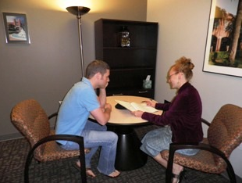
Staff
PhDs on site for training & supervision
Access to students enrolled in in counseling, counseling psychology, career counseling programs
Training materials

Slide 9
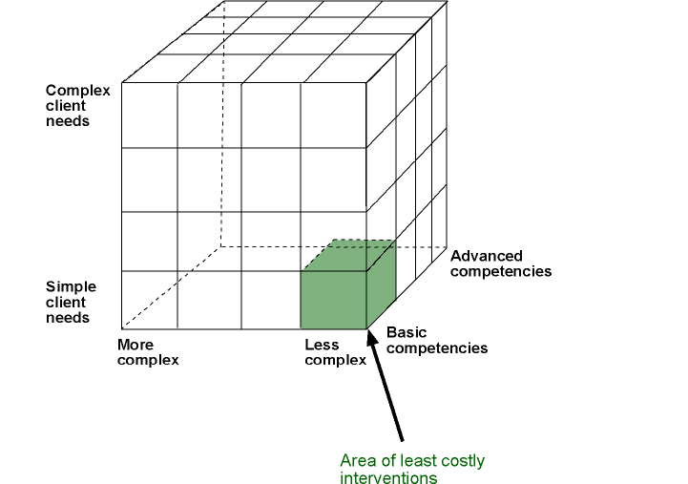
Synthesis of three career services dimensions:
client needs, intervention complexity, staff competencies
Level of
Client Needs
Level of Competencies
and Skills of
Counselors and Staff
Level of Career
Intervention
Complexity
Source: Sampson, J. P., Jr., Reardon, R. C., Peterson, G. W., & Lenz, J. G. (2004). Career counseling and services: A cognitive information processing approach. Pacific Grove, CA: Brooks/Cole.

Slide 10

Case Example: FSU Career Center
Key elements:
mission
theory base
staff credentials & expertise
existence of accredited counseling programs at Master’s & PhD level
nature of training provided to paraprofessionals

Slide 11
Career theory connected to practice
Holland’s RIASEC theory and secondary constructs
Use of cognitive information processing (CIP) theory
Connection to other counseling theories (e.g., Beck)

Slide 12
Holland’s RIASEC Theory
Impact of personality characteristics on life/career issues
Connection of secondary constructs (e.g., congruence, differentiation, profile elevation, vocational identity) to mental health factors

Slide 13
CIP Pyramid Domains
Thinking about my decision making
Client Version
Knowing how I make decisions
CASVE Cycle
Knowing about myself
Knowing about my options

Slide 14
CASVE Cycle
Knowing I Need
to Make a Choice
Knowing I Made a
Good Choice
Communication
Implementing
My Choice
Understanding
Myself and
My Options
Execution
Analysis
Choosing An
Occupation, Program
of Study, or Job
Expanding and
Narrowing My List
of Options
Valuing
Synthesis

Slide 15
Executive Processing Domain
Metacognitions—Thinking about decision making
  Self-talk
  Self-awareness
  Control and monitoring

Slide 16
Assessment of Readiness
Two Issues:
  Capability
  Complexity

Slide 17
Readiness
The capability of an individual to make appropriate career choices taking into account the complexity of family, social, economic, and organizational factors that influence career development
Readiness also includes possessing adequate language skills and literacy skills for communication and learning
Source: Sampson, J. P., Jr., Reardon, R. C., Peterson, G. W., & Lenz, J. G. (2004). Career counseling and services: A cognitive information processing approach. Pacific Grove, CA: Brooks/Cole.

Slide 18

Capability
The cognitive and affective capacity to engage in effective career choice behaviors
How are my career choices influenced by the way I think and feel?

Slide 19
Factors inhibiting capability
Disabling emotions
Dysfunctional career thoughts
Goal instability
Tension or urgency to make a decision
Self concept as a decision maker

Slide 20


Complexity
Contextual factors, originating in the family, society, the economy, or employing organizations, that make it more (or less) difficult to make career choices
How does the world around me influence my career choices?

Slide 21
Factors contributing to complexity
Personal conflict
Number of personal, social, occupational issues
Financial
Family
Relationships
Quality of life

Slide 22
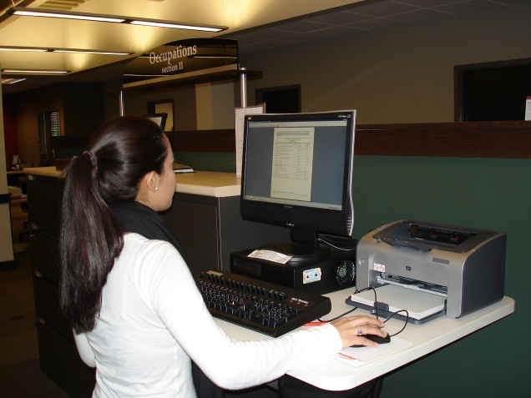

Levels of Service Delivery
Self-Help Services
Brief Staff-Assisted Services
Individual Case-Managed Services

Slide 23

CIP Readiness Model
Complexity (high)
Low readiness Moderate readiness
High degree of Moderate to low degree
support needed of support needed
(Individual Case- (Brief Staff-Assisted
Managed Services) Services)
Capability
(low) (high)
Moderate readiness High readiness
Moderate to low degree No support needed
of support needed (Self-Help Mode)
(Brief Staff-Assisted
Services)
(low)

Slide 24
Levels of Readiness Assessment
Direct behavioral observations
Career decision state
Low-cost, theory-based assessments
Psychological mental health appraisals
Peterson, G. W., Lenz, J. G., & Bullock-Yowell, E. (2012, June). ) Assessing and enhancing readiness for career decision making: Findings and implications from recent research. Presentation at the National Career Development Association Global Conference, Atlanta, GA.

Slide 25

Intake
Behavioral Observations:
“no options interest me”
“my teacher, parents, partner told me to come here”
Irregular speech patterns—slow/fast/broken
Not making sense, confusion

Slide 26
Career Decision State
Possible assessment tools:
  Occupational Alternatives Q. (OAQ)
  Career Tension Scale (CTS)
  Goal Instability Scale (GIS)

Slide 27
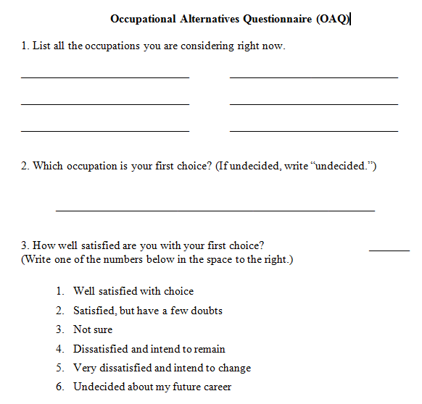
Occupational Alternatives Questionnaire (OAQ)
Measures career decision state:
  degree of certainty pertaining to a career choice
  satisfaction with current choice
  assesses clarity of occupational aspirations
  content indicates level of maturity and level of occupational knowledge

Slide 28
OAQ
Scoring the OAQ:
1 1st choice, no alternatives
2 alternatives and a 1st choice
3 alternatives, no 1st choice
4 neither alternatives, nor 1st choice
Note: this is an ordinal scale

Slide 29
Correlates of OAQ
Decision-Making Confusion (DMC) r =.33
Commitment Anxiety (CA) r =.25
CTI Total r =.22
Beck Depression r =.19
No choice = moderate depression
Walker & Peterson (in press) Journal of Career Assessment

Slide 30
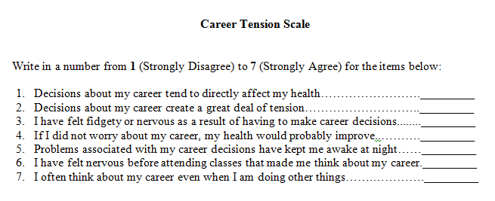
Career Tension Scale (CTS)
A measure of career stress or urgency to make a decision
Reed, C. (2006). The relationships among neuroticism, dysfunctional career thoughts, and coping strategies.

Slide 31
Correlates of CTS
NEO Neuroticism r = .44
DMC r = .37
CA r = .28
EC r = .36
OAQ r = -.04
Bullock-Yowell, et al. (2011). Relationships among career and life stress, negative career thoughts, and career decision state: A cognitive information processing perspective. The Career Development Quarterly, 59, 302-314.

Slide 32
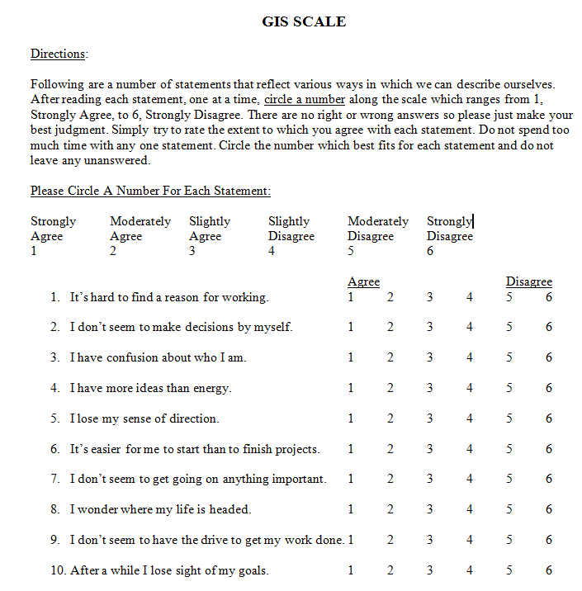
Goal Instability Scale (GIS; Robbins & Patton, 1985)
Measures lack of focus, low drive and energy, confusion about self
Bertoch, S. et al. (submitted). Goal instability in relation to career thoughts, decision state, and performance in a career course. Journal of Career Development.

Slide 33
Career Theory-Based Assessments
Examples:
  Career Thoughts Inventory (CTI; capability)
  Decision Space Worksheet (DSW; complexity)
  Self-Directed Search (SDS; capability)
    Secondary constructs as window into mental health issues (e.g., low differentiation)

Slide 34
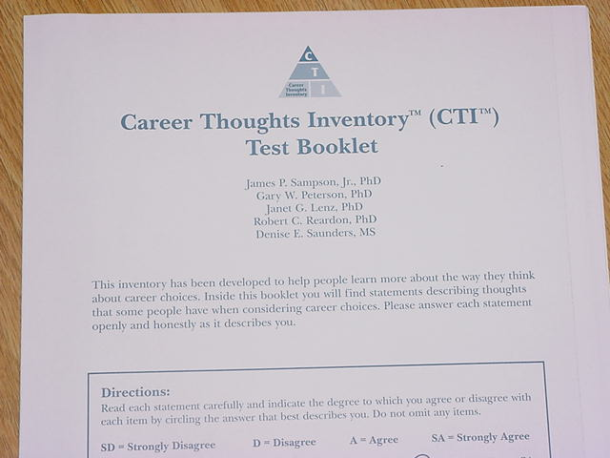
What is the CTI?
Self-administered
Objectively scored
48-Item measure of dysfunctional thoughts in career choice

Slide 35
Theoretical Basis of the CTI
Cognitive Information Processing (CIP) Theory
Beck’s Cognitive Theory

Slide 36
The CTI in Needs Assessment
Identifying the specific nature of negative thoughts
Three CTI Construct Scales
  Decision-making Confusion (DMC)
  Commitment Anxiety (CA)
  External Conflict (EC)
Specific career interventions can be related to specific construct scores

Slide 37
Mental health constructs directly correlated with dysfunctional career thoughts
  indecision
  neuroticism
  anxiety
  angry hostility
    depression
    hopelessness
    impulsivity
    vulnerability
For additional information visit: www.career.fsu.edu/techcenter

Slide 38
Assessing the personal and social context
Decision Space Worksheet (DSW)
A measure of complexity
Peterson, G. W., Leasure, K. K., Carr, D. L. & Lenz, J. G. (2010). The Decision Space Worksheet: An assessment of context in career decision making. Career Planning and Adult Development Journal, 25, 87-100.

Slide 39
Decision Space Worksheet
Page 1: list elements
Page 2: draw circles within a given circle in proportion to the importance of an element

Slide 40
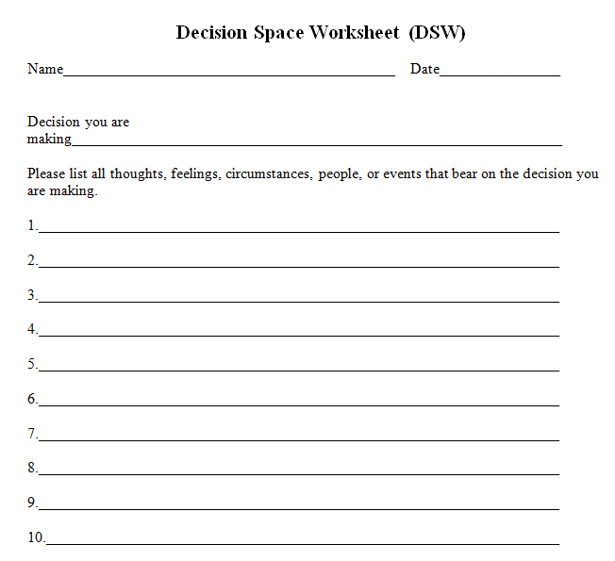
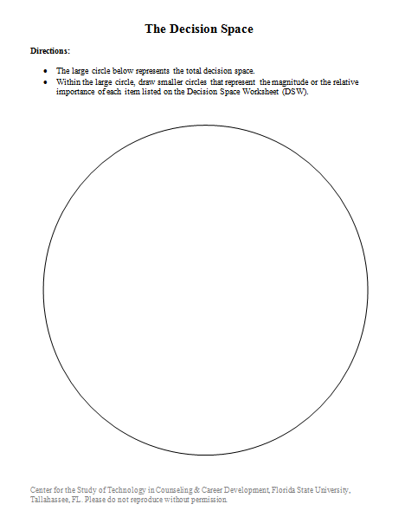
Decision Space Worksheet (DSW)

Slide 41
Purpose of the Decision Space Worksheet (DSW)
Cognitive mapping task
Helps clients reveal thoughts, feelings, persons, circumstances associated with career decision
Helps clients prioritize importance of contextual influences
Can be used with middle school through college level students and adults

Slide 42
Typical Issues Revealed
Cognitive distortion
Disabling emotions
Financial
Family
Education
Interests
Self doubt
Employment
Quality of life

Slide 43
Correlates of DSW
Beck Depression Inventory .21
CTI CA .19
CTI EC -.18
DSW is basically unrelated to measures of capability
Solomon, J. L. (2011). The Decision Space Worksheet, the Career Thoughts Inventory, and the Beck Depression Inventory-II as measures of mental health in the career decision-making process. The Florida State University. ProQuest Dissertations and Theses.

Slide 44
Assessments for Psychological/
Mental Health Appraisal
Examples:
  Beck Depression Inventory (BDI)
    Useful as a mental health screener
    Item 9 concerns suicide ideation
  Beck Hopelessness Scale (BHS)
    Useful as a mental health screener, especially for depressed individuals or those at risk for suicide
    Example item: “My future seems dark to me.”

Slide 45
Assessments for Psychological/
Mental Health Appraisal (continued)
MMPI-2 in Career Counseling
  Assesses personal and social adjustment
  Measures clinical syndromes that may interfere with or block effective decision making
  Used following screening measures such as CTI, DSW, and interview

Slide 46
The Case of George
37 year old Cuban-American with a high school degree
Sought assistance in finding a new job that would have more meaning
Formerly employed in the construction industry
Experienced dysfunctional family situation
Lack of social support
Previous counseling for depression

Slide 47
George’s CTI
Total Score T=78
Decision-Making Confusion (DMC) T=80
External Conflict (EC) T=74
Commitment Anxiety (CA) T=77

Slide 48
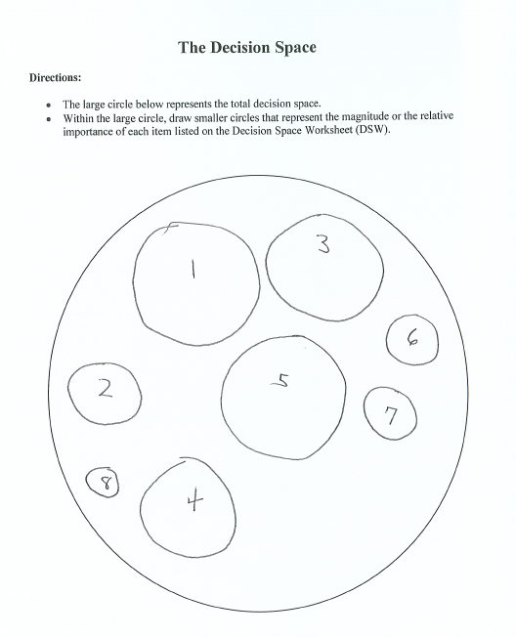
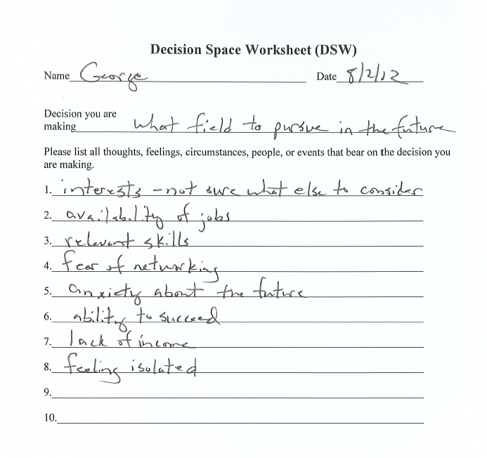
George’s DSW

Slide 49
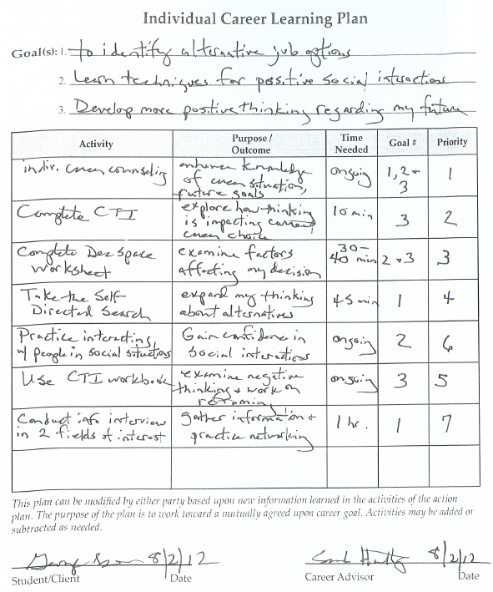
George’s ILP

Slide 50
George’s Counseling Outcomes
Identified areas of concern beyond the presenting career decision
Formulated counseling goals and activities that integrated career and mental health issues
Improved his quality of life related to career goals and social relationships

Slide 51
Summary
Clear support in the literature for integrating these areas
Important to consider organizational and programmatic issues
Implementation requires attention to staff resources, internal & external factors
Theoretical perspectives used in the setting may guide decisions about addressing career and mental health issues
Assessment tools influence extent to which these factors might be considered and addressed in the counseling process

Slide 52


For More Information
www.career.fsu.edu/techcenter

