Slide 1

Practitioner’s Guide to Using theory in Practice
Seth C. W. hayden, Wake Forest University
Na Mi Bang, University of Central Arkansas
Ron K. White, Johns Hopkins university-Advanced Academic Programs
V. Casey Dozier, Florida State University

Slide 2


Introduction
Seth C.W. Hayden, Ph.D., Assistant Professor of Counseling
• Wake Forest University
• LPC (VA,NC), NCC, CCMHC, ACS
Na Mi Bang, University of Central Arkansas
Ron K. White, Johns Hopkins university-Advanced Academic Programs
V. Casey Dozier, Ph.D., NCC, Faculty/Program Director
  Florida State University
Who is joining us today?
Notes:
Who is with us today? Show of hands
Theories (may or may not ask?)

Slide 3
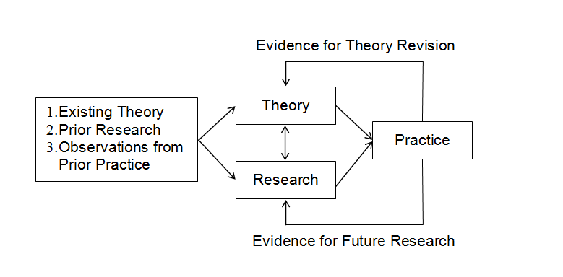
Theory
(Sampson et al., 2014)
Theory guides research by guiding the formulation of research questions, creating measures of various constructs, and interpreting the results.
Theory also guides research on career interventions by similarly supporting research questions, measures, and interpretation of ﬁndings.
Guides practice by helping practitioners better understand individuals’ concerns; creating appropriate interventions; and developing theory-based assessments, information, and instruction.

Slide 4
Theory
Some practitioners have less interest in the translation of theory to practice (Kidd, Killeen, Jarvis, & Offer, 1994; Morrow-Bradley & Elliott, 1986).
Some outcome studies of career interventions have shown that the models or theories supposedly guiding the intervention were not fully implemented (Miller & Brown, 2005).
One reason for the disconnect between theorists and practitioners is that each group uses different language to describe the same situation, with theorists focusing more on conceptual and research terms and practitioners focusing more on problems, information, and interpretations (Jepsen, 1996).

Slide 5

Theory
Research is used in creating and validating new theory.
Research also contributes to practice by providing an evidence base for improving career interventions.
Observations from practice support ongoing theory revision and provide evidence to further guide future research.
Thoughts?

Slide 6
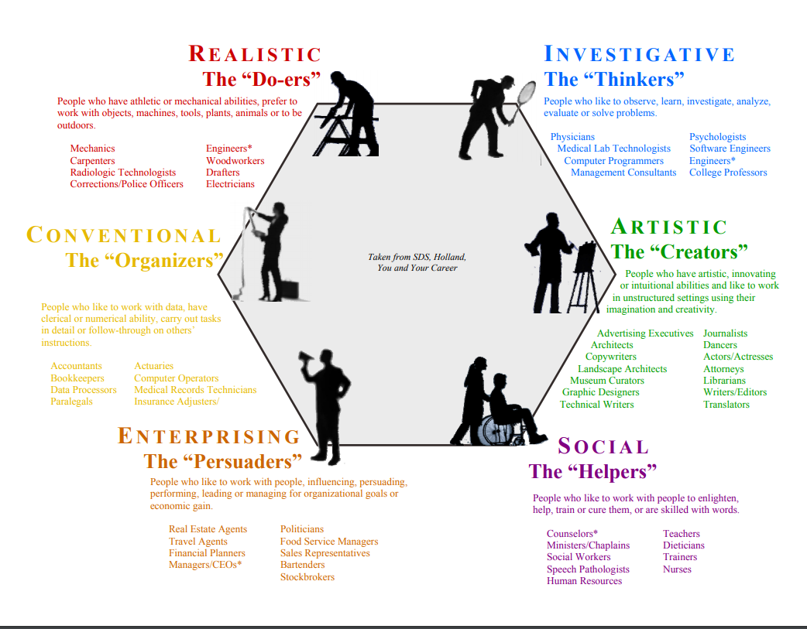

Slide 7
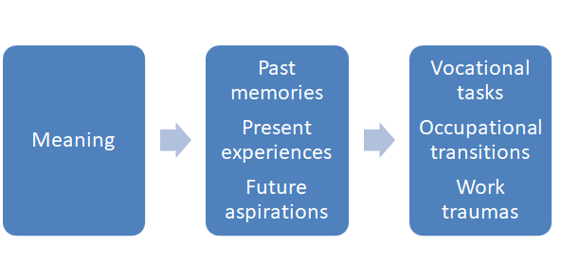
CCT- Theory
Narrative psychology
  Attention to stories to uncover meaning
  Stories as a source of reflection (Savickas, 2015)
  “Narrating the self increases comprehension, coherence, and continuity.” (Savickas, 2011)
  The power of language (Corso & Rehfuss, 2011)

Slide 8
CCT- Theory
Super- life-span development
  Career adaptability (how)
Adlerian- self-completion, Individual Psychology
  Life themes (why)
Holland- vocational personality
  Vocations (where)
Life Themes
Career Adaptability
Domains of Career Construction Theory
Vocational Personality

Slide 9
CCT- Premise
Third paradigm of career intervention
  Vocational guidance Career Education Life- Design counseling for career construction
    Scores to Stages to Stories (Savickas, 2015)
“Career Construction Theory, simply stated, holds that individuals build their careers by imposing meaning on vocational behavior.” (Savickas, 2011)

Slide 10
CCT- Primary Constructs
3 Parts
  Career Story Interview
  (construct)
  Presenting and discussing the client’s life portrait
  (deconstruct/reconstruct)
  Counseling
  (co-construct)
Elements
  Identifying life themes
  Examining career adaptability
  Exploring vocational personality
  Understanding vocational options
  Meaning Making
WHAT | WHERE | HOW | WHY

Slide 11
CCT- Assessment
CSI
  Reconstruction
    Entering the story
    Understanding the story
    Elaborating meaning
  Goals
    Find Patterns
    Align client’s goals
    Identify preoccupations
RIASEC Typology
  Exemplified with in CSI
  Scripts within RIASEC
    Ex. Realistic script moves from weak to strong (Savickas, 2011)

Slide 12
CCT- Research
Qualitative
  Case Studies
  Surveys
Mixed Method
Measures
  Holland Codes
  The NEO
  A selected construct
Adolescents
  (Perera & McIlveen, 2014)
Chinese employees
  (Xie, Xia, Xin, & Zhou, 2016)
Undergraduates
  (Perera & McIlveen, 2017)
Groups
  (Barclay & Stoltz, 2016)

Slide 13
CCT- Tips for Practice
Attend training institutes
Career Construction Institute
Read
  Life-Design Counseling Manual (Savickas, 2015)
  Career Counseling: Theories of Psychotherapy (Savickas, 2011)
  The Play that Changed My Life (Hodges, 2009)
Consult
Adapt to each client= Improvise
Understand how to identify and work with metaphors
Appreciation for language to amplify words to inspire movement

Slide 14
CCT- Samples
Integration of theory
  Sampled students
  Received training
  Listened for roadblock
Practice
  Identified need
  Students struggling
  Clarifying shadowed paths
Testimonials
  Opens dialogue
  Adds insight
  Liberates roadblocks
  Reveals social justice
Future research
  Graduate Students
  Career & Mental Health Dx

Slide 15
Cognitive Information Processing theory
Notes:
Casey
How many cook? Think about whether or not use recipe
Follow recipe to the letter
Change the recipe some
Never use a recipe
How do you make decisions?
Blank stares – will teach you today what we teach them

Slide 16
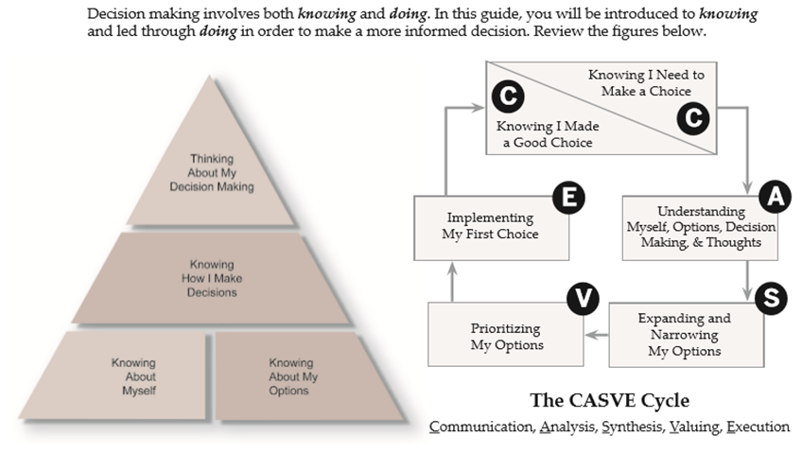
Notes:
Overview of CIP – make a decision (buy new cell phone or register for classes)

Slide 17
Two-Dimensional Readiness Model
Complexity (high)
Low readiness Moderate readiness
High degree of Moderate to low degree
support needed of support needed
(Individual Case- (Brief Staff-Assisted
Managed Services) Services)
Capability
(low) (high)
Moderate readiness High readiness
Moderate to low degree No support needed
of support needed (Self-Help mode)
(Brief Staff-Assisted
Services)
(low)
Notes:
Complexity – external factors
Health
Finances
Family
Capability – internal factors
Motivation
Self-esteem
Mental health (depression, anxiety)
Thoughts – health/finances

Slide 18

Notes:
Individual enters room – readiness assessment to decide self-help; brief-staff assisted vs. individual case managed
theory on the wall

Slide 19
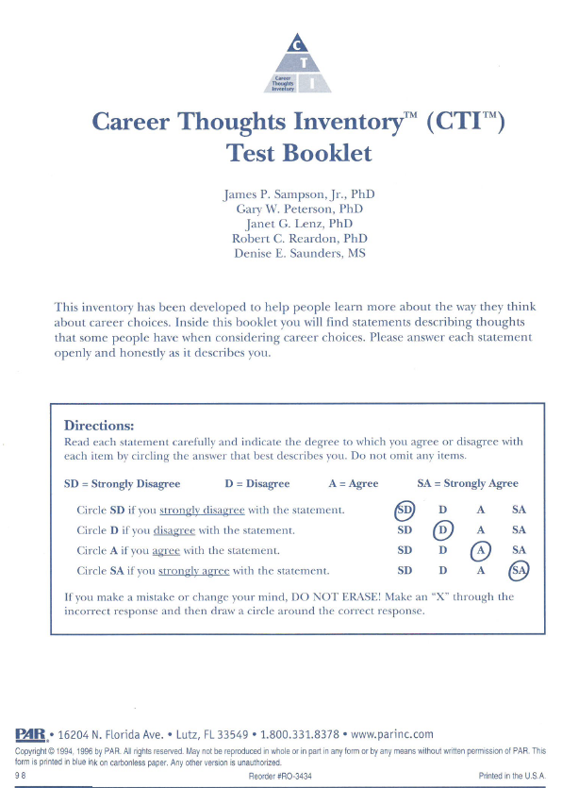
Career thoughts inventory: readiness measure
Self-administered
Objectively scored
48-item measure of dysfunctional thoughts in career choice
Notes:
CTI – correlated with depression, anxiety, etc.

Slide 20
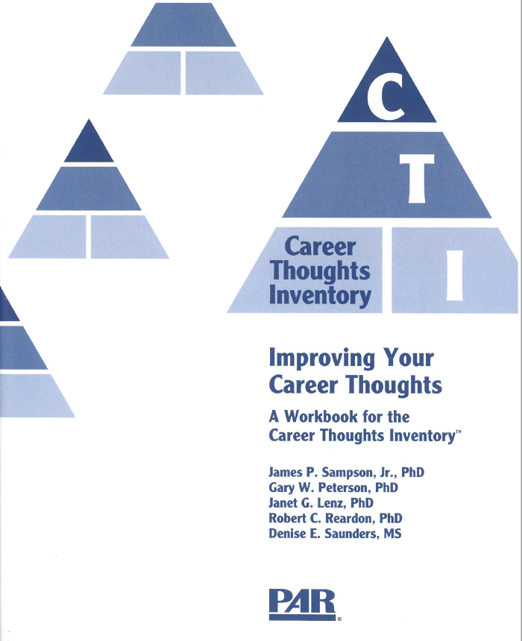
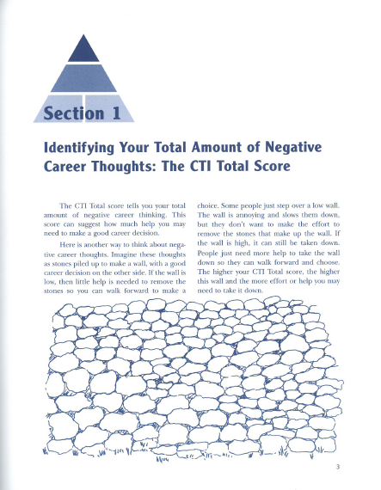
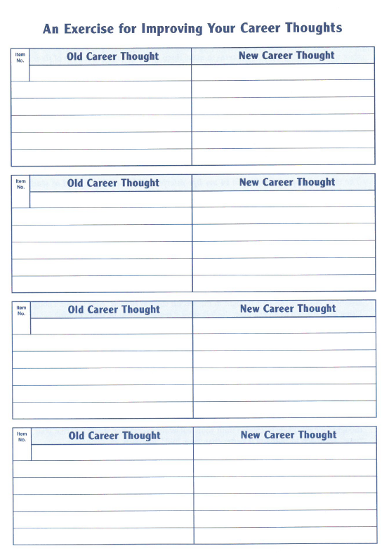
Career Thoughts Inventory Workbook
Notes:
See how assessment & interventions connect to CBT, solution-focused theories (as well as CIP)
Mention checklist – p. 30-33

Slide 21
Theory, Research, and Practice Integration
Sampson, J. P., Jr., Bullock-Yowell, E., Dozier, V. C., Osborn, D. S., & Lenz, J. G. (Eds.). (2017). Integrating theory, research, and practice in vocational psychology: Current status and future directions. Tallahassee, FL: Florida State University Libraries. Retrieved from http://journals.fcla.edu/svp2016/
CIP Bibliography - https://www.career.fsu.edu/sites/g/files/upcbnu746/files/20171109%20CIP%20Bibliography.pdf
Holland bibliography - https://career.fsu.edu/tech-center/resources/bibliographies
Sampson, J. P., Jr., et al. (2014). Annual review: A content analysis of career development theory, research, and practice - 2013. The Career Development Quarterly, 62, 290-326. doi:10.1002/j.2161-0045.2014.00085.x

Slide 22
SCCT - Theory
What are the relationships among values, needs, aptitudes, and interests as they operate in concert to influence occupational choice making?
Social Cognitive Career Theory (SCCT) is based on Albert Bandura’s general social cognitive theory, an influential theory of cognitive and motivational processes.
SCCT explains:
  How basic academic and career interests develop
  How educational and career choices are made
  How academic and career success is obtained

Slide 23
SCCT - Premise
SCCT was developed to address the role of background variables, self-efficacy, and outcome expectations in the development of vocational interest, career choice, and work performance (Lent, Brown, & Hackett, 1994).
Career development is influenced both by objective and perceived environmental factors.

Slide 24
SCCT - Primary Constructs
Key components:
  Self-efficacy expectations
  Outcome expectations
  Personal goals
SCCT focuses on:
  Several cognitive-person variables
  How these variables interact with other aspects of the person and his or her environment to help shape the course of career development.

Slide 25
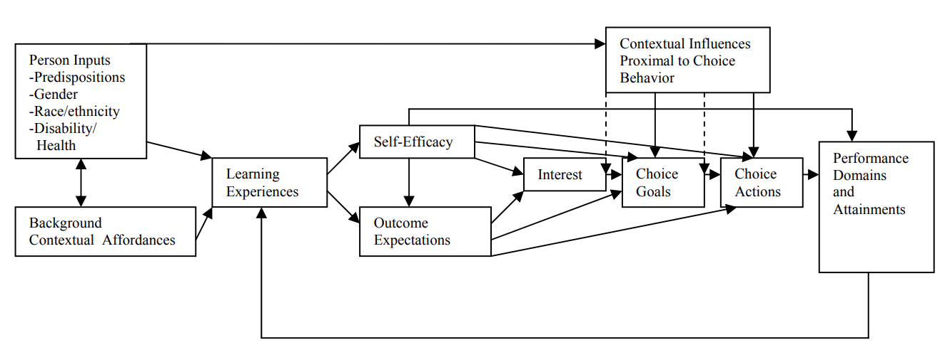
SCCT - Primary Constructs
(Lent, Brown, & Hackett, 1993)

Slide 26
SCCT - Research
Domain-specific measures of self-efficacy are predictive of career-related interests, choice, achievement, persistence, indecision, and career exploratory behavior.
Should focus on programming that attends to Latino students’ self-efficacy and outcome expectations, and efficacy for overcoming barriers.
SCCT is a useful explanatory framework of career behaviors among youth and young adults with epilepsy.
Role models are an important influence in the development of African Americans’ investigative self-efficacy as well as investigative and social outcome expectations
(Ali & Menke, 2014; Dickinson, 2007; Hackett, 1995; Hackett & Lent, 1992; Sung & Connor, 2017; Swanson & Gore, 2000)

Slide 27
SCCT- Tips for Practice
The interventions that career professionals may consider:
Developing and Modifying Self-Efficacy Percepts
Overcoming Barriers to Choice and Success
Expanding Interests and Facilitating Choice
The Role of Learning Experiences in SCCT

Slide 28

Linda Gottfredson’s Theory of Circumscription, Compromise, and Self-Creation
Circumscription - the process of eliminating unacceptable occupational alternatives based primarily on gender and social class
Compromise - the process of modifying career choices due to limiting factors, such as availability of jobs
Notes:
Seth

Slide 29
Linda Gottfredson’s Theory of Circumscription, Compromise, and Self-Creation
Process of formulating occupational aspirations in childhood and adolescence.
“Why do children seem to recreate the social inequalities of their elders long before they themselves experience any barriers to pursue their dreams?” (p. 205; Gottfredson, 2002)
Developmental and sociological perspective of career development.
Distinguish occupations by dimensions of masculinity-femininity, occupational prestige, and field of work (p. 88; 2002)
A person’s self-concept interactions with her or her occupational stereotypes.

Slide 30
Linda Gottfredson’s Theory of Circumscription, Compromise, and Self-Creation
Research with different populations
  Armstrong, P. I., & Crombie, G. (2000). Compromises in adolescents' occupational aspirations and expectations from grades 8 to 10. Journal of Vocational Behavior, 56(1), 82-98.
  Cochran, D. B., Wang, E. W., Stevenson, S. J., Johnson, L. E., & Crews, C. (2011). Adolescent occupational aspirations: Test of Gottfredson's theory of circumscription and compromise. The Career Development Quarterly, 59(5), 412-427.
  Leung, S. A. (1993). Circumscription and compromise: A replication study with Asian Americans. Journal of Counseling Psychology, 40(2), 188.
  Ivers, N. N., Milsom, A., & Newsome, D. W. (2012). Using Gottfredson's theory of circumscription and compromise to improve Latino students' school success. The Career Development Quarterly, 60(3), 231-242.

Slide 31
Gottfredson Tips for Practice
Be aware of any social inequity both broadly and within your community
Continually focusing on identities and the degree they can impact one’s career development
Consider strategies for micro/macro and counselor/client led advocacy
Can use activities such as Pink or Blue Career Fantasy on Pg. 71 in Experiential Activities in Teaching Career Counseling Classes and for Facilitating Career Groups Volume III by Lara, Pope, and Minor (2011) to elicit examination of aspects of gender and social impact on career development.

Slide 32
Final Thoughts/Questions
Theories provide a framework in which to guide practice
Theories help us be more effective and efficient in our work
Practitioners can research the theories one uses in practice
Remember practice informs theory
Ongoing examination and utilization of a framework injects life into career theory
Questions?

Slide 33
References
https://career.fsu.edu/tech-center/resources
Gottfredson, 2002
Sampson, J. P., et al. (2014). Annual review: A content analysis of career development theory, research, and practice - 2013. The Career Development Quarterly, 62, 290-326. doi:10.1002/j.2161-0045.2014.00085.x
Sampson, J. P., Jr., Bullock-Yowell, E., Dozier, V. C., Osborn, D. S., & Lenz, J. G. (Eds.). (2017). Integrating theory, research, and practice in vocational psychology: Current status and future directions. Tallahassee, FL: Florida State University Libraries. Retrieved from http://journals.fcla.edu/svp2016/
Sampson, J. P., Jr. Peterson, G. W., Lenz, J. G., & Reardon, R. C. (1996). Career Thoughts Inventory: Improving your career thoughts a workbook for the Career Thoughts Inventory. Odessa, FL: PAR, Inc.
Sampson, J. P., Jr., Reardon, R. C., Peterson, G. W., & Lenz, J. G. (2004). Career counseling and services: A cognitive information processing approach. Pacific Grove, CA: Brooks/Cole.

Slide 34
Selected References
Barclay, S. R., &Stoltz, K. B. (2016). The life design group: A case study vignette in group career construction counseling. Journal of Student Affairs Research and Practice, 53(1), 78-89. Doi:10.1080/1946591.2016.1087859
Del Corso, J., & Rehfuss, M. C. (2011). The role of narrative in career construction theory. Journal of Vocational Behavior, 79, 334-339. doi:10.1016/j.jvb.2011.04.003
Hodges, B. (2009). The play that changed my life. New York, NY: Scribners.
Perera, H. N., & McIllveen, P. (2014). The role of optimism and enegagement coping in college adaptation: A career construction model. Journal of Vocational Behavior, 84, 395-404. doi: http://dx.doi.org/10.1016/j.jvb.2014.03.002
Perera, H. N., & McIllveen, P. (2017). Profiles of career adaptivity and their relations with adaptability, adapting, and adaptation. Journal of Vocational Behavior, 98, 70-84. doi: http://dx.doi.org/10.1016/j.jvb.2016.10.001
Notes:
How about “Selected References”? If not, it would be too long. - Na Mi

Slide 35
Selected References
Sampson, J. P., et al. (2014). Annual review: A content analysis of career development theory, research, and practice - 2013. The Career Development Quarterly, 62, 290-326. doi:10.1002/j.2161-0045.2014.00085.x
Sampson, J. P., Jr., Bullock-Yowell, E., Dozier, V. C., Osborn, D. S., & Lenz, J. G. (Eds.). (2017). Integrating theory, research, and practice in vocational psychology: Current status and future directions. Tallahassee, FL: Florida State University Libraries. Retrieved from http://journals.fcla.edu/svp2016/
Sampson, J. P., Jr. Peterson, G. W., Lenz, J. G., & Reardon, R. C. (1996). Career Thoughts Inventory: Improving your career thoughts a workbook for the Career Thoughts Inventory. Odessa, FL: PAR, Inc.
Sampson, J. P., Jr., Reardon, R. C., Peterson, G. W., & Lenz, J. G. (2004). Career counseling and services: A cognitive information processing approach. Pacific Grove, CA: Brooks/Cole.
Savickas, M. L., (2011). Career Counseling. Washington, DC: American Psychological Association.
Savickas, M. L., (2015). Life-Design Counseling Manual. Mark Savickas
Xie, B., Xia, M., Xin, X., & Zhou, W. (2016). Linking calling to work engagement and subjective career success: The perspective of career construction theory. Journal of Vocational Behavior, 94, 70-78. doi: http://dx.doi.org/10.1016/j.jvb.2016.02.011
https://career.fsu.edu/tech-center/resources
Notes:
How about “Selected References”? If not, it would be too long. - Na Mi

