Slide 1
Add Artifacts

Slide 2
Artifacts
Showcase samples of your work to employers, instructors, and graduate/professional schools
Demonstrate your skills through examples
Only include top-quality work!

Slide 3
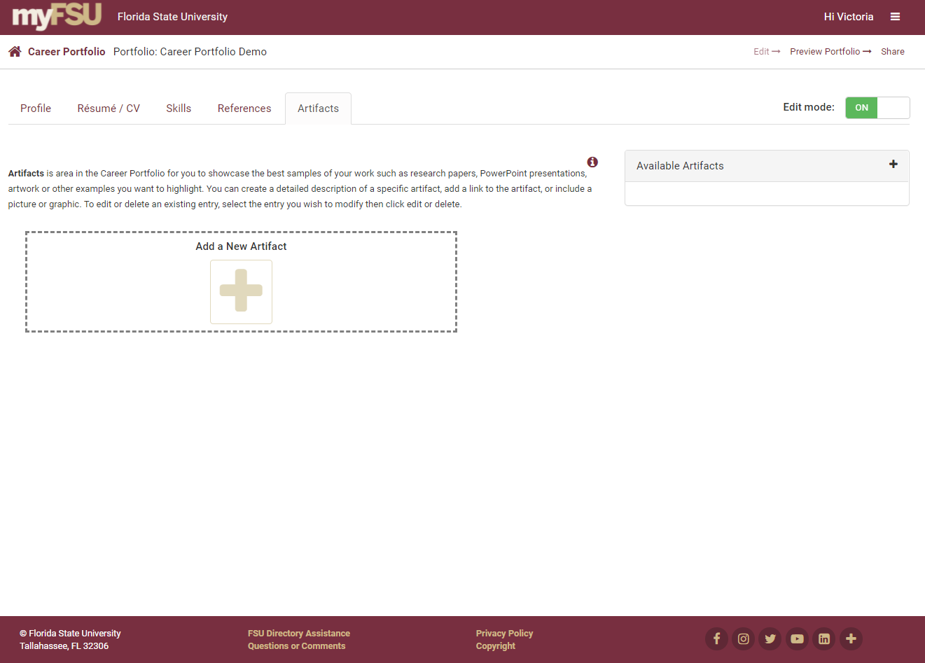
Add a New Artifact

Slide 4
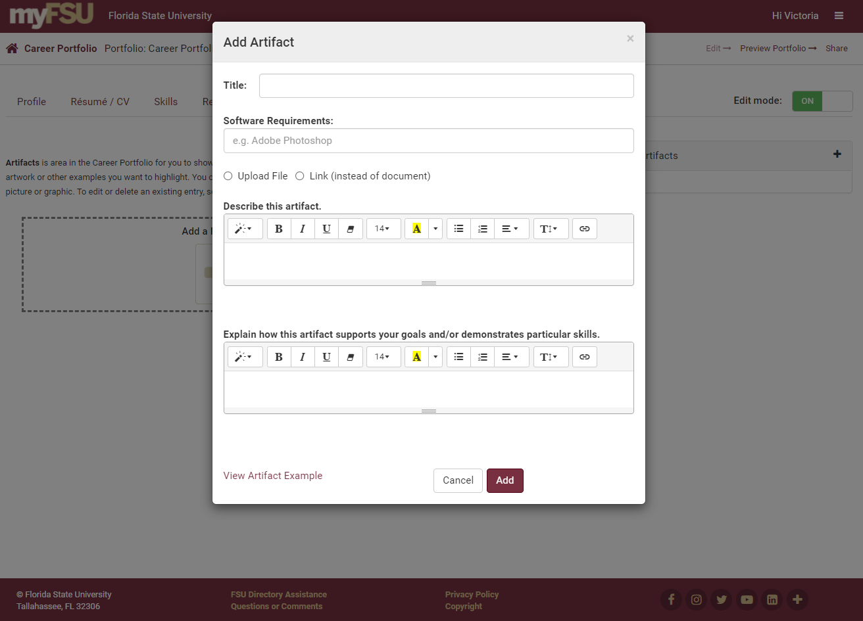
Upload an Artifact

Slide 5
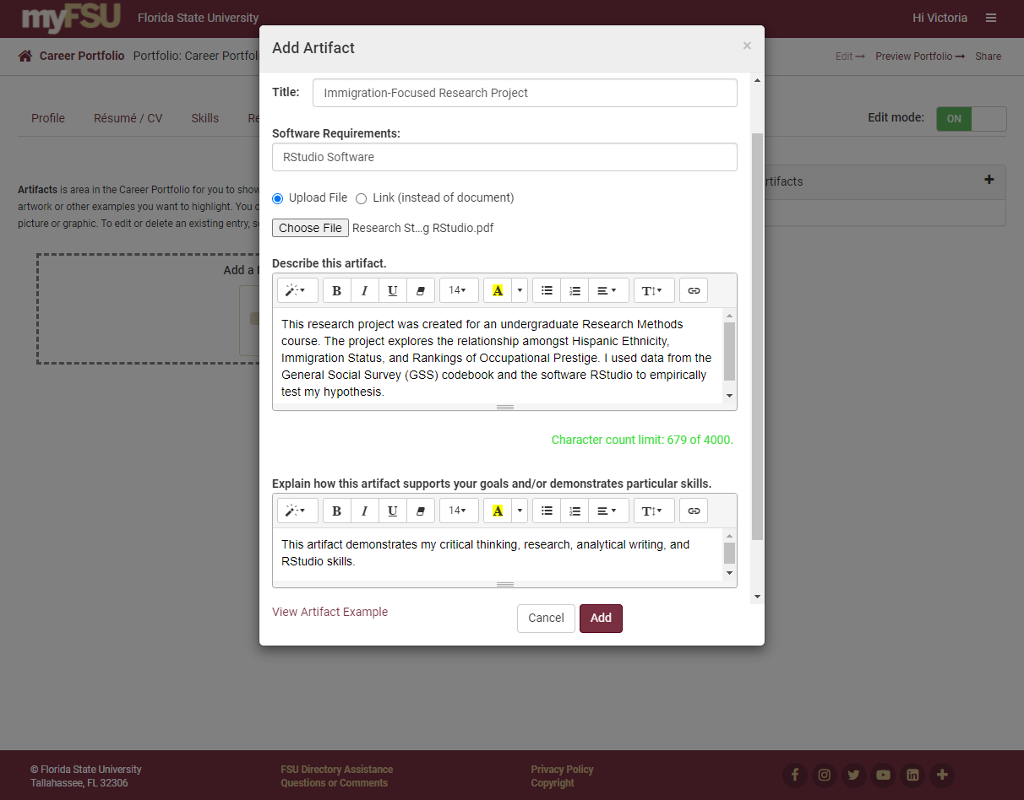
Edit and Add Your Artifact

Slide 6
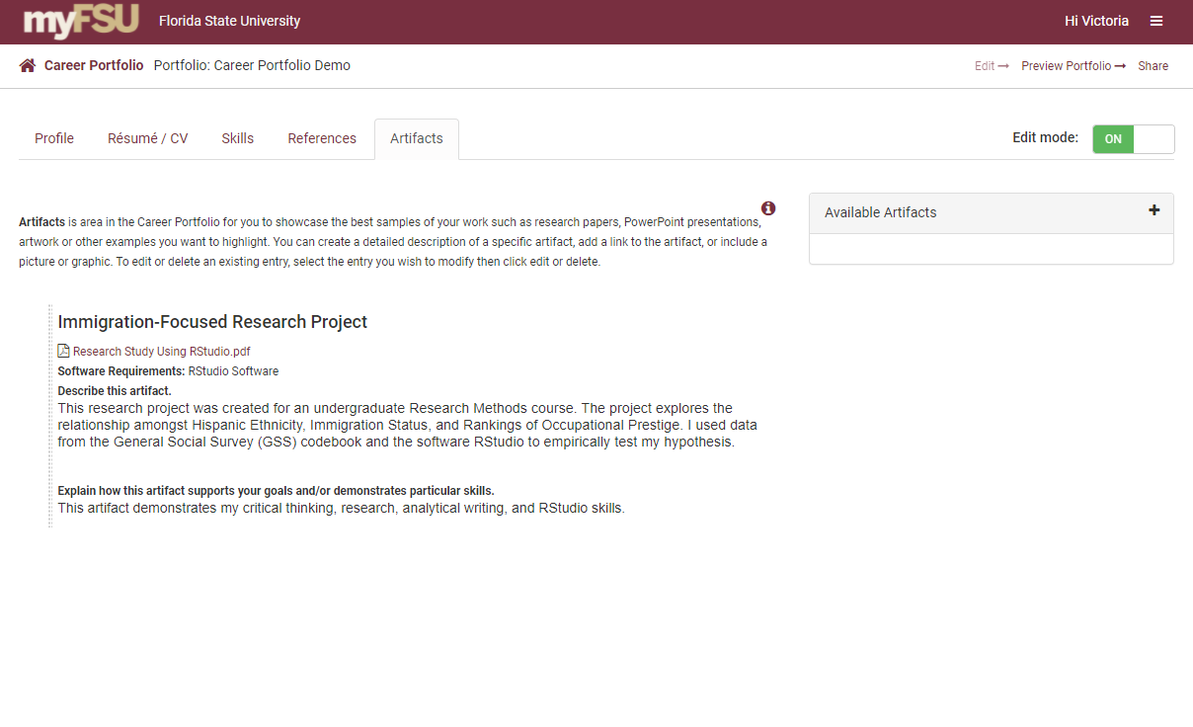
Add an Additional Artifact

Slide 7
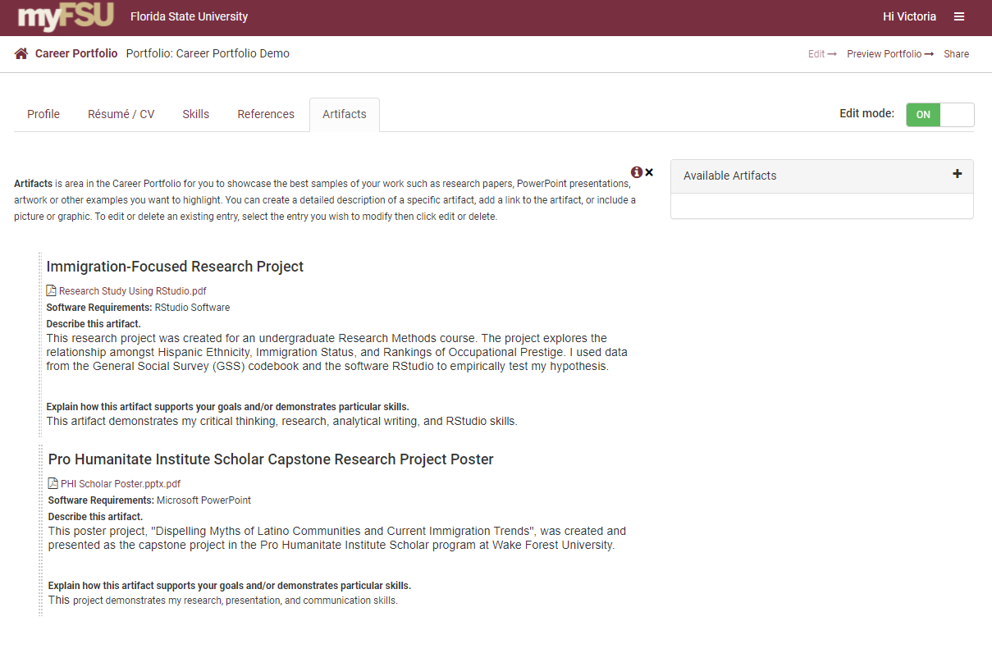
Reorder Your Artifacts
Reorder your artifacts by clicking on and dragging them.

Slide 8
Preview Your Portfolio

Slide 9
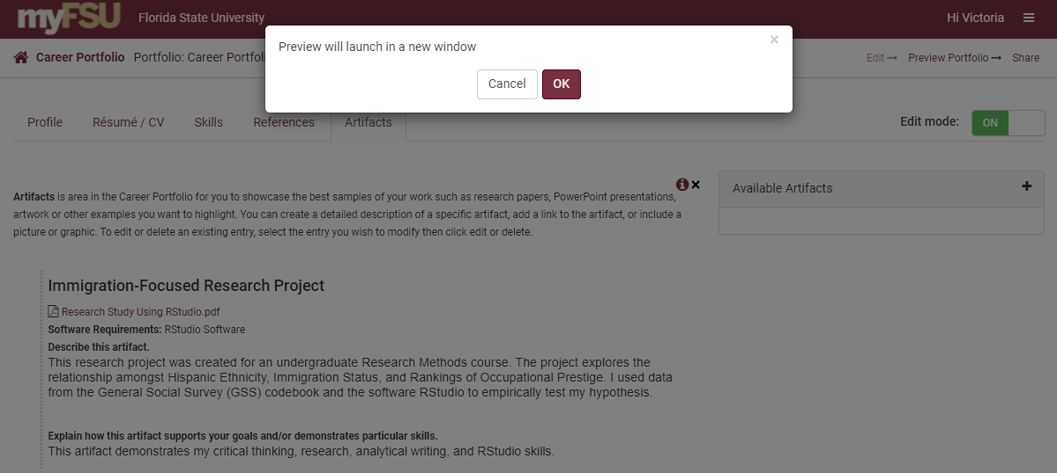
Preview Your Portfolio

Slide 10
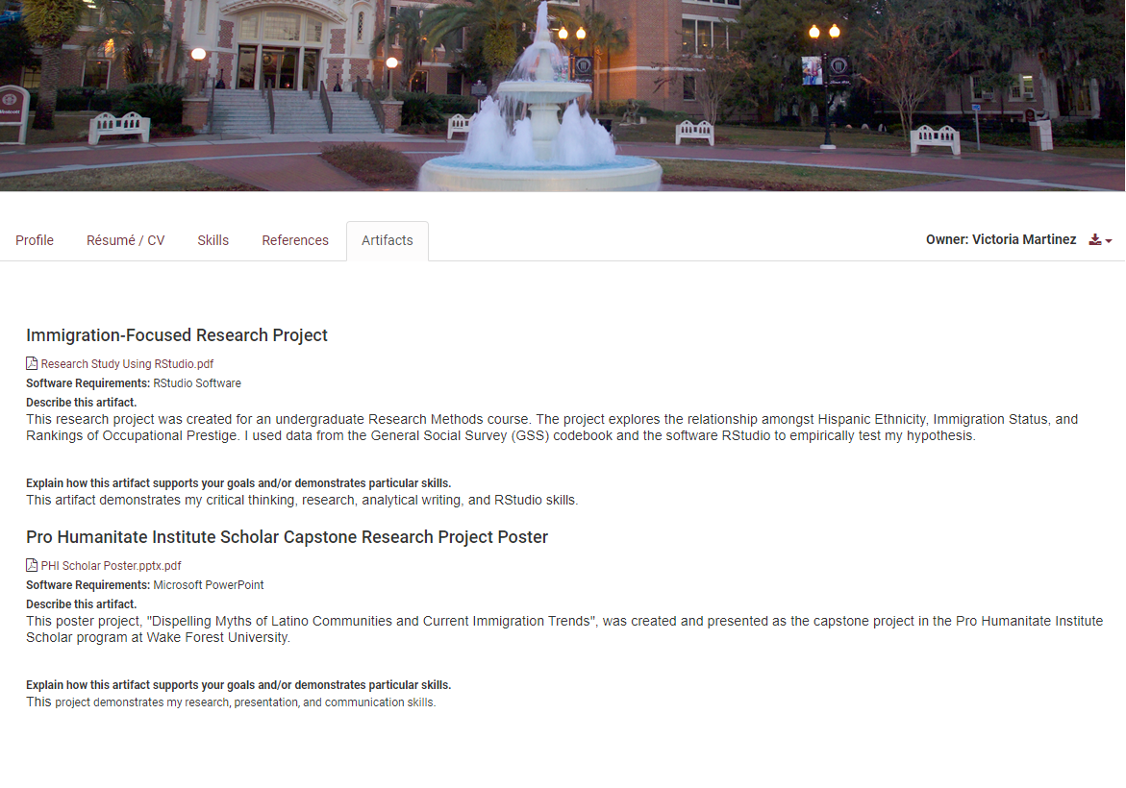
Preview of Your Portfolio

