Slide 1
Unit Three: Implementing a Strategic Career Plan

Slide 2
Chapter 11
Launching an
Employment Campaign

Slide 3
Presentation Overview
Nature of job campaigns
History of job-hunting methods
Employment for college graduates
Employers’ view of job campaigns
Job hunting myths
CIP perspective on job hunting

Slide 4
What is a Job Campaign?
Doing a personal assessment
Identifying goals/objectives
Targeting potential employers
Considering alternative work
settings/ways of working
Preparing letters and resumes
Contacting employers
Interviewing with employers
Making onsite visits
Maintaining a record- keeping system
Evaluating offers
Choosing the best offer

Slide 5
Job Campaigns
Importance of an active approach—what does this mean?
What are some life events that can lead to persons starting a job campaign?
How is job hunting like having a “job?”
Time commitment needed

Slide 6
History of Job-Hunting Methods
Frank Parsons
Best & worse ways to job hunt
Networking & the “hidden job market”
What Color is Your Parachute?
Internet’s impact on job hunting
Research on job hunting—what have we learned from this?

Slide 7
Employment for College Graduates
Jobs and well-being
Where jobs are found—visibility of small vs. large employers
Staffing services industry
Deciding about working in this industry— see Table 11.1
Tips for job hunting in staffing services industry—see Table 11.2

Slide 8
Employment for College Graduates
Factors in college job search success
Majors, jobs, and salaries—what does the research say?
Importance of skills valued by employers
how might this information relate to your transferable skills?

Slide 9
Employer Recruiting & Hiring Strategies
Understand recruiting strategies used by employers
Challenges faced by employers
Using campus resources to be successful in one’s job campaign
Know candidate characteristics valued by employers

Slide 10
Employer Views of Your Job Campaign
Gain Experience
Create Connections
First Impressions
Be a Professional
Be Prepared
Be Persistent
Be Realistic, Open-Minded, & Flexible
How many of these can you check off?

Slide 11
Four Job-Hunting Myths
“Wallflower Syndrome”
“Lone Ranger Syndrome”
“Looking Under the Light”
“I’ll Do Anything”
Avoid these by using a more proactive job hunting approach

Slide 12
CIP Perspective on Job-Hunting
Self-Knowledge
Values
Interests
Skills
How does your self-knowledge relate to the types of jobs you will seek?
What other aspects of self-knowledge might be important in job hunting?
Share examples of these

Slide 13
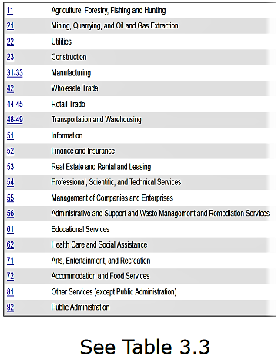
CIP Perspective on Job-Hunting
Option Knowledge
Knowledge of specific
employers:
job titles
employment classifications
& industrial categories

Slide 14
CIP Perspective on Job-Hunting
Option Knowledge
How do geographic preferences impact your options?
How do potential employment options affect the following:
future education?
leisure?
family?

Slide 15
CASVE Cycle in the Job Campaign
Communication
Awareness of a “gap”
Internal and external cues— what are some of these?

Slide 16
CASVE Cycle in the Job Campaign
Analysis
Reflecting on self- and option knowledge
Understanding how you make important
decisions related to employment
Influence of self-talk on the job search

Slide 17
CASVE Cycle in the Job Campaign
Synthesis
Expanding and narrowing employment
options
What resources can help you expand your list
of possible employers?
What factors will you use to narrow that list?

Slide 18
CASVE Cycle in the Job Campaign
Valuing
Prioritizing employment options
Consider self-knowledge and employment preferences
Weigh costs and benefits to self, significant others,
cultural group, community, society at large
Ranking options—may be job targets or job offers

Slide 19
CASVE Cycle in the Job Campaign
Execution
Actions taken to pursue employment or implement employment choice
Developing job search tools
Develop record-keeping system
If executing job offer choice, completing remaining steps in hiring process

Slide 20
Thoughts in the Job Campaign
Self-Talk
How might negative self-talk impact
your job campaign?
Self-Awareness
Awareness of how well you are executing job
hunting tasks, your feelings, thoughts, behaviors
Reactions from friends and significant others
Monitoring and Control
Knowing next steps in the job campaign
When to move on and when to ask for help
What are some tips to help the job search process go better?

Slide 21
Summary
Steps in an active job campaign
Importance of understanding what employers want
Consider how CIP Pyramid and CASVE cycle can be used in your job search

