Slide 1
Chapter 14
Negotiating & Evaluating Job Offers

Slide 2
Presentation Overview
Negotiating defined
Student vs. employer views of skills
needed to negotiate effectively
Social power in negotiating
Maximizing bargaining power
What do you negotiate?
Determining what’s important to you
in evaluating offers
CIP perspective

Slide 3
The Negotiating Process
Negotiating defined:
“to confer with another so as to arrive at the settlement of some matter”
What are employers seeking in applicants?
What do job hunters seek?
What is your previous experience with negotiating?

Slide 4
Employer Ratings of Essential Career Readiness Skills
See text Table 14.2
What skills are most essential for new hires?
What are ways you can develop these skills?
What class assignment allows you to highlight your skills?

Slide 5
Job Interview Preparation
Know yourself—values, interests,
key skills employers value
Review sample questions—
see Table 13.1
What value added might you bring to an organization?
Which questions would you find challenging to answer?

Slide 6
What employer characteristics are most important to you?

Slide 7
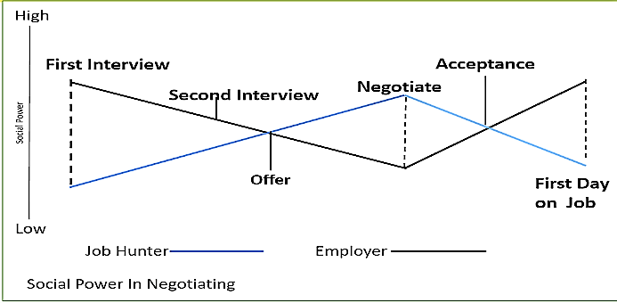
Social Power in Negotiating
Negotiating is a social process
Social power changes over time in negotiation
When does a job hunter have the most social power in the job search process?

Slide 8
Maximizing Your Bargaining Power
Knowledge about yourself & employer
Solid recommendations
Poise & confidence
Inside recommendations
Supply and demand
Other offers
Persuasion
Silent on salary

Slide 9
Receiving a Job Offer
Timing of an offer
Impressions still count
Clarify the offer
Learn about employment agreements
Negotiate time of a decision
Program hiring as a special type of job offer

Slide 10
Things to Negotiate: Salary
Importance of research
Minimum, realistic, “dream”
Avoid mentioning a specific salary; talk about ranges
Ask for more than you expect to receive

Slide 11
Other Things That May Be Negotiated
Timing of appraisal reviews
Signing bonus
Sales commissions, profit sharing, stock options
Job location
Insurance, pension plans, other benefits
Relocation expenses

Slide 12
Other Things That May Be Negotiated
Expense account, car, mileage
Club memberships
Consumer product discounts
Office furnishing
Insurance, pension plans,
other benefits
Relocation expenses
Relocation expenses
Start date
Vacations/work schedule
Division, department, title,
classification
Fulfillment & fun

Slide 13
Some Additional Words About Salary
Know what a job pays and know what you’re worth
Be informed about different ways to think about salary rates, e.g., hour, week, month, year
Ask for time to clarify salary data
Recognize role of initial salary in future jobs
Never accept a job until you know the salary

Slide 14
The Process of Negotiating
Decide your conditions
Remain positive
Make a decision
Be honest with employers
How might your values influence what you negotiate for with an employer?

Slide 15
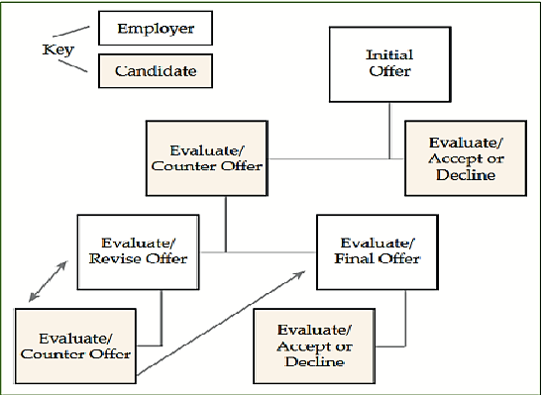
Evaluating Offers: Making the Best Choice
Clarity of career goals
Managing the process
The employer’s “sales pitch”
Ethical issues—
reneging on an offer
Being sure about the job—
10 factors to consider

Slide 16
The Matching Process
Revisiting what is important to you
Consider the factors in Table 14.3
Lifestyle
Nature of the employer/job
Pay and benefits
Work activities
Which of these factors would you focus on in evaluating offers?

Slide 17
Final Steps Before You Start
What happens before you sign your contract or appointment papers?
What types of background checks does employer require?
Importance of being honest about things in your background that might impact your employment

Slide 18
Using CIP and CASVE Cycle to Negotiate & Decide on an Offer
What self-knowledge factors will be important in your decision?
Values? interests? skills? employment preferences?
Knowledge of options--specific facts about the employer and job

Slide 19
Analysis Phase
Complete and accurate knowledge about self and job options
How your decision-making style influences the process
Role of negative and positive thoughts about the job offers received

Slide 20
Synthesis Phase
Elaboration: Have you negotiated for your best options?
Crystallization: Do you have all the information needed to narrow your options?

Slide 21
Valuing Phase
Considering costs & benefits
Some valuing questions to ask—how does each job option fit your needs and lifestyle preferences?
What other considerations are important, e.g., employer’s reputation, community involvement?
Ranking your offers—determining a first choice (assuming you have more than one!)

Slide 22
Execution Phase
Communicating with employers
Accepting offer verbally and
in writing
Declining other offers
Acceptance letters—what should these include?

Slide 23
Executive Processing
Extent to which you thought strategically in negotiating and evaluating job offers
Handling input from significant others
Influence of negative thinking in relation to offers received
Process that requires self confidence and positive self-talk!

Slide 24
CIP Perspective
Self-Knowledge
Importance of self-knowledge in helping you decide
on the best offer
Option Knowledge
Knowing about specific positions, along with organization’s culture
Decision Making
Using the CASVE cycle to make decisions about job offers
Executive Processing
Importance of thinking strategically & not allowing negative thinking to impact your views of offers

Slide 25
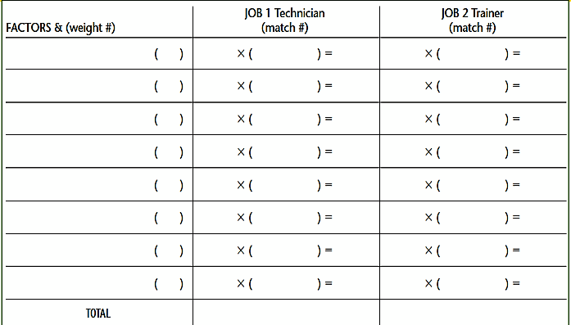
Employment Decision-Making Case Study
See Appendix L in text
Assess level of importance and degree of match
Which job offer should Elena accept?

