Slide 1
Chapter 7
Working in the New Global Economy

Slide 2
Working in the New Global Economy
How will we work and learn globally in the future?
Changes in work activity & production
U.S. labor markets trends
Services industry
State labor markets
CIP perspective

Slide 3
What do these things have in common?
Terrorism
Telemedicine
Cyber warfare
Artificial intelligence
Sun belt

Slide 4
Drucker’s Post-Capitalist Society
Knowledge as primary resource
Importance of “knowledge workers”
What Holland types are relevant to these
changes in society?

Slide 5
Reich’s Global Enterprise Webs
High value, complex, flexible, global work organizations
May involve small groups of workers
who quickly identify and solve problems
Communication may be horizontal
rather than vertical
Business model is more like a “spider web” with
connecting points across workers
What are some examples of these types of organizations?

Slide 6
Friedman’s Flat World
Three earlier periods of globalization
Individuals collaborating and competing globally
with new software
How might this “flat world” & the next industrial
revolution affect your career planning?

Slide 7
Precarious Work
Defined as uncertain, unstable,
and insecure
Employees assume risks of
employment, receive limited
benefits or protections
Implications for organizations
and individuals
Do you know
Individuals involved
in “precarious work?”
How do you
feel about it?

Slide 8
Rifkin’s Social Economy
Third Sector—social economy
This sector’s rate of growth
What are some examples of activities in this sector?
Social entrepreneurship

Slide 9
Labor Market Trends Through 2026
How new occupations develop
What contributes to the rise in new occupations?
Who works?
Reasons individuals are not in the labor force
Two views of employment growth—numeric vs. percent change—what is the difference?

Slide 10
Labor Market Trends Through 2026
Employment trends
How can projections affect the forecast outcomes?
Factors that can affect forecasts:
Natural disasters
World political events
Changes in government spending
New financial support programs
Technological inventions
New laws

Slide 11
Labor Market Trends
Big Growth Occupations (Table 7.1) vs. Fast Growth Occupations (Table 7.2)
How do these tables differ? Where would you rather look for jobs?

Slide 12
Labor Market Information Sources
Government agencies
Federal & state
Professional/trade associations
Private publishers & system developers
Futurist organizations

Slide 13
Federal Government Sources
U.S. Department of Labor/Bureau of Labor Statistics
Occupational Outlook Handbook
Career Outlook
Monthly Labor Review

Slide 14
Fast-Growth Occupations Requiring a Bachelor’s Degree

Slide 15
Changes in Industry Employment

Slide 16
Unemployment & Earnings Rates by Education

Slide 17
Holland Codes and Jobs

Slide 18
The Services Industry
Significant growth area of the economy
Source of many types of jobs from high to low skilled
Options for college students within this “office
economy”

Slide 19
State Labor Market Information
Impact of geographic location on labor market information
How might knowledge of Holland codes inform your understanding of job markets in an area?
See examples at:
Florida Employment Projections
www.careeronestop.org

Slide 20
CIP Perspective & the Labor Economy
Self-Knowledge
What interests, values, and skills are needed in the emerging economy?
Which Holland codes and qualities will be needed in the workplace?
What personal qualities/
experiences are likely to be valued?

Slide 21
CIP Perspective & the Global Economy
Option Knowledge
Nature of new kinds of work organizations?
New types of workers (e.g., knowledge workers)
Global vs. local changes, impact on options

Slide 22
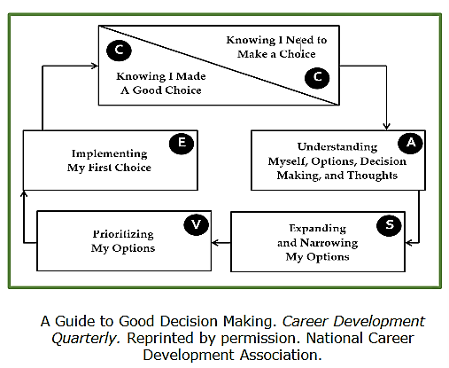
CIP Perspective & the Global Economy
Dynamic Knowledge
Dynamic nature of
the world economy
Ongoing use of
the CASVE Cycle

Slide 23
CIP Perspective & the Global Economy
Executive Processing
Need for career management
Complexity of contemporary career life
Thinking globally and work locally

