Slide 1

Chapter 3
Knowing About My Options

Slide 2

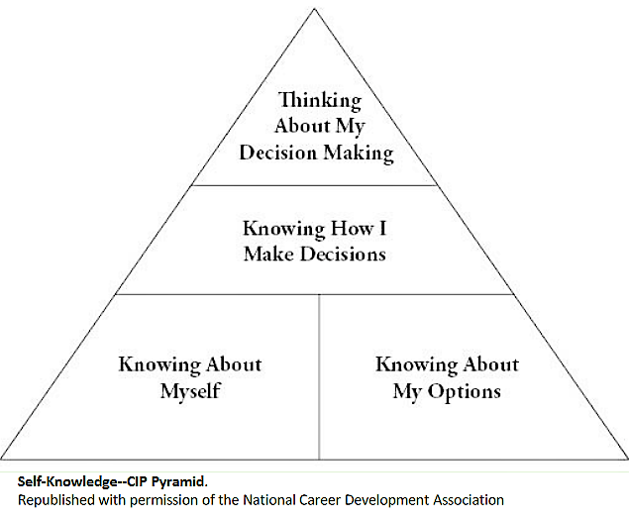
Pyramid of Information Processing

Slide 3
Connecting Occupations,
Education, & Leisure
Many believe these are three separate areas
of life: education, work, leisure
Today they are more interconnected
  Blended throughout our lives
  How are you blending learning, working, and
  playing into your life right now?
  How will you do it in 20 years?
Consider all 3 areas of options knowledge
  Education
  Work
  Leisure

Slide 4
Options Knowledge
Connection to self-knowledge
Forms foundation of career decision making
Complex nature of options knowledge
Options knowledge is “out there”
Research skills needed
  Labor market and occupational information
  Government reports, websites, books, journals, etc.
  Find, organize, and evaluate information

Slide 5
Knowledge About Occupations
Review of definitions:
  work, career, occupation, job, position
Number of occupations
  Schema: a meaningful way to categorize
Occupations are changing
  Information is fluid and dynamic

Slide 6
Information About Occupations
O*NET: www.onetonline.org
Occupational Employment Statistics: www.bls.gov/oes/
Occupational Outlook Handbook (OOH):
www.bls.gov/ooh/
CareerOneStop: www.careeronestop.org
Career Outlook: www.bls.gov/careeroutlook/

Slide 7
Occupational and Industry Classifications
Standard Occupational Codes (SOC)
16 Career Clusters
Holland’s RIASEC Codes
North American Industry Classification (NAICS)

Slide 8
Other Sources of Occupational Information
Internet
Private Publishers
Trade & Professional Associations

Slide 9
Computer-Assisted Career Guidance Systems (CACGS)
FOCUS2
SIGI3®

Slide 10
Knowing About Educational Options
Departments and majors
Connections between majors &
occupations
Broad vs. specific majors
Pros and cons of pursuing higher degrees
Decide based on self-knowledge

Slide 11
Non-College Training Options
Vocational education
Apprenticeships
Continuing education
Military training
Credit for prior work

Slide 12
Compare & Contrast
Accreditation
Ranking
Certification
Licensure
Which of these , if any,
are important to you?

Slide 13
Education & Training
Life/career process
  Education and training are already part of one’s career
  As a college student, you are already in your career

Slide 14
Knowledge About Leisure
Desirable or wasteful?
Historical perspective from Greeks & Romans
Definition of “work” includes leisure activities
Role of self-determination— what you choose
as leisure activities

Slide 15
Role of Leisure Activities
Complimentary
Supplementary
Compensatory

Slide 16
Leisure Classifications
700+ different leisure activities
Connecting Holland codes to leisure activities
How would you
classify leisure
activities?

Slide 17
Sources of Leisure Information
Clubs/organizations
Internet sites/online groups
Magazines, newsletters
Newspapers
Recreation/community centers
Student activity centers

Slide 18
Improving Options Knowledge
Develop a schema or framework
Learn strategies for making distinctions
Increase complexity of your thinking
Beware of bias, stereotypes, inaccuracies

Slide 19
Using Information About Options
Apply your research
skills
Invest the time
Use different formats
  Read
  Listen
  Observe
  Write
  Talk
  Visit
Constantly seek
information from
varied sources
Be a critical reader
Get help from a
career services or
information professional

