Slide 1
Courage to Change Careers
Dr. Hyatt
Dr. Dozier
Erica Stallings, MS, NCC
John Scanlon
Rana Emad

Slide 2
Socialization and Career
Can be combined with other theories of development & counseling in order to reflect on the ROLE OF CAREER DEVELOPMENT DECISION MAKING!
All aspects of human development are interconnected
No single aspect can adequately explain development
Everything MUST be considered
Notes:
Microsystem
People and objects in the immediate environment
Mesosystem
Influences of microsystems on each other
Exosystem
Social, environmental, governmental forces
Macrosystem
Subcultures and cultures in which the other three systems are embedded
*All aspects of human development are interconnected
No single aspect can adequately explain development
Consider all factors – environmental, family, political, social, etc. – and how they interact

Slide 3
Changing Careers Takes Courage!
Internal Barriers to Change?
External Barriers to Change?
Notes:
Internal Barriers: Fear, Insecurity, Previous bad experiences, Trauma, Lack of Knowledge/Education/Options, Etc. **Open this for discussion
motivation
External Barriers: Cost (personal and financial), travel, culture, systemic, etc. **Open for Discussion

Slide 4
CAREER COUNSELING:
First DO NO HARM!
Must be able to manage client expectations- whether this is a college campus, community setting, private practice, etc.
Scope of Practice
NCDA, ACA, APA
Advocate for Clients
Notes:
Discuss the Role of Advocacy- Career Counseling: Active Listening- SCOPE OF PRACTICE! ACA, APA, NCDA….. NOT SETTING THE CLIENT UP FOR FAILURE! MUST BE ABLE TO HELP THE CLIENT AND BE HONEST. MANAGE EXPECTATIONS WITH THE CLIENT. CIP, NARRATIVE, BROWNS VALUES. *** CAN TALK BRIEFLY ABOUT ACTIVE LISTENING HERE AND EXPLORING CLIENT VALUES-THIS WILL OPEN UP FOR CONVERSATION LATER IN THE PRESENTATION

Slide 5
Notes:
As we talk about career change, want share
Individual enters room – readiness assessment to decide self-help; brief-staff assisted vs. individual case managed
theory on the wall

Slide 6
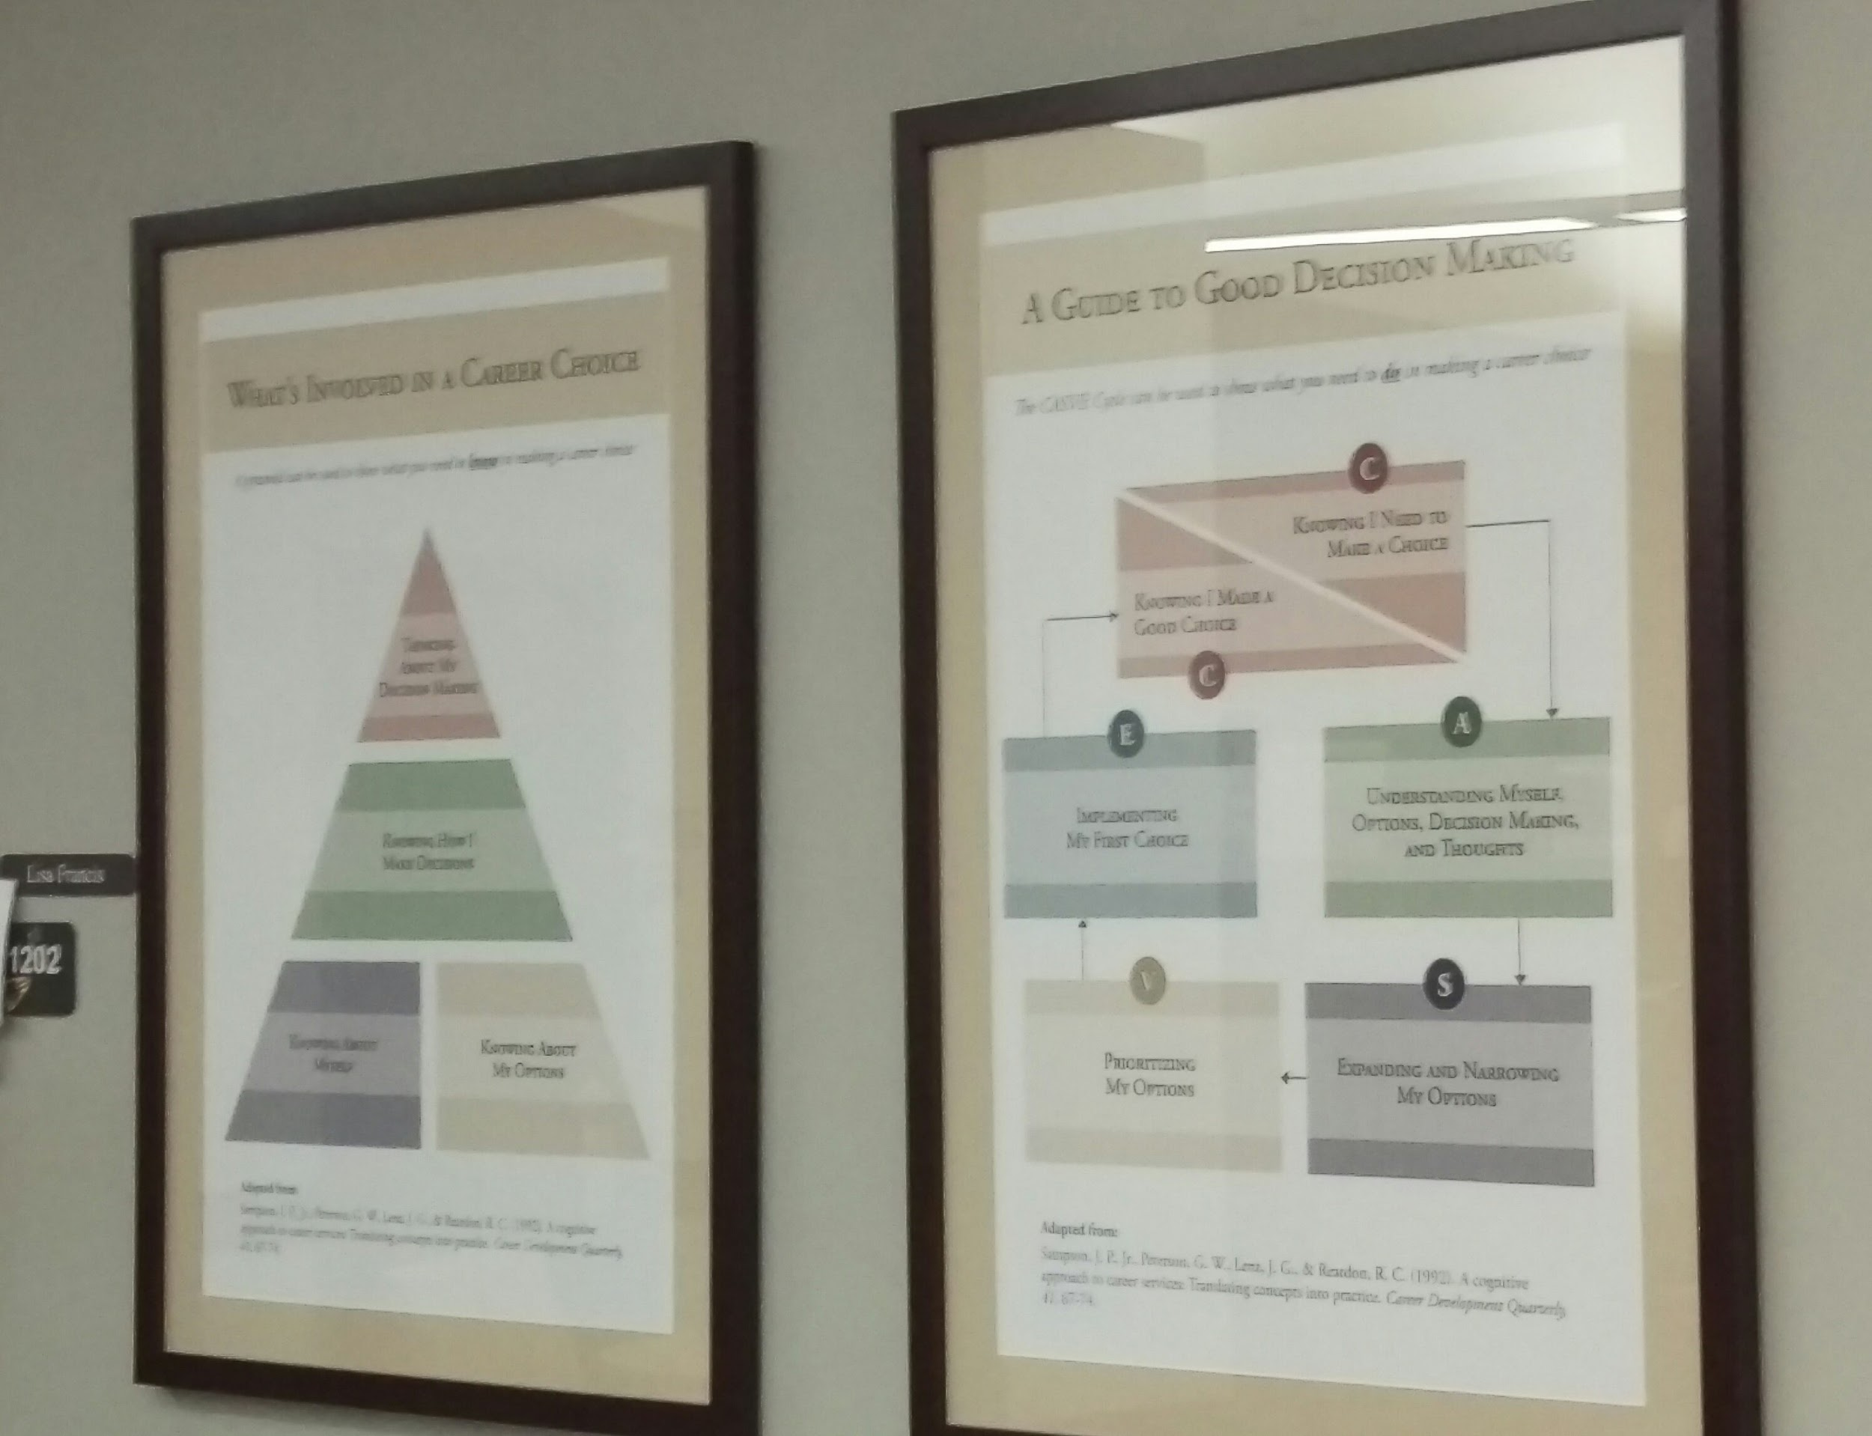
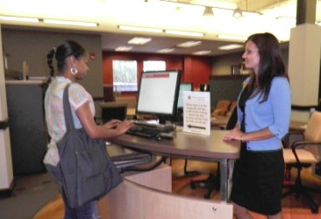
Differentiated Service Delivery Model
Individual Enters
Brief Screening
Self or Staff
Referral
Comprehensive Screening
Self-Help
Services
Brief
Staff-Assisted
Services
Individual
Case-Managed
Services
Complete differentiated model of delivering career resources and services

Slide 7
Career Thoughts Inventory: Readiness measure
Self-administered
Objectively scored
48-item measure of dysfunctional thoughts in career choice
Notes:
CTI – correlated with depression, anxiety, etc.

Slide 9
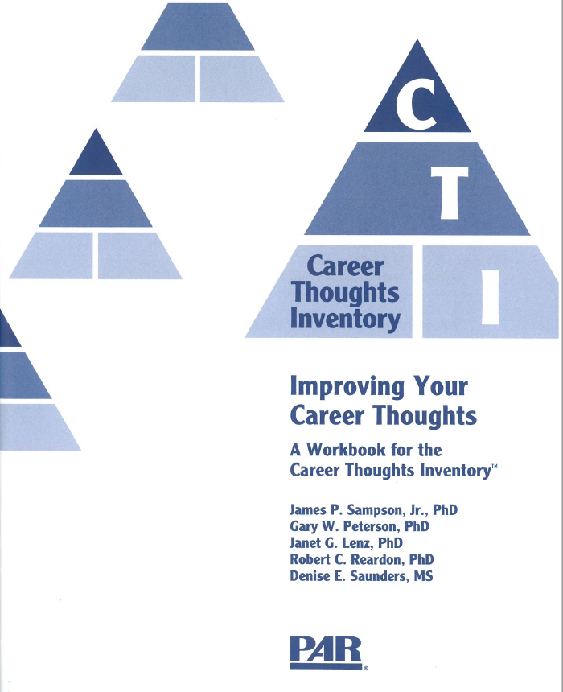
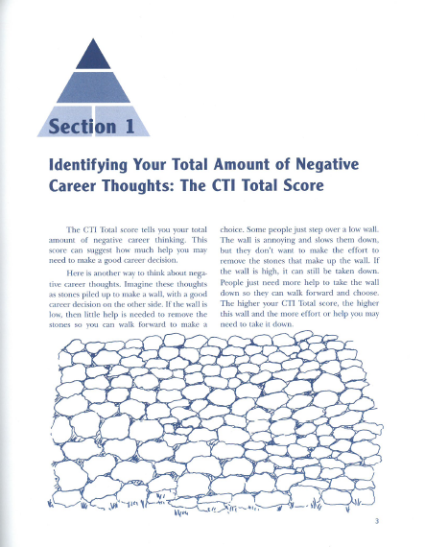
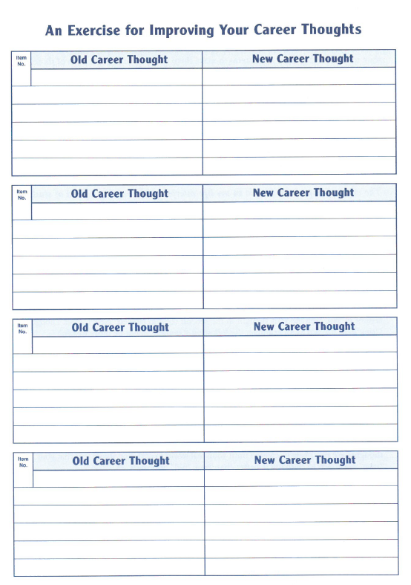
CTI Workbook
Notes:
See how assessment & interventions connect to CBT, solution-focused theories (as well as CIP)
Mention checklist – p. 30-33

Slide 10
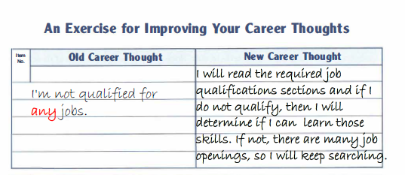
Reframing Activity

Slide 11
The Spirit of MI
“If you treat an individual as he is, he will stay as he is, but if you treat him as if he were what he ought to be and could be, he will become what he out to be and could be”
- Johann Wolfgang Von Goethe
Notes:
Helping clients find who they want to be is important

Slide 12
Overview
Motivational interviewing is a collaborative approach which focuses on client autonomy to choose and their motivation to make changes.
Focus on wellness, acceptance, and client growth
“More than 25,000 articles citing MI and 200 randomized clinical trials of MI have appeared in print, most of them published since the second edition. Research has provided important new knowledge on MI processes and outcomes, and psycholinguistics of change, and how practitioners learn MI”
Miller & Rollnick, 2013, p. vii).

Slide 13
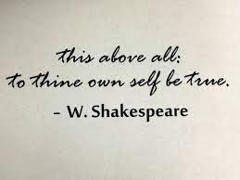
Let’s Talk About VALUES
Motivational Interviewing and Values!
https://motivationalinterviewing.org/sites/default/files/valuescardsort_0.pdf
What are your values? How are you true to them?
Notes:
Everyone will talk about their own values here. What they love-their career choices- the importance of knowing thyself.

Slide 14
Self-Knowledge
Knowledge domain and foundational building block of career decision-making
Schema developed throughout an individual’s life experiences (Peterson et al., 2002; Sampson et al., 2004)
The awareness of one’s values, interests, and skills, and is influenced by life experience and culture (Sampson et al., 2004).
Adapted from Career development and services: A cognitive approach (p. 28), by G. W. Peterson, J. P. Sampson, and R. C. Reardon, Copyright 1991 by Brooks/Cole. Adapted with permission.

Slide 15
Self-Knowledge
Gap in self-knowledge is a basis for a career problem (Sampson et al., 2004)
Contributes to difficulty in analysis and synthesis in decision making process.
Lack of self-knowledge impedes the decision-making process – Contributes to Dysfunctional Thoughts and Emotions
May experience worry, depression, and anxiety
Lack confidence and motivation (stuck or immobile)
Low Capability and Uncertain Decision State/Readiness Dimension (Osborn et al., 2020; Leierer et al., 2017)

Slide 16
Let’s Assess
https://www.ismanet.org/doctoryourspirit/pdfs/Beck-Depression-Inventory-BDI.pdf
https://res.cloudinary.com/dpmykpsih/image/upload/great-plains-health-site-358/media/1087/anxiety.pdf
Notes:
BDI and BAI, CAMS, Columbia Suicide Rating Scale, etc.

Slide 17
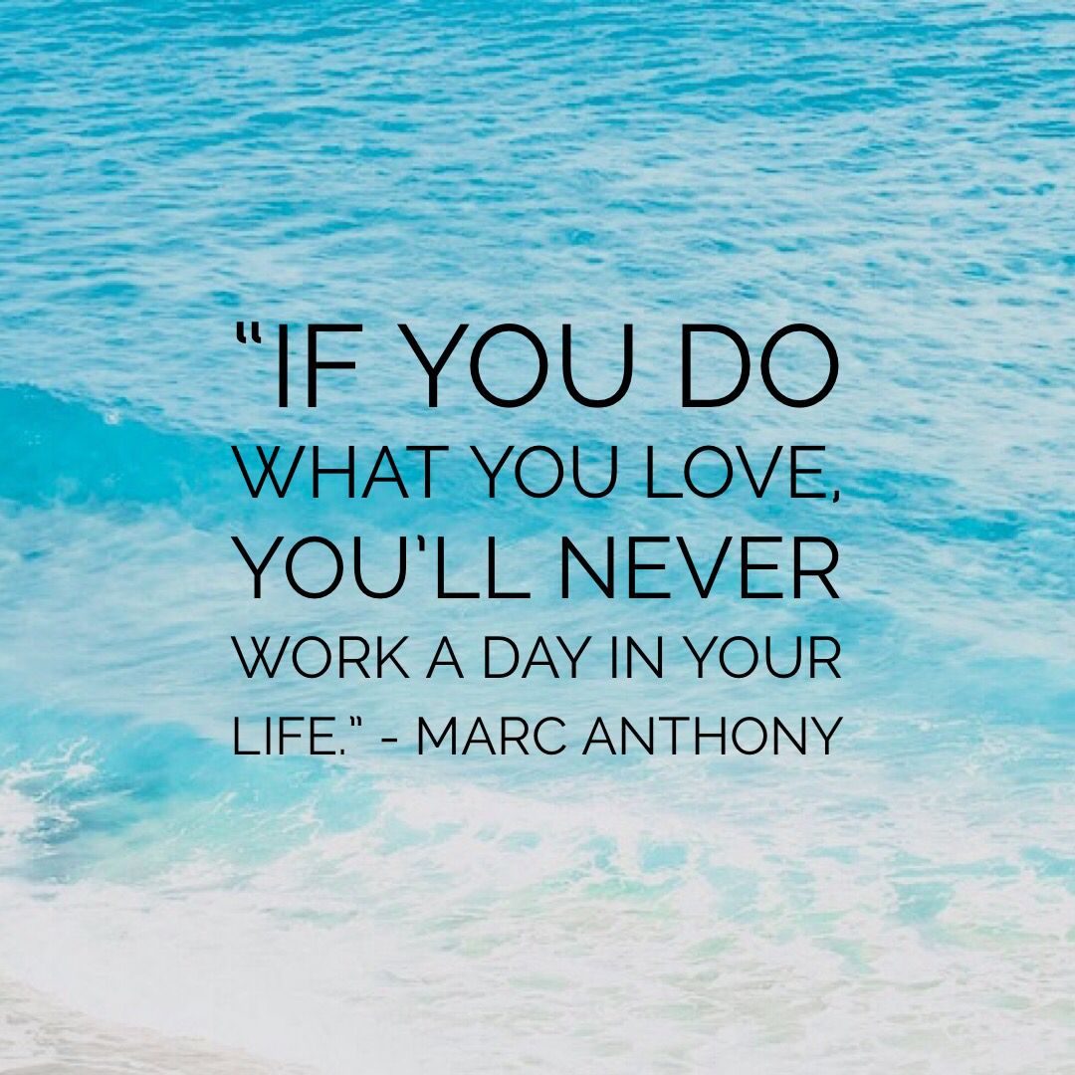
Notes:
68% reported in APA stress survey being negatively impacted by pandemic- citing stress at home, work, over the economy, etc.
Xiong (2020) reported increase in mental health concerns- substance use, SI, depression, anxiety, etc.
It is important to assess for SI, substance use, anxiety and ongoing stressors. The use of the CAMs, the Columbia Suicide Rating Scale, Beck Depression Inventory, Beck Anxiety Inventory, etc. are brief and use- friendly assessments to check in with clients.
**Assess with BDI and BAI

Slide 18
References
American Counseling Association. (2014). ACA code of ethics. American Counseling Association. Alexandria, VA: Author.
American Psychological Association. (2020, May). Stress in the time of COVID-19, volume one. Stress in America Survey 2020. https://www.apa.org/news/press/releases/stress/2020/stress-in- -covid.pdf
Arkowitz, H., Westra, H. A., Miller, W. R., & Rollnick, S. (2007). Motivational interviewing in the treatment of psychological problems. Guilford Press.
Coleman, M. (2020). Women leaders in the workplace: perceptions of career barriers, facilitators and change. Irish Educational Studies, 2, 233.
Herman, K. C., Reinke, W. M., Frey, A. J., & Shepard, S. A. (2014). Motivational interviewing in schools: Strategies for engaging parents, teachers, and students. Springer Publishing
Hirschi, A. (2011, June 1). Effects of orientations to happiness on vocational identity achievement. Career Development Quarterly, 59(4), 367.
Kail, R.V. and Cavanaugh, J.C. (2013). Human development: A Lifespan View (8th ed.). Belmont, CA: Wadsworth, Cengage Learning.
National Career Development Association. (2015). NCDA code of ethics. American Counseling Association. Alexandria, VA: Author.
Miller, W., & Rollnick, S. (2013). Motivational interviewing: Helping people change (3rd ed.). Guilford Press.
Motivational Interviewing Network of Trainers website: http://www.motivationalinterviewing.org
Naar-King, S. & Suarez, M. (2011). Motivational interviewing with adolescents and young adults. Guilford Press.
Rosengren, D. B. (2009). Building motivational interviewing skills: A practitioner workbook. Guilford Press.
Sampson, J. P., McClain, M. C., Musch, E., & Reardon, R. C. (2017). The supply and demand for career development programs and services as a social justice issue. In V. S. H. Solberg, & S. R. Ali (Eds.), Handbook of career and workforce development research, practice, and policy (pp. 57-75). London: Routledge.
Xiong, J., Lipsitz, O., Nasri, F., Lui, L. M. W., Gill, H., Phan, L., Chen-Li, D., Iacobucci, M., Ho, R., Majeed, A., & McIntyre, R. S. (2020). Impact of COVID-19 pandemic on mental health in the general population: A systematic review. Journal of Affective Disorders, 277, 55–64. https://doi.org/10.1016/j.psychres.2020.113441

Slide 19
Contact Information
Dr. Tristen Hyatt- thyatt@fsu.edu
Dr. Casey- casey.dozier@fsu.edu
Erica Stallings- estallings@fsu.edu
Notes:
BDI and BAI, CAMS, Columbia Suicide Rating Scale, etc.

