Slide 1
Create a Portfolio

Slide 2
Customize Your Portfolio
You can Customize:
Name of your Portfolio
Photo Banner: On/Off
Include E-mail Address
Include Confidentiality Agreement
Transcripts
Unofficial and Service Transcripts (if applicable)

Slide 3
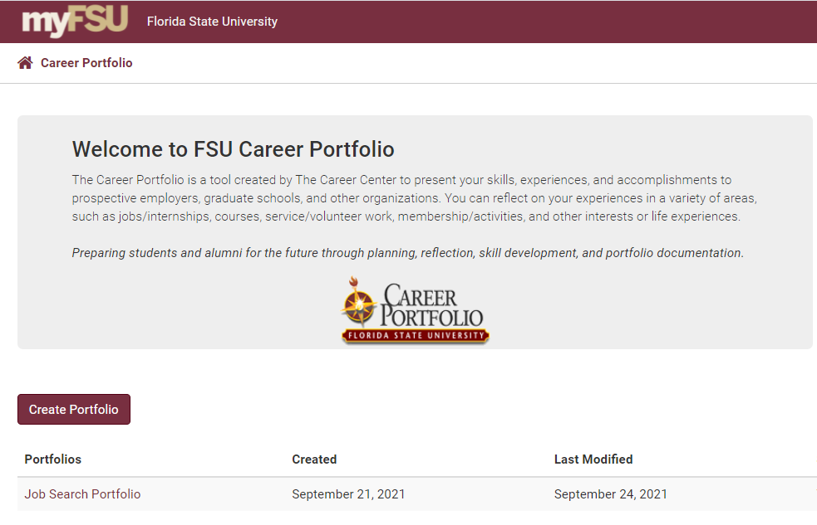
New Portfolio

Slide 4
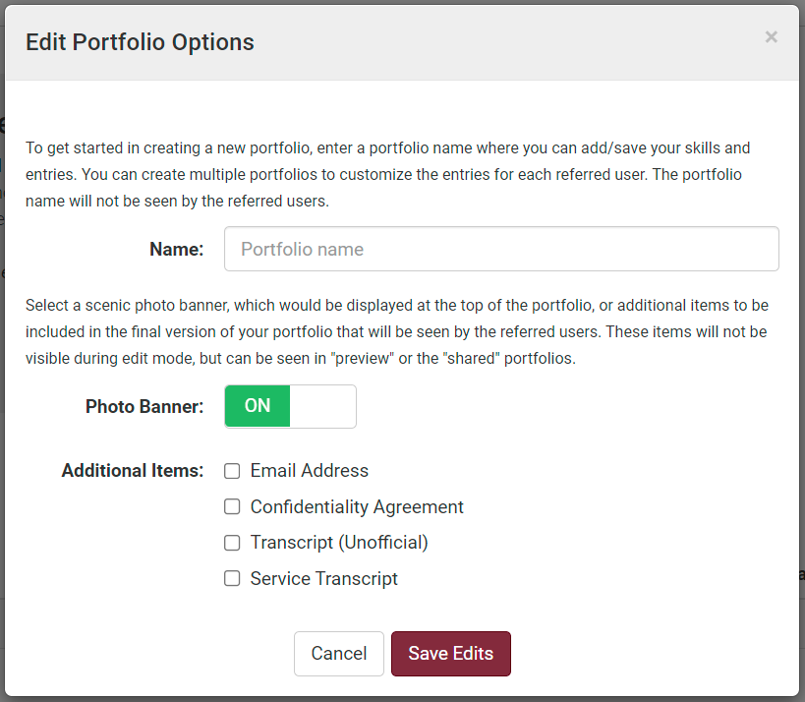
Portfolio Options

Slide 5
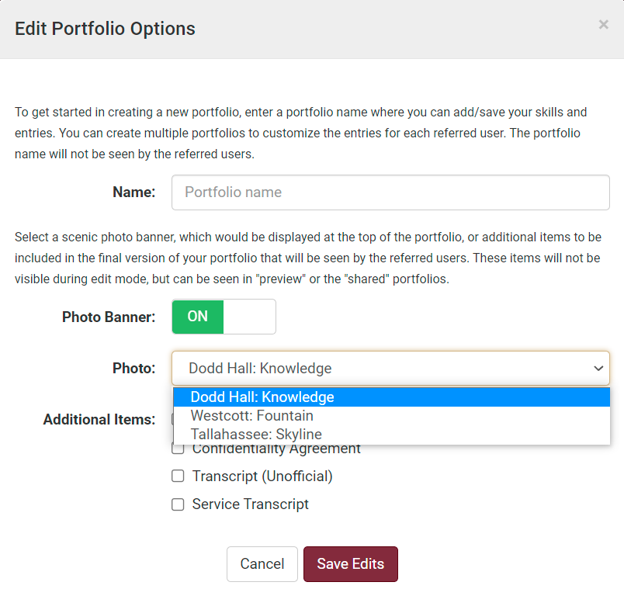
Photo Banner Options

Slide 6
Preview Your Portfolio

Slide 7
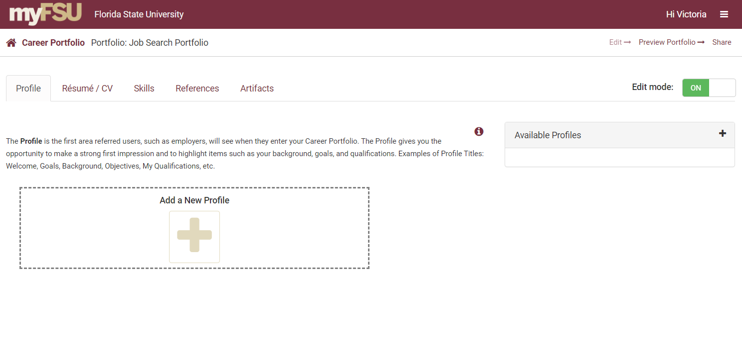
Preview Your Profile
Preview your portfolio while you’re working on it

Slide 8
Get Your Portfolio in PDF

Slide 9
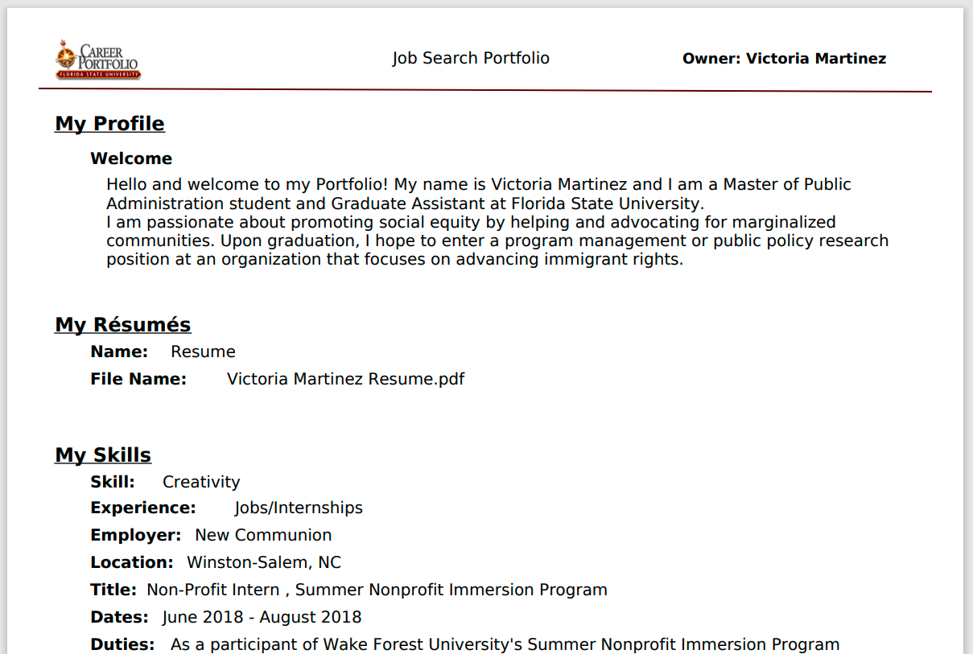
PDF Version

Slide 10
Delete a Portfolio

