Slide 1
Enter Your References

Slide 2
References
OBTAIN PERMISSION FROM YOUR REFERENCE
Sufficient contact information
Variety of reference types
Spelling, punctuation, and correct information listed

Slide 3
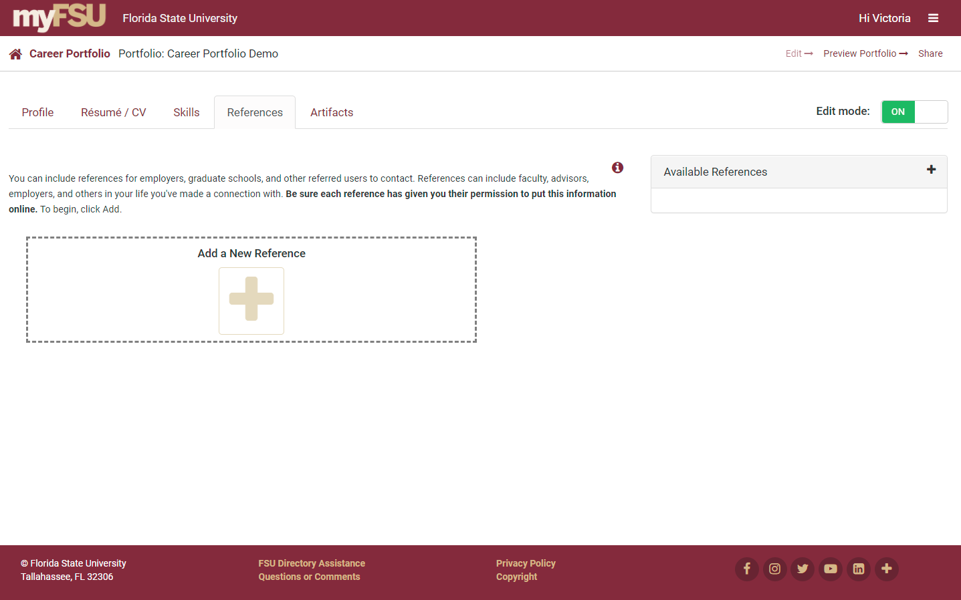
Add a New Reference

Slide 4
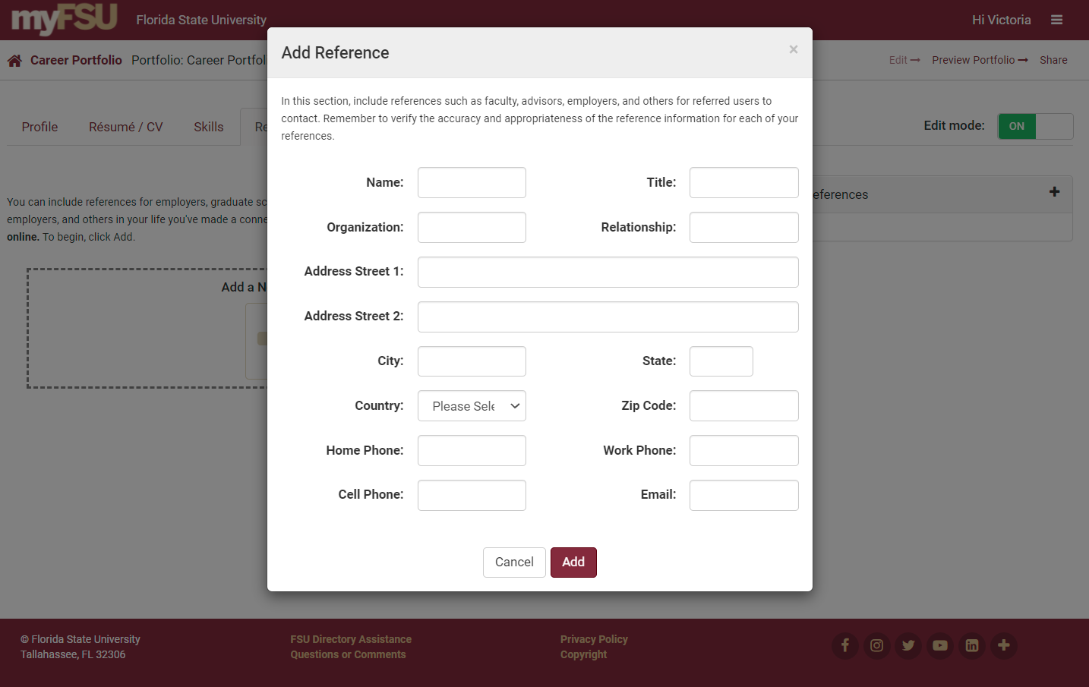

Slide 5
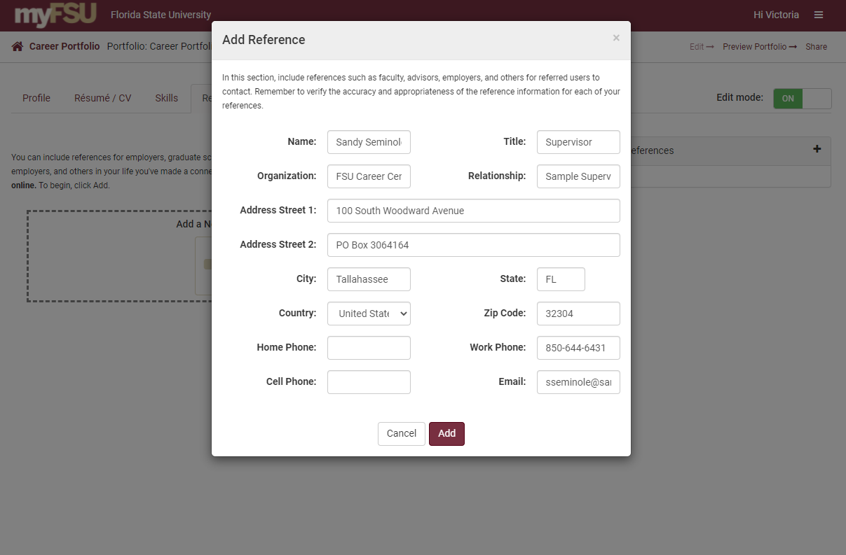
Edit and Save Reference

Slide 6
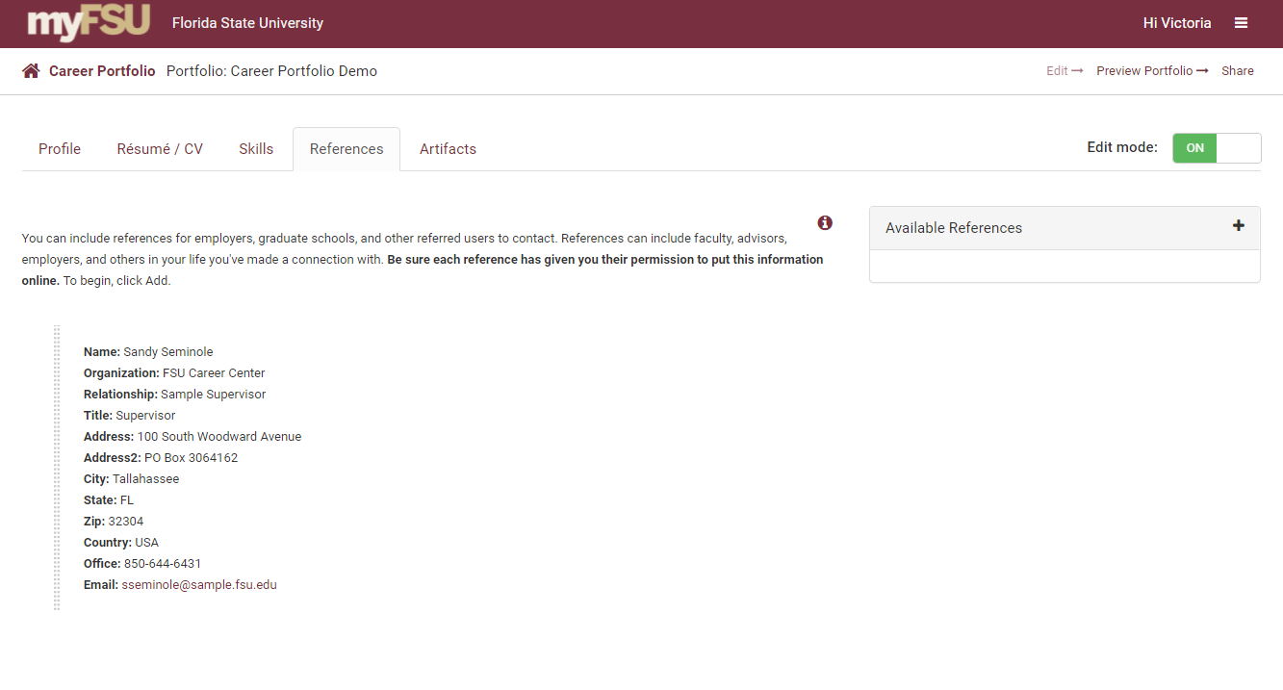
Add an Additional Reference

Slide 7
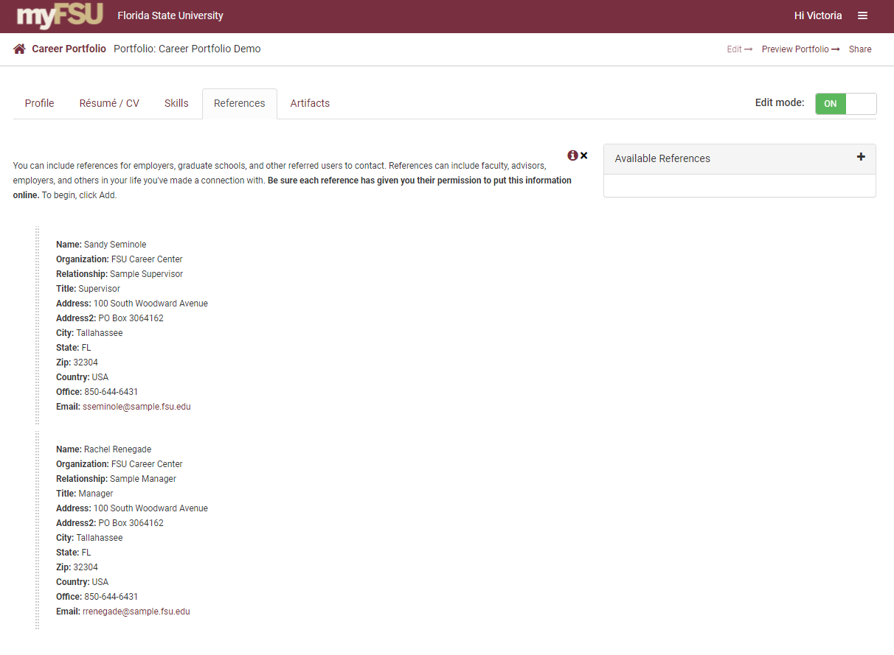
Reorder Your References
Reorder your references by clicking on and dragging them.

Slide 8
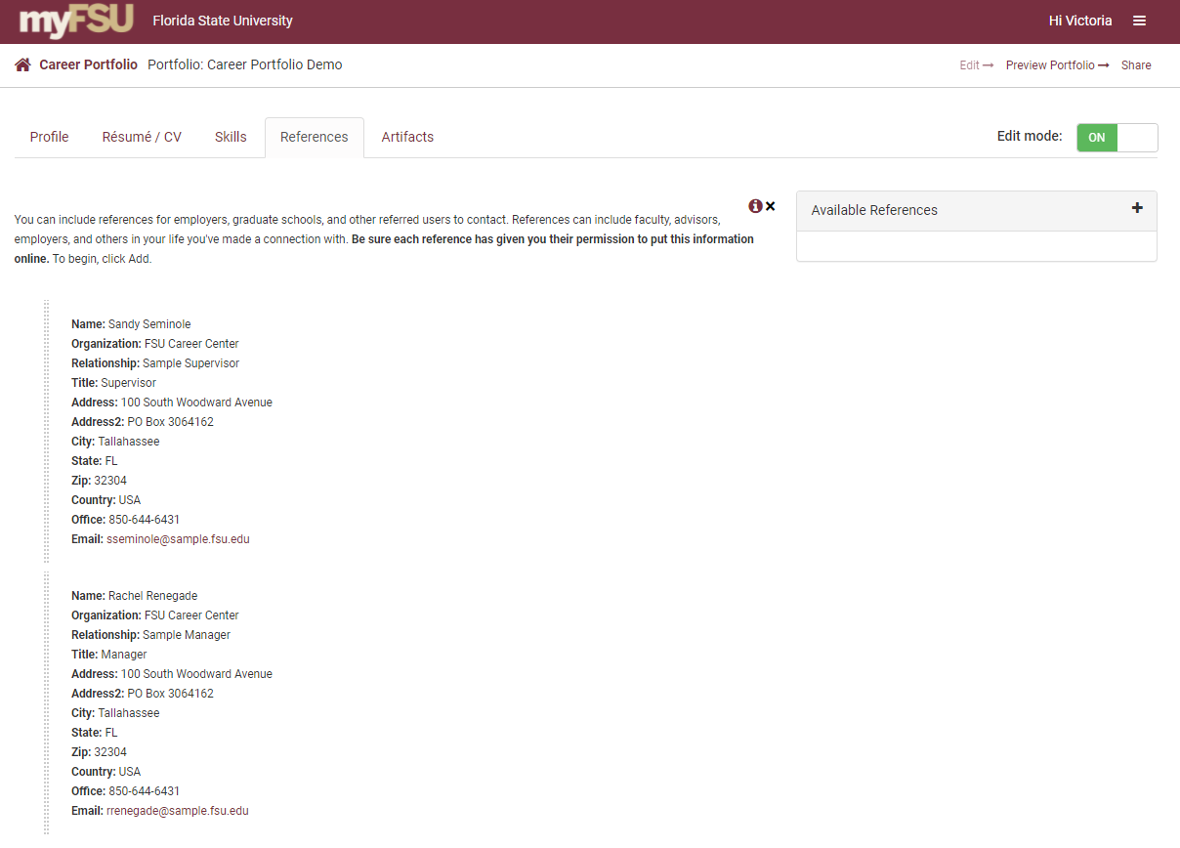
Preview Your Portfolio

Slide 9
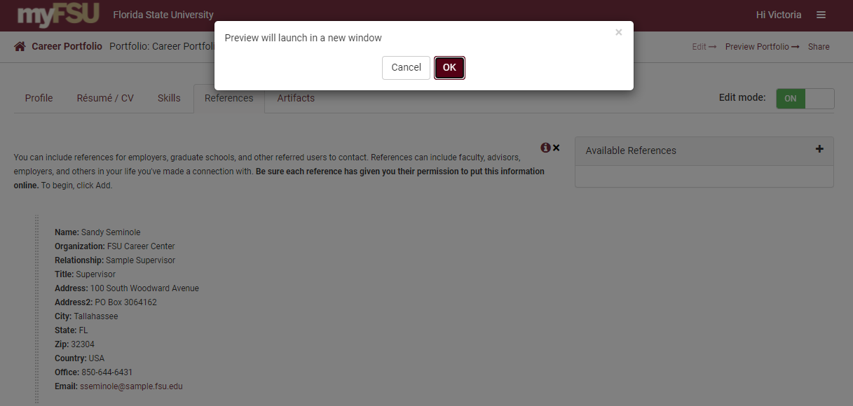
Preview Your Portfolio

Slide 10
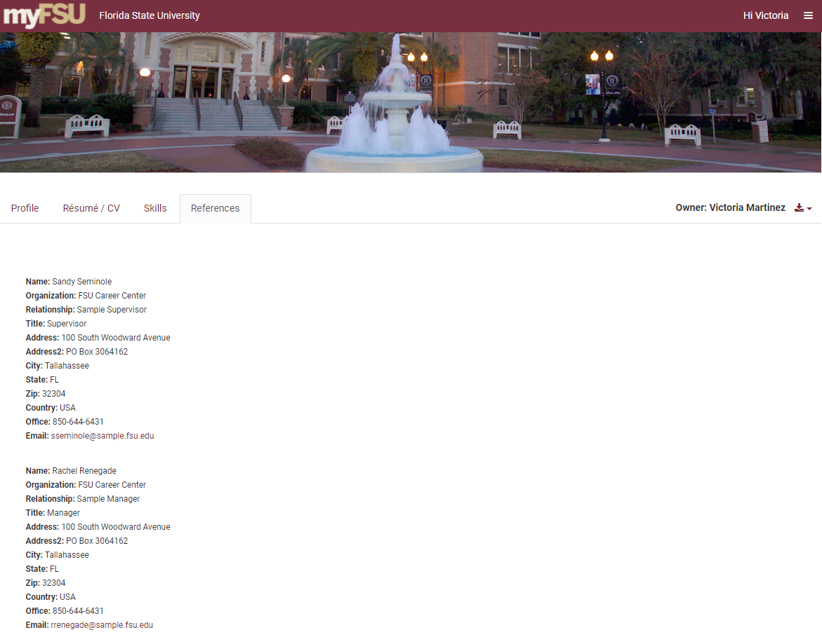
Preview of Your Portfolio

