Slide 1
Upload Your Resume/CV and Cover Letter

Slide 2
Resume/CV
Well-written with appropriate content
Tailored to field and career objective of the portfolio
Revised for clarity, errors, organization, and format

Slide 3
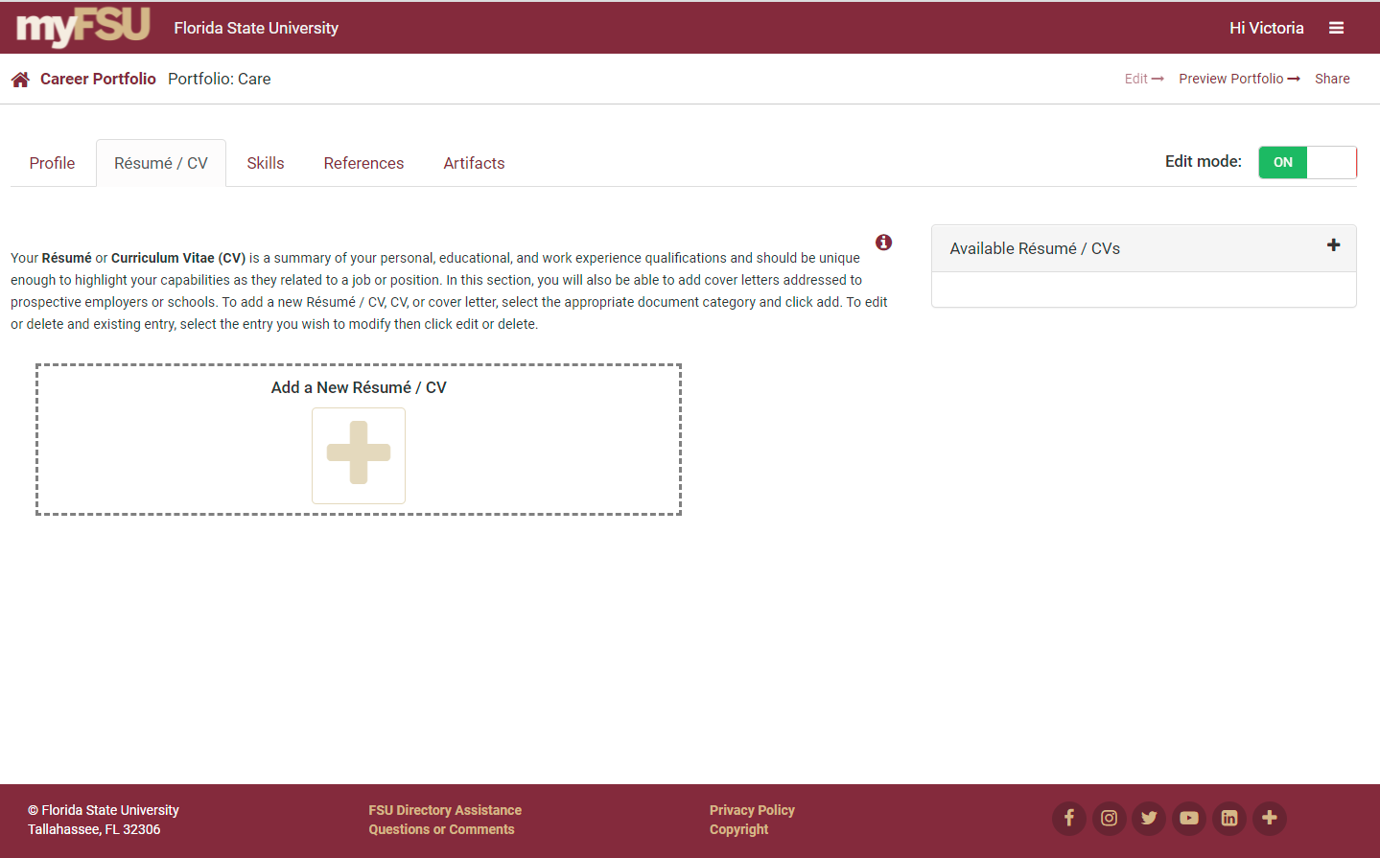
Add a Resume/CV

Slide 4
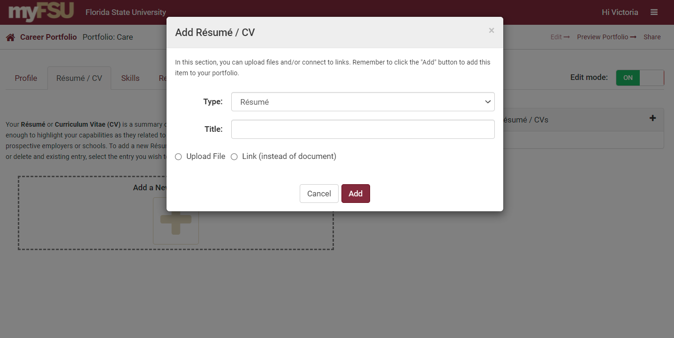
Upload Your Resume/CV

Slide 5
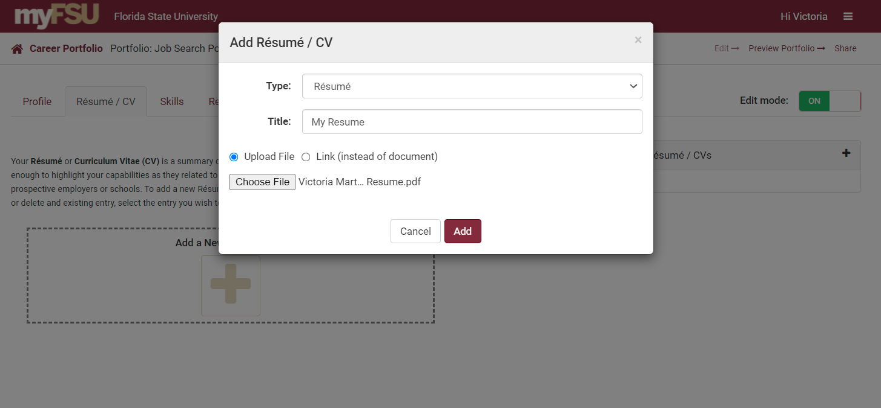
Add Your Resume/CV

Slide 6
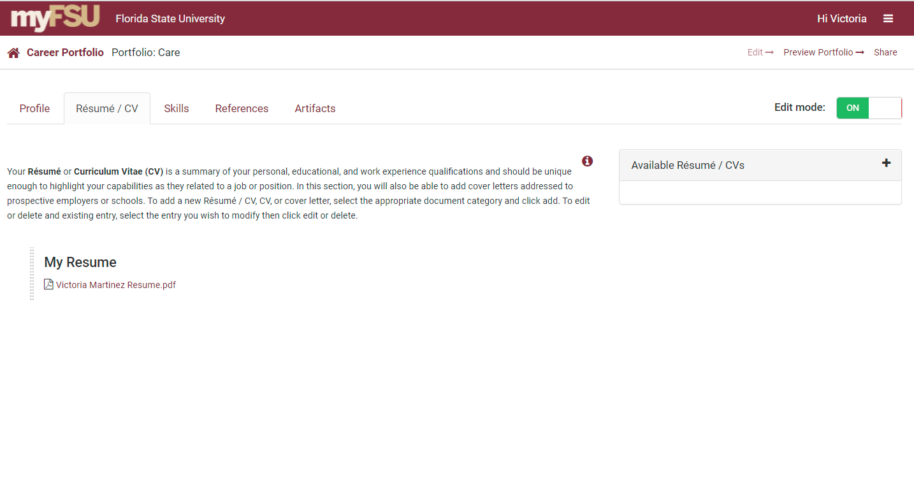
Add a Cover Letter

Slide 7
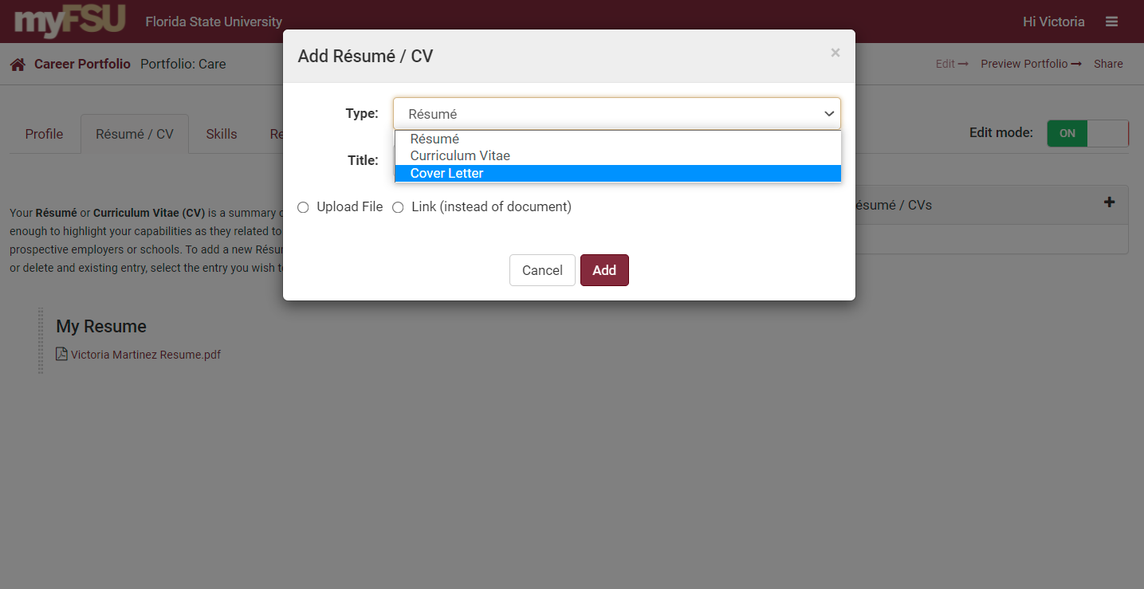
Upload Your Cover Letter

Slide 8
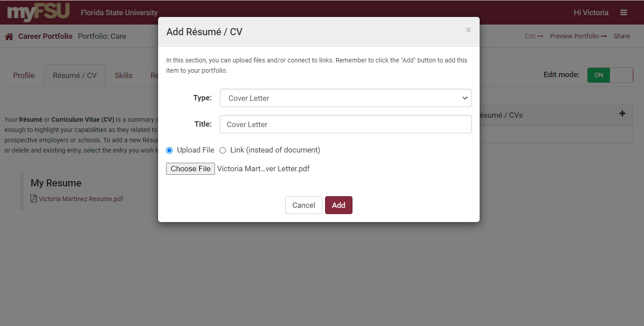
Add Your Cover Letter

Slide 9
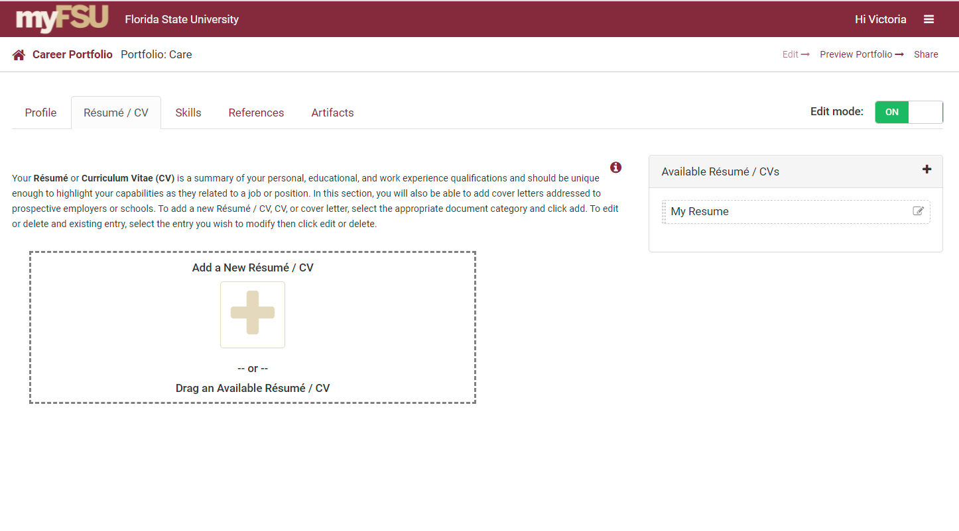
Adding Previous Resumes/CVs
Drag “Available Resumes/CVs” from previous portfolios you’ve created to add them.

Slide 10
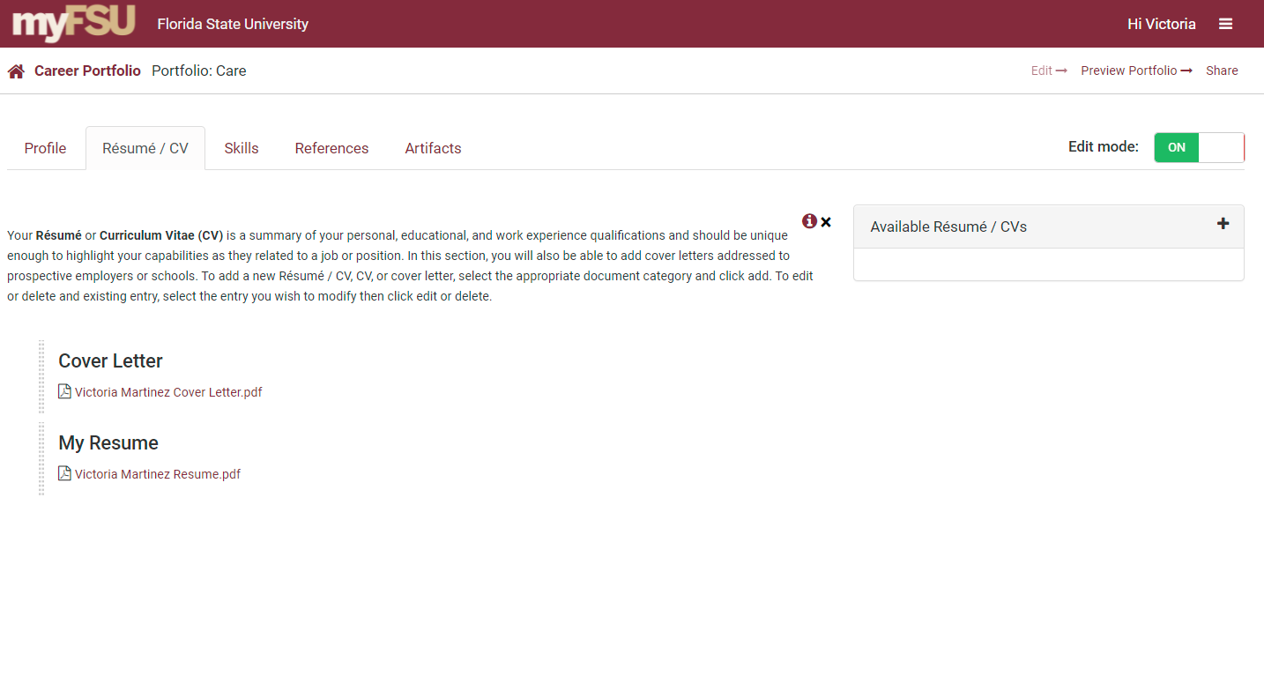
Preview Your Portfolio

Slide 11
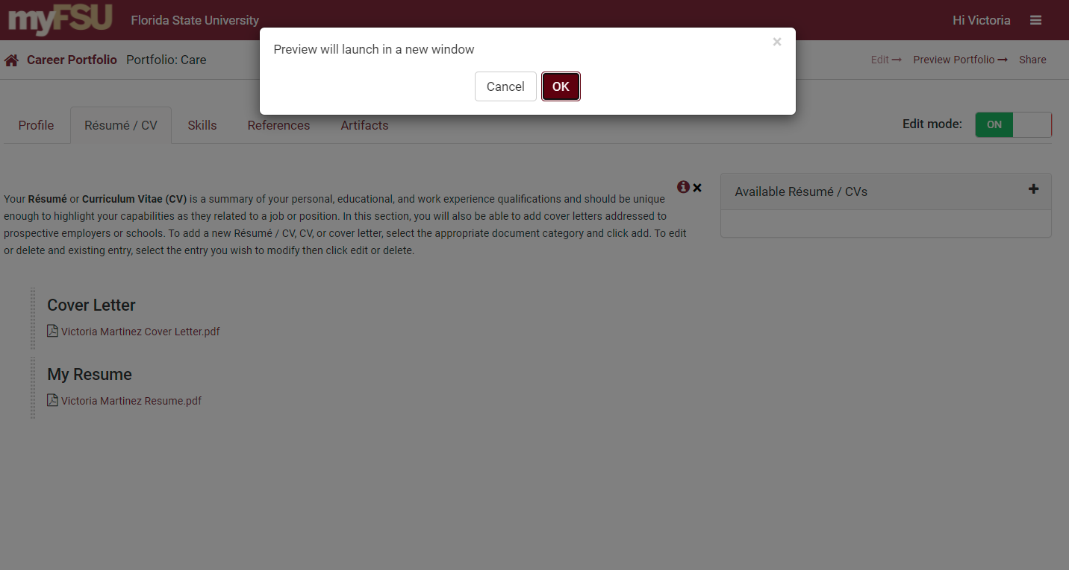
Preview Your Portfolio

Slide 12
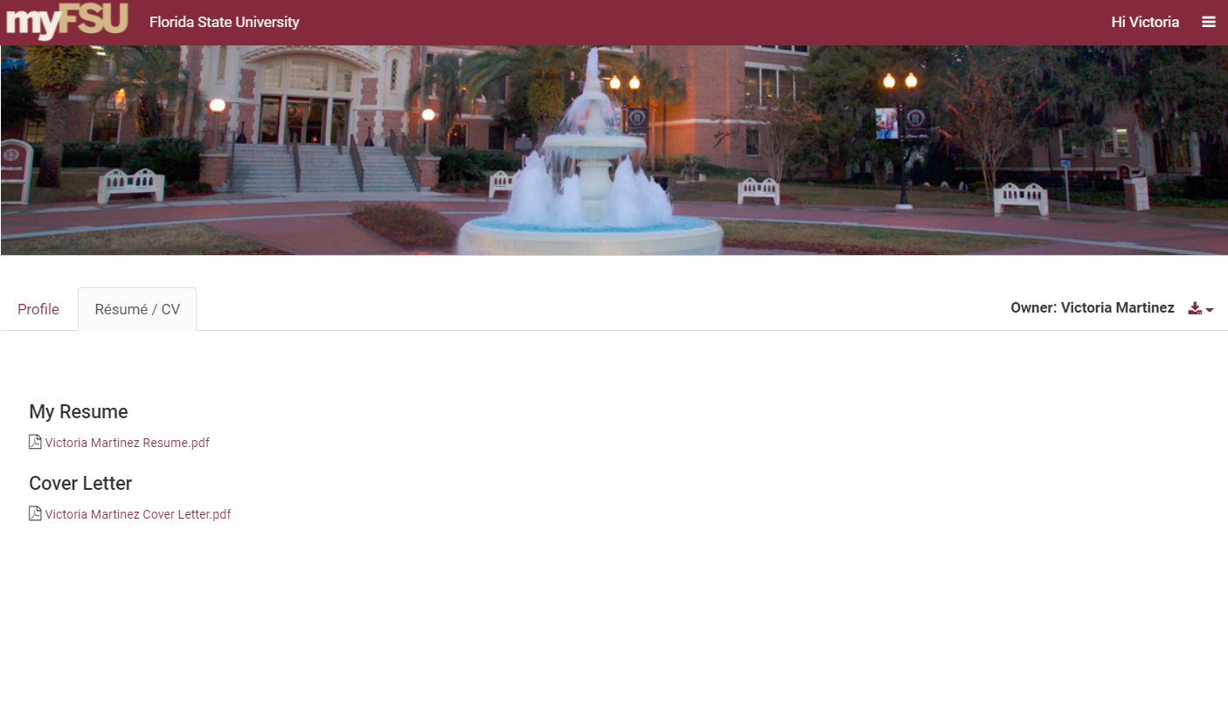
Preview of Your Portfolio

