Slide 1
Create a Portfolio

Slide 2
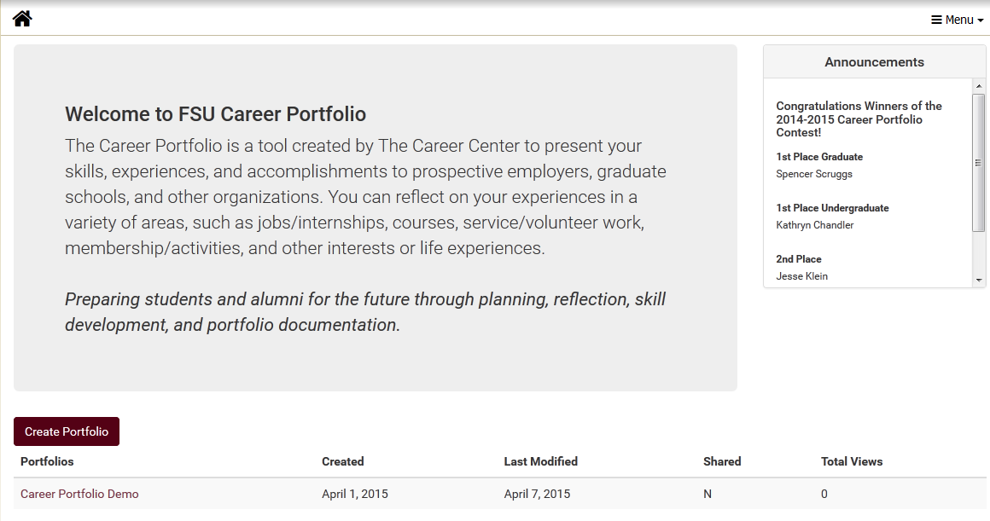
New Portfolio

Slide 3
Customize Your Portfolio
You can customize:
Name
Photo Banner: on/off
Include e-mail address
Include confidentiality agreement
Transcripts
Unofficial and service transcripts (if applicable)

Slide 4
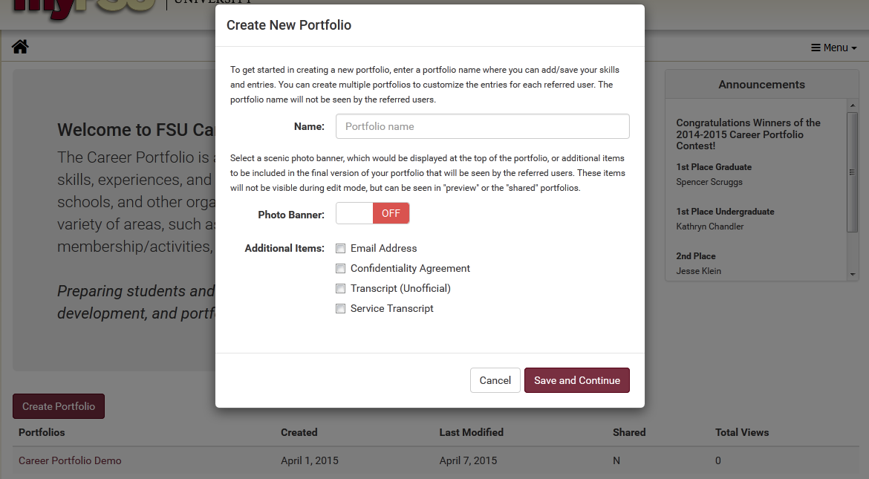

Slide 5
Banner Options

Slide 6
Main Screen Options

Slide 7
Preview Your Portfolio

Slide 8
Preview Your Profile (cont.)
You can preview your portfolio while you’re working on it

Slide 9
Get Your Portfolio in PDF

Slide 10
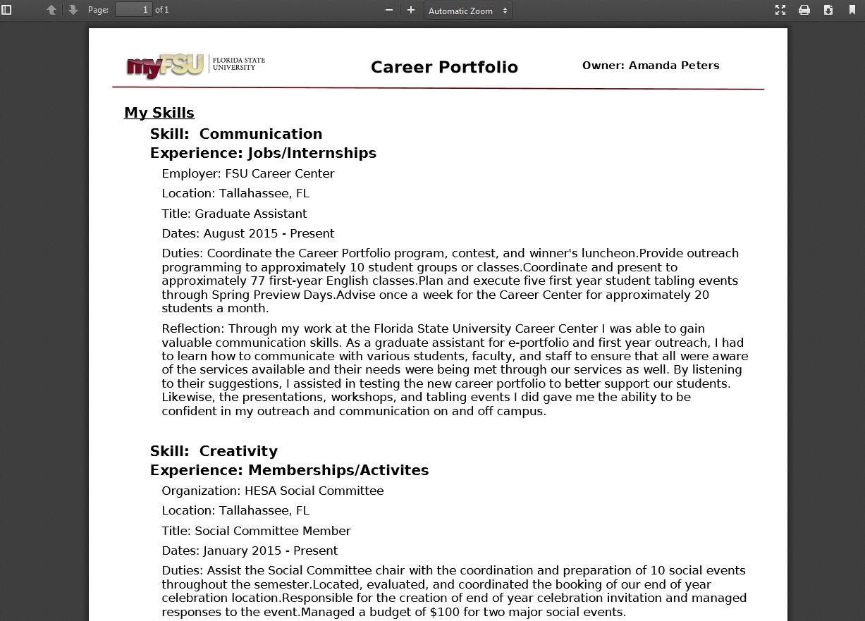
PDF Version

Slide 11
Delete a Portfolio

