Slide 1


Chapter 1
Introduction to
Career Planning

Slide 2
Presentation Overview
History of “career” – past and present
Key definitions
A sample of career theories
Cognitive information processing
(CIP) theory

Slide 3

Historical Review
Emergence of “career”
Historical review
Hazards of early work
environments

Slide 4

Vocational Guidance
Frank Parsons’ Vocations Bureau
Parsons’ 3-step model
self-assessment
study of options
careful reasoning
Lifelong process

Slide 5

Career Planning Today
Rapid change
Nature of work in today’s
organizations
Work options
Shifts through time
Career materials and resources

Slide 6

Why Are Career Problems Important?
Economic impact
Impact of full employment on
“health” of a nation
Relation between unemployment
and social and physical problems
Impact of organizational failures
Numbers of people impacted

Slide 7

Some Definitions
career development
career
work
occupation
position
job

Slide 8
Key Definitions Exercise
career development
career
work
occupation
position
job
Volunteering at the animal shelter
Includes all factors that shape your current situation
Accountant
My interview was successful, and I got the _______.
Microsoft has an opening for a Technical Trainer
Right now, you are in your _______.

Slide 9
Roe’s Formula
Occupational Choice =
S[(eE + bB + cC) +(fF, mM)) + (lL + aA) + (pP x gG x tT x iI)]
S = sex E = state of the economy B = family background/ethnicity C = chance F = friends, peers M = marital situation
L = general learning & education A = special acquired skills P = physical characteristics G = cognitive or special natural abilities T = temperament/personality I = interests/values

Slide 10

Which of Roe’s 12 characteristics do you think is most important? Why?
1)
2)
3)
4)
5)
6)
7)
8)
9)
10)
11)
12)

Slide 11

Theories of Career Choice and Development
Why learn about career theories?
How can they help us?
Personal Career Theory (PCT)

Slide 12



Theories of Career Choice and Development
Structured Theories (point-in-time; what to choose)
Process Theories (developmental; how to choose)

Slide 13
Structured Theory Examples
R
I
Parsons
Holland
C
A
E
S

Slide 14
Process Theory Example
Super’s Life Career Rainbow- Nine Life Roles
child
student
leisurite
citizen
worker
pensioner
spouse/partner
homemaker
parent
How many of these roles are you playing right now?

Slide 15
Cognitive Information Processing Theory (CIP)
Based on how we think & process information
Depends on knowledge structures stored in our
memories
Key aim: help individuals learn to make career
decisions

Slide 16

Characteristics of Career Problems
Involve a gap
Complex and involve feelings
Multiple options, not a single
correct choice
Uncertainty about the outcome
Decisions create new problems

Slide 17
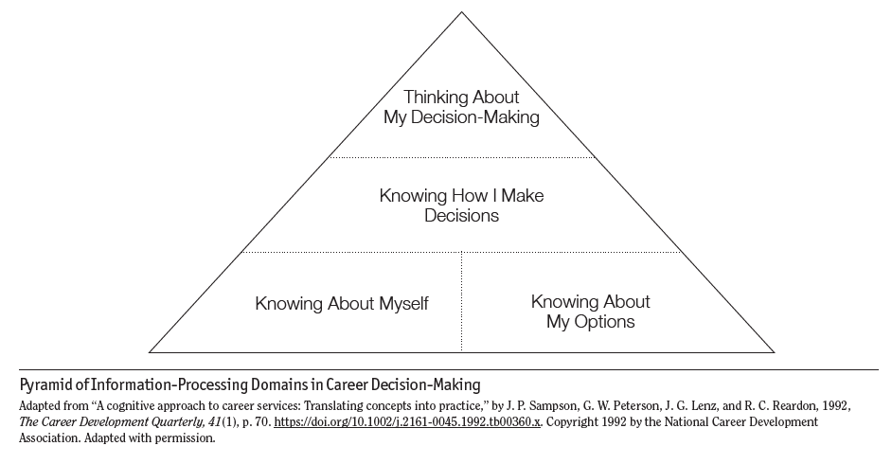
Information Processing Pyramid

Slide 18
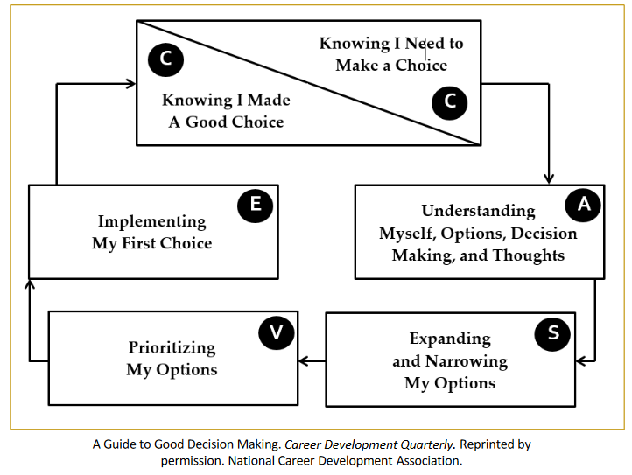
CASVE Cycle
Adapted from “A cognitive approach to career services: Translating concepts into practice,” by J. P. Sampson, G. W. Peterson, J. G. Lenz, and R. C. Reardon, 1992, The Career Development Quarterly, 41(1), p. 70. https://doi.org/10.1002/j.2161-0045.1992.tb00360.x. Copyright 1992 by the National Career Development Association. Adapted with permission.

Slide 19
Summary
Impact of social forces on career development
Importance of career problems
Views of career choice & development
Cognitive information processing (CIP) theory

