Slide 1

Unit Two:
Social Conditions Affecting Career Development

Slide 2
Chapter 6
Careering in a
Changing World

Slide 3

Role of Liberal Studies Courses
Courses that involve learning broadly about
things that make us what we are and the
world about us what it is
How do these courses relate to career
planning?
What are some examples?

Slide 4
Liberal Studies Courses & Employers
Research says—organizations want students
who have the ability to work with a wide
range of cultures
Highest-rated ability for new hires:
  Building and sustaining professional
  working relationships

Slide 5
Liberal Studies Courses & Careers
Pyramid of Information- Processing Domains
General education courses provide knowledge
about work options and the changing workplace
In terms of the CASVE Cycle:
  General education courses help you
    learn about and clarify societal ‘‘gaps’’ to which you might
    want to dedicate your career
    prioritize values used in your career decisions

Slide 6
New Career Metacognitions
How can I use this information about the sociology of work, economic changes, workplace diversity, and alternative work styles to sharpen my PCT career metacognitions, and become a more effective career decision maker?
How does this information relate to my:
  gender?
  cultural or ethnic group?
  Religious preferences or spirituality?
  identification with my community?

Slide 7
New Career Metacognitions
How will this information affect my ‘‘careering’’ as I finish school, look for a good job, make plans for a significant personal relationship or family, and undertake job changes (voluntary or forced)?
How can I develop a strategic plan for my career in light of the powerful, rapidly changing socioeconomic forces affecting persons today?

Slide 8
Two Career Metaphors
Sailing your career ship:
What are the conditions?
Macrolevel forces to consider?
Roe’s “formula” for occupational choice:
How do these elements-- E, B, C, F, & M shapes one’s career?
(see Table 1.1)

Slide 9
Having a Successful Career
What does this mean to you?
How do you define success?

Slide 10
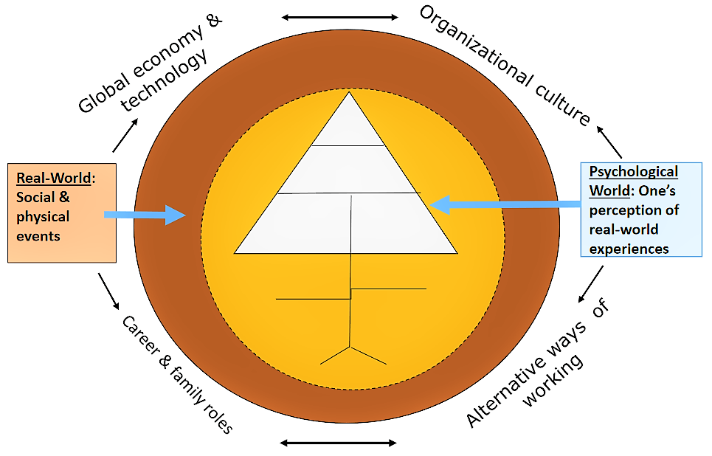
Connecting Units I & II

Slide 11
Four Macro-Level Career Factors
Technology & the global economy
Organizational culture
Alternative ways of working
Career and family roles
How might each of these impact your career?

Slide 12
Strategic Career Thinking
Formulating a “vision” of success
Doing the “right” things in your career
Implementing a plan to do things “right” in your
career
Consider internal & external forces
How do these ideas contribute to career
success and your PCT?

