Slide 1
Managing Chaos of Staff Recruitment and Supervision:
A Cognitive Information Processing Approach

Slide 2
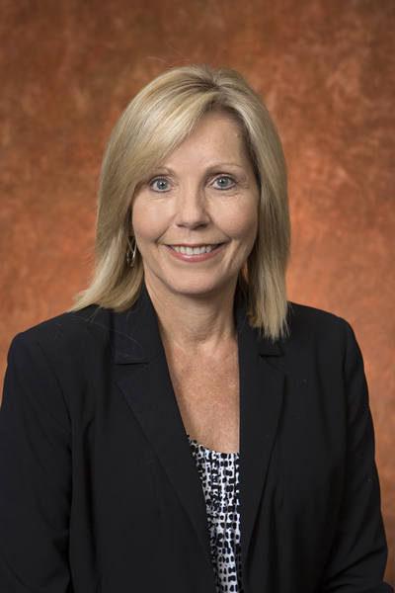
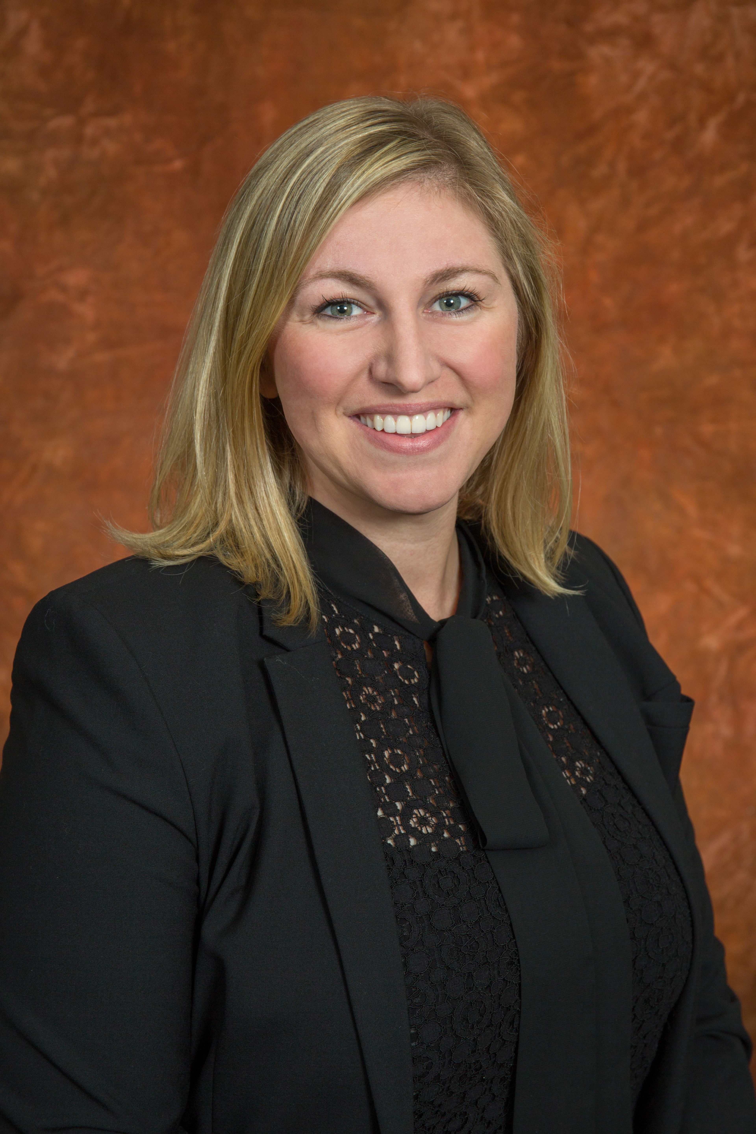
Meet the Presenters
Myrna Hoover
Director,
FSU Career Center
Erica Stallings
Program Director,
Career Advising and Counseling

Slide 3
Session Purpose
Discuss the current climate in career service around talent recruitment and retention
Introduce Cognitive Information Processing as a model for recruitment decisions and supervision of personnel
Discuss the CIP Process at work in the FSU Career Center
Provide resources to take back to your career center

Slide 4
Discussion
What does the recruitment and retention landscape look like for Career Services nationally?
On your campus, what are some of the issues you are facing?

Slide 5
Cognitive Information Processing (CIP):
Adapted for Recruitment and Supervision of Talent

Slide 6
Key Concepts of CIP
Pyramid of Information Processing Domains (Knowing)
CASVE Cycle (Doing)
Readiness for Career Choice Model
Individual Learning Plans

Slide 7
Pyramid of Information Processing
Executive Processing Domain
Meta-cognitions
Decision-Making Skills Domain
CASVE Cycle
Self -
Knowledge
(Organization)
Occupational
Knowledge
(Options)
Knowledge Domains

Slide 8

CASVE Cycle
Communication
Identifying the
problem - the gap
Execution
Taking action to
narrow the gap
Analysis
Thinking about
alternatives
Valuing
Prioritizing
alternatives
Synthesis
Generating likely
alternatives
Notes:
This is a general introduction to the CASVE cycle. Which is what it takes to make the best FROYO or Career Center team possible. Knowing one’s self and the need to make a decision by identifying the gaps. Analyzing options, synthesizing options with foundational knowledge, Valuing the options to select the top option, and then executing the decision.

Slide 9
Role Readiness and Level of Supervision adapted from CIP Career Readiness Model
The capability of an individual in a role or roles within the Career Center, and taking into account the complexity of personal and organizational factors that influence career development
Assists in determining how to supervise and develop talent, and considerations for role fit when recruiting talent
Source: Sampson, J. P., Jr., Reardon, R. C., Peterson, G. W., & Lenz, J. G. (2004). Career counseling and services: A cognitive information processing approach. Pacific Grove, CA: Brooks/Cole.
Notes:
Readiness is a tenant of CIP, in regards to the level of service delivery needed by a student seeking career services.
However, this can also be used as an assessment when recruiting for an open position, as well as determining the extent and level of supervision needed.
Capability is effectively assessing skill and competency to do the job
Complexity is assessing areas such as: Family factors that could hinder them from accepting or successfully acclimating to Tallahassee, Are they juggling multiple responsibilities or commitments that could impact their commitment to work (school, relationships, etc.), is there an organizational or environmental fit

Slide 10
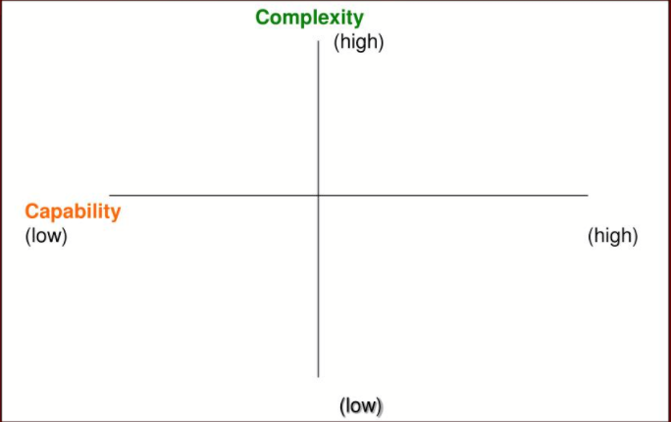
Readiness Model
Low Readiness: high degree of support needed
Moderate Readiness: low to moderate degree of support needed
Moderate Readiness: moderate to low degree of support needed
High Readiness: no to minimal support needed
Notes:
For career services a person with low readiness would be referred to counseling services, at times someone with moderate readiness will be referred, while High readiness and most moderate readiness are a fit for brief staff assisted career advising.
This is also the case in hiring. The higher the readiness, the less support or frequency of supervision needed. Which allows for faster adaptation and ownership of a role.

Slide 11
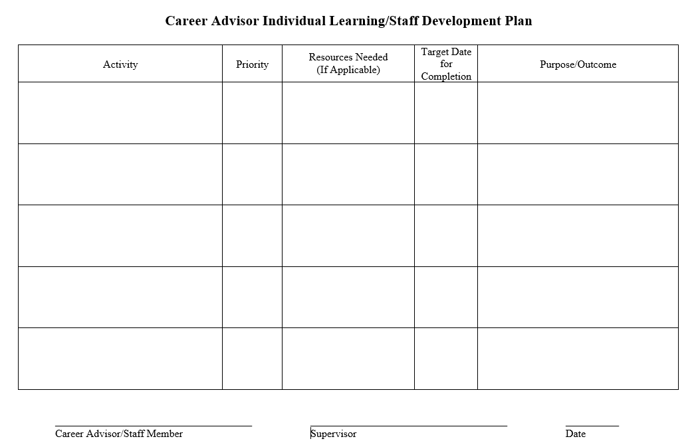
Individual Learning Plan/Staff Development Plan
Career Aspiration:
Annual Goal 1:
Annual Goal 2:
Annual Goal 3:
Notes:
ILP’s serve to aligning professional development to strategic initiatives within the career center while allowing personalization and ownership of one’s career path.
Many times this leads to cross team partnerships on programming which allows for well rounded growth and a stronger sense of belonging within the career center. It also allows leadership to work more effectively and intentionally when delegating tasks and projects to team members.

Slide 12
Pyramid of Information Processing Domains
CIP FOR RECRUITING
CASVE Cycle
Communication
Identifying the
problem - the gap
Execution
Taking action to
narrow the gap
Analysis
Thinking about
alternatives
Thinking about decision making
Valuing
Prioritizing
alternatives
Synthesis
Generating likely
alternatives
Knowing how leadership makes decisions
Knowing about the org. and team
(value, initiatives, talent)
Knowing about the options
(current, future, internal or external)
Notes:
Many times we know when an a position is going to become vacant because we are aware of career aspirations or complexity of life situations.
Due to understanding the VALUES, INTERESTS, and SKILLS of our Career Advisors, Graduate Assistants and Staff, we can align them with areas within the pyramid.
We look at the organization and team’s values, initiatives, and talents
We are aware of current and future needs, as well as internally based on career aspirations and capabilities do we have internal candidates for the job or do we need to look else where which demonstrates that we have a GAP in career center personnel.
We then generate likely alternatives externally depending on our network and what an outside candidate could bring to the position
Next we prioritize our alternatives based on out foundational knowledge of our organization, team, and potential options
Lastly we execute a search or effectively move Career Center Team members into positions where they are going to be most effective based on their capability and the institutional and organization fit.
If looking for an outside candidate, during the process, we effectively seek to understand who they are, are they a fit for the current position, and based on their readiness, are they a fit for potential positions in the future.
After working through the CASVE cycle during the recruitment and hiring process, based on their readiness, supervisors are better able to provide the need supervision for the new team member, as well as collaboratively work with the new team member to create a professional development plan based on his or her career aspirations. Knowing one’s career aspirations might be within another team, this can actually foster better cross team collaborations and provide an informal liaison role or go to person for collaborative programing with the other team or unit. Providing a since of purpose and belonging on the team where they currently reside, while fostering connections and enhancing skills for a future role within the Career Center.
These items, such as cross team programming or liaisons roles within the career center team can added to the staff development or individual learning plans. Along with other opportunities both internal and externally for growth and development.

Slide 13
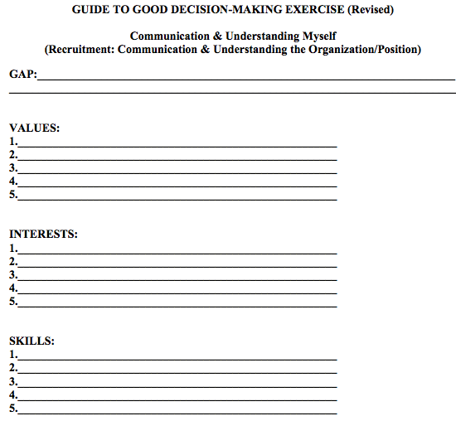
Communication and Analysis

Slide 14
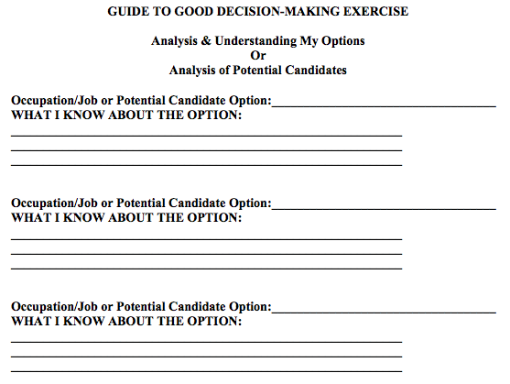
Synthesis

Slide 15
VALUING THE DECISION

Slide 16
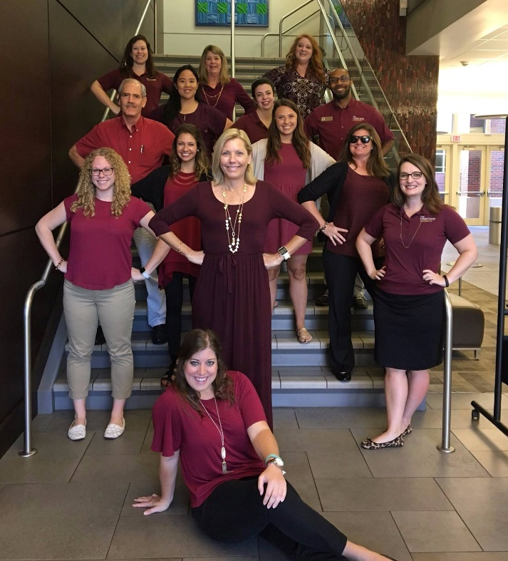

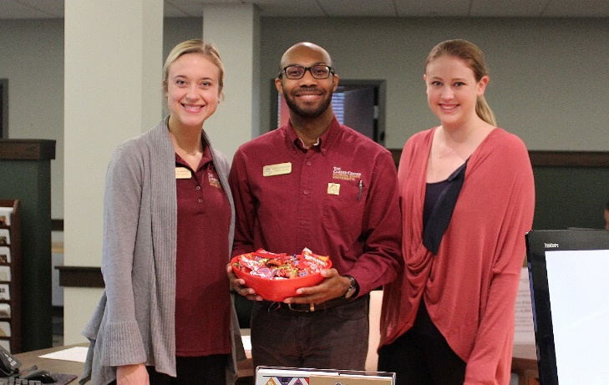
DECISION MAKING IN ACTION
CASES OF RECRUITING TALENT AND DEVELOPING TALENT AT FSU
Notes:
Training and Supervision of Career Advisors
Geneva, Li Pon, Jackie, Joshua, Jenn, and Michelle (Internal to Career Center)
Erica, Coleman, Rebecca (External)
Kyle and Kevin (Internal to FSU and External to Career Center)

Slide 17
The Case of the Counselor and Dual Career Parenting
Counselor interviewing for an Employer Relations position
Years of clinical counseling experience
Career Advising and Counseling Opening
Over 4 years with the Career Center
Two children; one with diverse abilities (special needs)
Partner/spouse is a physician starting a medical practice who has been without a paycheck for several months

Slide 18
The Case of the Interviewee with Great Potential
Interviewing for a Program Assistant position with Experiential Learning
Beginning Graduate School looking for opportunity to fund education
FSU Shadow Graduate Assistant
2 years' experience working with University System of Florida – Board of Governors
Multilingual
Displayed great potential
FSUshadow Graduate Assistantship

Slide 19
Closing Thoughts and Questions
How are you embracing the inevitable staffing changes and recruitment process within your department?
How do you consider readiness for a position and through supervision?
Are there elements of CIP that you can take back and utilize on your campus?
What questions do you have for us?

Slide 20
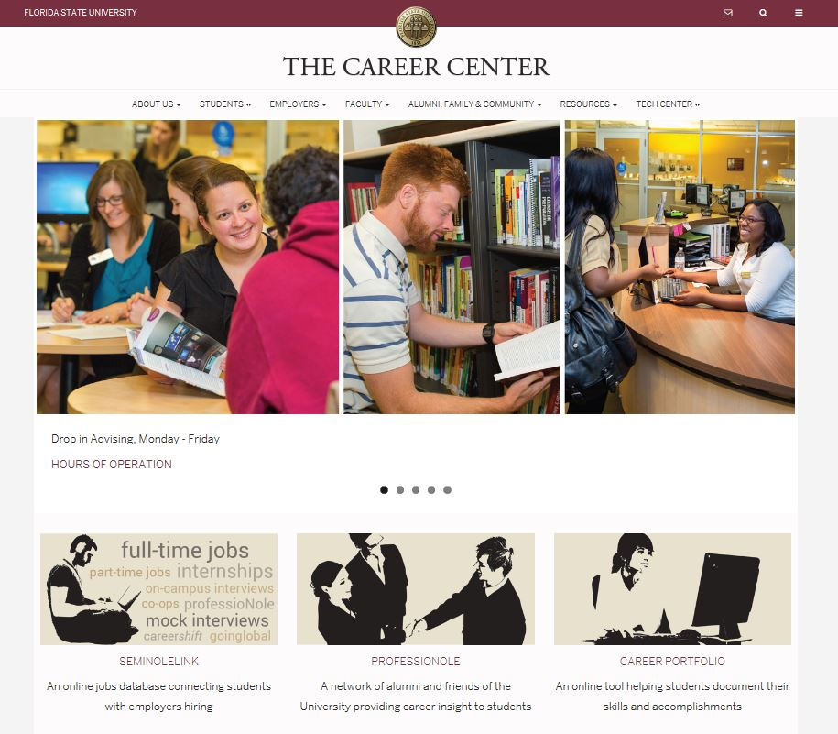




Connect with us!
FSU Career Center
@FSUCareerCenter
FSU Career Center
@FSUCareerCenter

Slide 21
Thank you for attending today’s session!
Let’s GO GREEN!
Please complete your session evaluation in the NACE18 Mobile App.
1. Launch the NACE18 Mobile App.
2. Go to Agenda > Select the Session Name.
3. Fill out the evaluation form.

