Slide 1
How to Help When They’re Hopeless: Career Counseling with Suicidal Clients
Michael Morgan
Mariah Seybold
Link to presentation:
https://career.fsu.edu/tech-center/resources/presentations/ncda-presentations

Slide 2
What will you learn?
Knowledge
Skills
Relationship of Career to Suicidality
How do career problems relate to the Interpersonal Theory of Suicide?
What aspects of career intervention could work best with suicidal clients?
How can I identify clients most at risk of suicidality in relation to job loss?
How can I measure a suicidal client’s progress in career counseling?
How can I better advocate for Career Counseling as an allied profession in treating suicidality?

Slide 3
What is your experience of client suicidality?

Slide 4
How do you assess client suicide risk?
Major Predictors
Columbia –Suicide Severity Rating Scale
Previous Suicide Attempt
Family History of Suicide
Mental and Physical Illness
Unemployment
Social Isolation
Family Conflict
Do you wish you were dead?
Have you thought about killing yourself?
Did you think of a way you would kill yourself?
Is killing yourself something you think you would really do?
Have you thought about how, when, and where you would kill yourself?
(Van Orden, et al., 2010)
Access to Lethal Means
Guns = highest chance for death
Lethal dose of medication = most common for attempt, low chance of death
(Posner, et al., 2010)
(Suicide Prevention Resource Center)

Slide 5
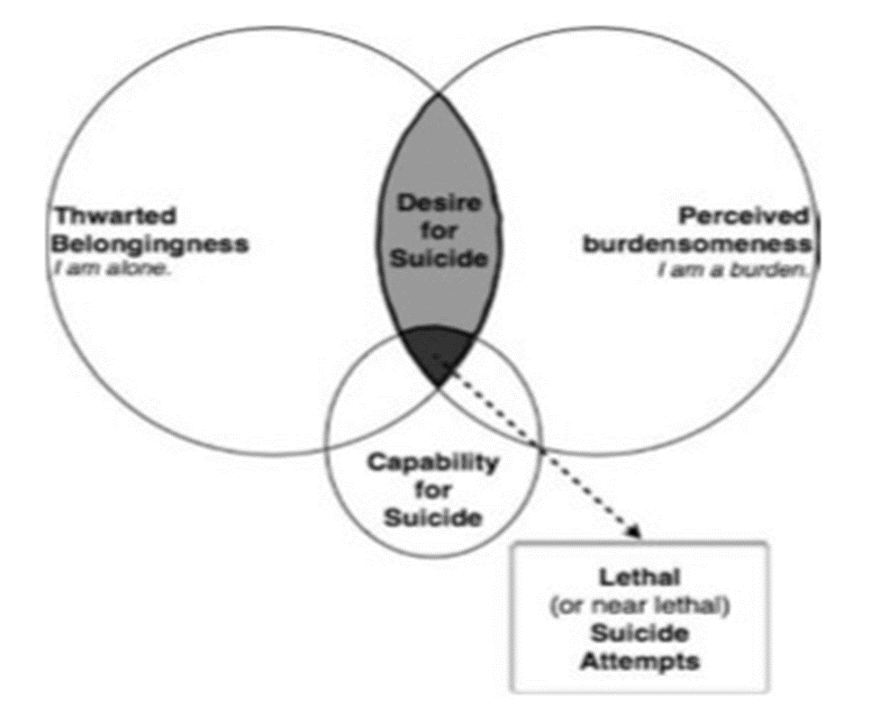
What is the Interpersonal Theory of Suicide (ITS)?
Adapted from “The Interpersonal Theory of Suicide,” by K.A. Van Orden and colleagues, 2010, Psychological Review, 117, p. 576. Copyright 2010 by the American Psychological Association.

Slide 6
How Does Unemployment Relate to ITS?

Slide 7
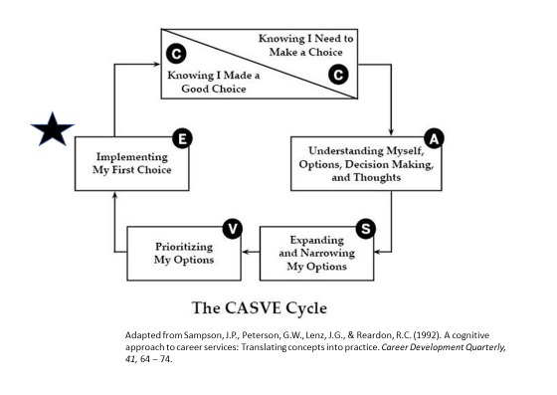
Suicidal Clients Immediate Career Concerns

Slide 8
Long-Term Goal of Career Counseling with Suicidal Clients

Slide 9
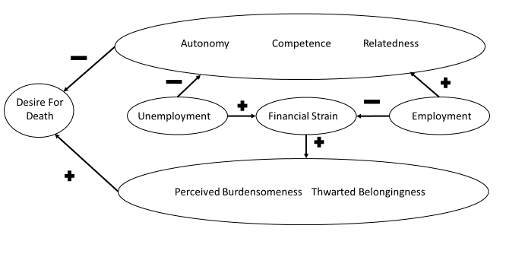
Self-Determination Theory and Career Counseling

Slide 10
The JOBS Program Improves Mental Health Outcomes
A group intervention for unemployed individuals
Increases persistence in job search
Reduces length of unemployment
Improves quality of reemployment
Reduces risk of depression in unemployed, especially for high risk individuals
Reduces symptoms of depression
Increases emotional and role functioning

Slide 11
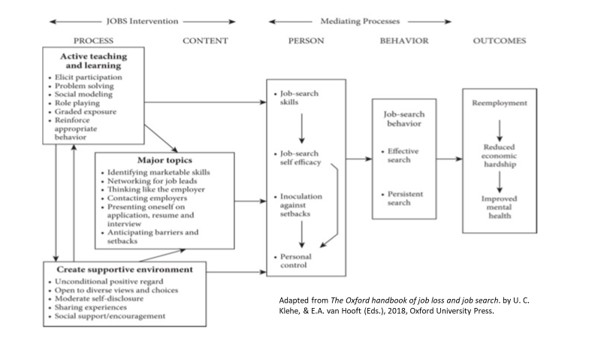

Slide 12
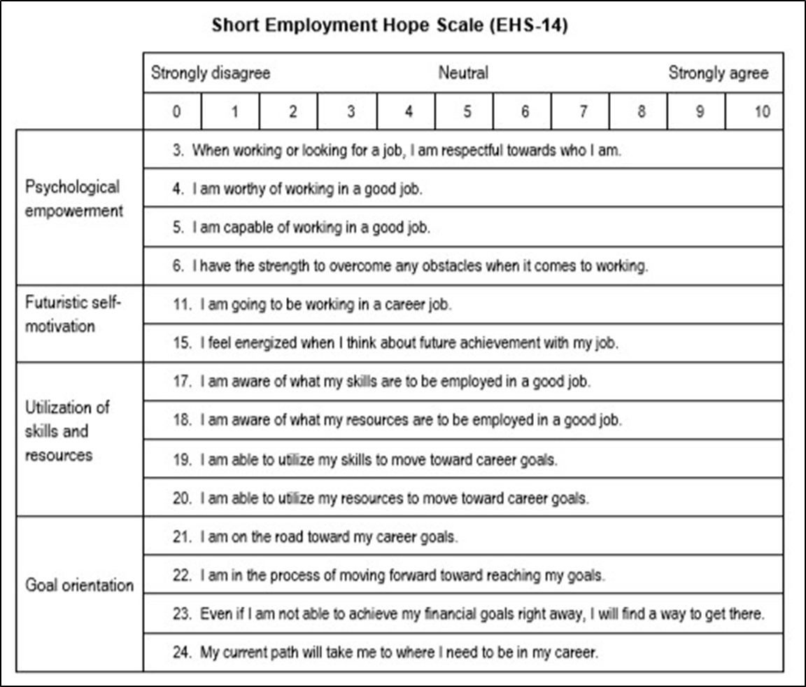
How can I assess a suicidal clients progress?
Retrieved from: http://www.philiphong.weebly.com/uploads/2/1/4/1/21418864/ehs___pebs__hong__2017.pdf

Slide 13
References
Hong, P. Y. P., Choi, S., & Polanin, J. R. (2014). A multisample confirmatory factor analysis of the Short Employment Hope Scale (EHS-14). Journal of Social Service Research, 40(3), 339-352.
Imam, K., & Ansari, S. A. A study of depression, anxiety and stress among employed and unemployed people. National Journal of Multidisciplinary Research and Development,3(2), 49 -51.
Liira, J., & Leino-Arjas, P. (1999). Predictors and consequences of unemployment in construction and forest work during a 5-year follow-up. Scandinavian journal of work, environment & health, 42-49.
Posner, K., Brown, G. K., Stanley, B., Brent, D. A., Yershova, K. V., Oquendo, M. A., ... & Mann, J. J. (2011). The Columbia–Suicide Severity Rating Scale: initial validity and internal consistency findings from three multisite studies with adolescents and adults. American Journal of Psychiatry, 168, 1266-1277.
Price, R. H., Choi, J. N., & Vinokur, A. D. (2002). Links in the chain of adversity following job loss: how financial strain and loss of personal control lead to depression, impaired functioning, and poor health. Journal of occupational health psychology, 7(4), 302.
Price, R.H., & Vinokur, A.D. (2014). The JOBS Program: Impact on Job Seeker Motivation, Reemployment, and Mental Health. In U. Klehe and E. Hooft (Eds.), The Oxford Handbook of Job Loss and Job Search (575 – 593). New York, New York: Oxford University Press.
Rodriguez, E., Allen, J. A., Frongillo, E. A., & Chandra, P. (1999). Unemployment, depression, and health: a look at the African-American community. Journal of Epidemiology & Community Health, 53(6), 335-342.
Sampson, J.P., Peterson, G.W., Lenz, J.G., & Reardon, R.C. (1992). A cognitive approach to career services: Translating concepts into practice. Career Development Quarterly, 41, 64 – 74.
Van Orden, K. A., Witte, T. K., Cukrowicz, K. C., Braithwaite, S. R., Selby, E. A., & Joiner Jr, T. E. (2010). The interpersonal theory of suicide. Psychological review, 117(2), 575.
Vinokur, A. D., Price, R. H., & Caplan, R. D. (1996). Hard times and hurtful partners: How financial strain affects depression and relationship satisfaction of unemployed persons and their spouses. Journal of personality and social psychology, 71(1), 166.

