Slide 1
PRC Express Workshop: Job Search Strategies
Notes:
Introduce your name, role, what your role entails, and then presentation topic.
As our world becomes more interconnected, the phrase “the world is getting smaller” is very much a reality in our workplace, it is important that any graduate understands that they will be interacting with diverse people and cultures.
Recommended CareerSpots videos for workshop:
Global and Intercultural Fluency: http://www.careerspots.com/newplayer/default.aspx?key=Cz0p0GUJCPNYUArt0M60uw2&
Teamwork/Collaboration: http://www.careerspots.com/newplayer/default.aspx?key=Cz0p0GUJCPNYUArt0M60uw2&

Slide 2
Overview:
Outcomes
5 tips
Next steps
Questions

Slide 3
Learning Outcomes and Career Readiness Competencies:
Learning Outcomes: Gain knowledge of job search process, including application tips, timing, job search platforms and general research tips
Related competencies:
Digital technology
Career management
Notes:
COMPETENCIES:
Digital Technology: Leverage existing digital technologies ethically and efficiently to solve problems, complete tasks, and accomplish goals. The individual demonstrates effective adaptability to new and emerging technologies.
Career Management: Identify and articulate one’s skills, strengths, knowledge, and experiences relevant to the position desired and career goals, and identify areas necessary for professional growth. The individual is able to navigate and explore job options, understands and can take the steps necessary to pursue opportunities, and understands how to self-advocate for opportunities in the workplace.

Slide 4
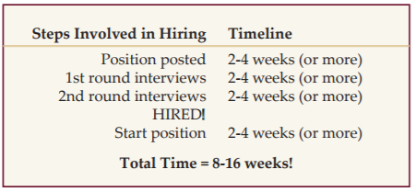
Tip #1: Plan for the process
Allow enough time
Know the steps involved
Be ACTIVE not passive
Get organized
Notes:
Begin your search with enough time to feel comfortable that you are attending to each part of the process. There is no right or wrong time to start searching for positions, however there are several steps involved in preparing for and executing a job search. It could easily be two to four months or more from the time you apply to when you are hired and begin your job. The timeline here is a sample from an employer’s perspective. Knowing this ahead of time will help you prepare accordingly.
The U.S Department of Labor gives these statistics:
Length of Job Search
Age Week
16-19 8.1
20-24 12.5
25-34 15.6
What is important to remember is that a successful job search requires, not just decisions, but ACTION!!
As you research and begin applying to positions, you may want to create a system for keeping track of your research findings, application materials, and correspondence with employers/ networking contacts. One example might be to keep file folders labeled with organization names. There are also online applications like JibberJobber. There is no one system that is better than another; just choose a method that will work best for you.
https://www.jibberjobber.com/login.php

Slide 5
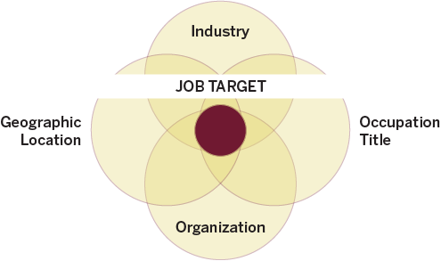
Tip #2: Develop Job Targets
Organize your search by:
Industry
Position
Organization
Location
Notes:
As you get started, it can be helpful to develop job targets to guide your search. Keep your values, interests, and skills in mind as you create your targets. You might find it useful to write down the factors that are most critical to you in potential jobs. For some, this might be a type of field or industry, a specific occupation, a preferred location, or a combination of things. For example, you may want to stay in Florida and work in the field of finance. In this situation, your target is to find finance organizations in Florida which you are both interested in and which offer a good fit.
Consider the sample here. The job target is the intersection of an individual’s most important factors: You can have multiple job targets to expand your job search, but the purpose of a job target is to focus a search for better use of time and energy, so it is best to be intentional and specific. Consider narrowing your job targets enough so you can focus energy on finding the positions in which you are most interested.

Slide 6
Tip #3: Do your research
Identify resources
Handshake and other job search sites
Career Center Library
Occupational Outlook Handbook & OnetOnline.org
Research companies
Company websites and social media
LinkedIn; Glassdoor.com
Google ‘News’
Notes:
Identify resources:
Use Handshake to find job listings, both local and national. Other search sites include Indeed.com, LinkedIn, Idealist.org (for nonprofit jobs), and specialty sites, such as journalismjobs.com and mediabistro.com for media/marketing/communications jobs. Professional associations and may also have job listings and your Chamber of Commerce may have local listings not found on national job sites.
There are countless resources available related to every phase of the job search campaign in the career center’s library and online at our website under RESOURCES. Additionally, the Career Center has several databases that allow users to search by employer, industry, location etc. such as AtoZ databases.
OOH and O-net can help you research different types of jobs, as well as salary, working conditions, education requirements and more.
Research companies:
Company websites are first place to look. Find key people; research mission, vision and values and programs and services, view media releases, etc. Social media can provide another look into marketing strategies, products, customer service philosophy, etc.
Find company profiles and research staff on LinkedIn; research salaries and find employee reviews on Glassdoor.
Google news about the company so you have up-to-date knowledge about the organization and people working there, stock trends, etc.

Slide 7
Tip #4: Use your network
Attend networking events (employer info sessions, panels, career fairs)
Create a LinkedIn account and find FSU alumni (www.linkedin.com/alumni)
Connect with a ProfessioNole Mentor
Discuss your goals with your professors, family, current employer, etc.
Develop a 30-second elevator speech
Notes:
The term network, when used in a professional context, refers to those individuals with which you have relationships that are personal, professional, or both. Networking is a term used to describe the process of creating, building, and maintaining these relationships. Networking can involve interactions with others in-person and/or online through professional social media applications (such as LinkedIn.com). When searching for a job in the hidden job market, networking is the primary way opportunities are found and secured. One of the best ways to get started networking is to develop a personal elevator speech: a 30-second or less speech you deliver when meeting a contact for the first time.
Other places to network: Clubs/Organizations
Family and Friends
Professionals
Listserv groups
Neighbors
Organized Networks
Former Teachers/Employers
School Associates/Alumni/Seminole Connection
Recreational Acquaintances

Slide 8
Tip #5: Be prepared
Get your resume critiqued
Write a cover letter
Work on your interviewing skills
Mock Interview Program
Employer-in-Residence
Notes:
Application Materials: The job search involves many moving pieces. For most job opportunities, employers will request a variety of application materials, depending on your industry and job target. You will want to prepare a strong résumé and cover letter that can be tailored based on the positions you are applying for, and speak with professionals in your field to inquire about other materials you might need to develop (i.e., portfolio, writing sample, teaching philosophy). For more information, review the “Writing a Résumé,” “Writing Effective Cover Letters” or other related guides at career.fsu.edu/Resources/CareerGuides.
Interviewing: Preparation for the interview is essential. There are a variety of interview formats (i.e., Skype, panel, group, etc.) and questioning styles used by employers that are helpful to review prior to your interview. Practice your interview skills through The Career Center’s Mock Interview Program, or review the guides on interview preparation at career.fsu.edu/Resources/CareerGuides.
Employer in Residence: Employers in residence provide resume critiques, mock interviews and networking opportunities for students. It’s a great way to practice your skills with an employer before you apply for jobs and start interviewing.

Slide 9
Next steps
Look for jobs and ‘favorite’ employers in Handshake
Have your resume and cover letter critiqued by the Career Center
Complete a Mock Interview
Notes:
Use Handshake to look for jobs in your field. You can also ‘favorite’ employers and positions that are listed, which can make it easier to find opportunities when they are posted.
It’s important to have your materials critiqued! Stop by The Career Center to have a career advisor provide you with feedback on your application materials. Mock interviews provide valuable practice and help you overcome anxiety before your job interviews. Sign up for mock interviews on Handshake.

Slide 10
Questions
What are some mistakes students make when searching for a job?
Is it important to include a cover letter with my application?
What is the ‘hidden’ job market?
Notes:
Mistakes: Poor resume, failure to network, inadequate research, canned approach, negative attitude, dress/appearance, poor interview preparation.
Cover letter: Yes! Consider that if others submit a cover letter and you don’t, they will come across as stronger applicants. Plus, it’s another chance to sell yourself!
Hidden job market: The hidden job market refers to positions that are rarely advertised online, in newspapers, or anywhere else in print. They may not even be real positions yet, but rather, an area within an organization with the potential to create a new position if the need arises and the right candidates present themselves. To find these positions, it is essential to create, maintain, and actively utilize a network of personal and professional contacts as part of your job search, as well as utilize multiple methods to locate available positions for optimal results (for example, social media, online search engines and attending career fairs).

Slide 11
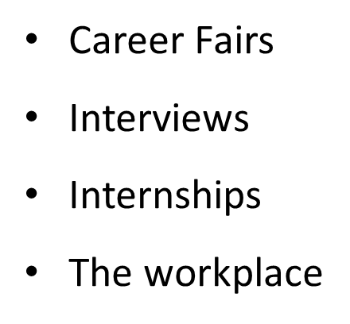
Professional Clothing Closet
Students can obtain FREE professional and business casual attire appropriate for:
View hours of operation at career.fsu.edu/ClothingCloset

Slide 12
Drop- in Career Advising
Monday – Friday, 9 a.m. - 4:30 p.m.
Extended Tuesday hours, 9 a.m. - 8 p.m.
(Fall and Spring semesters only)
Closed Fridays, 1:30 - 2:30 p.m. (Fall & Spring semester)
Visit career.fsu.edu/CareerSpots to learn more!

Slide 13
Complete the survey to confirm your attendance
PRC workshop survey
*This will count towards your completion of the ProfessioNole Ready Certificate
Career.fsu.edu

Slide 14
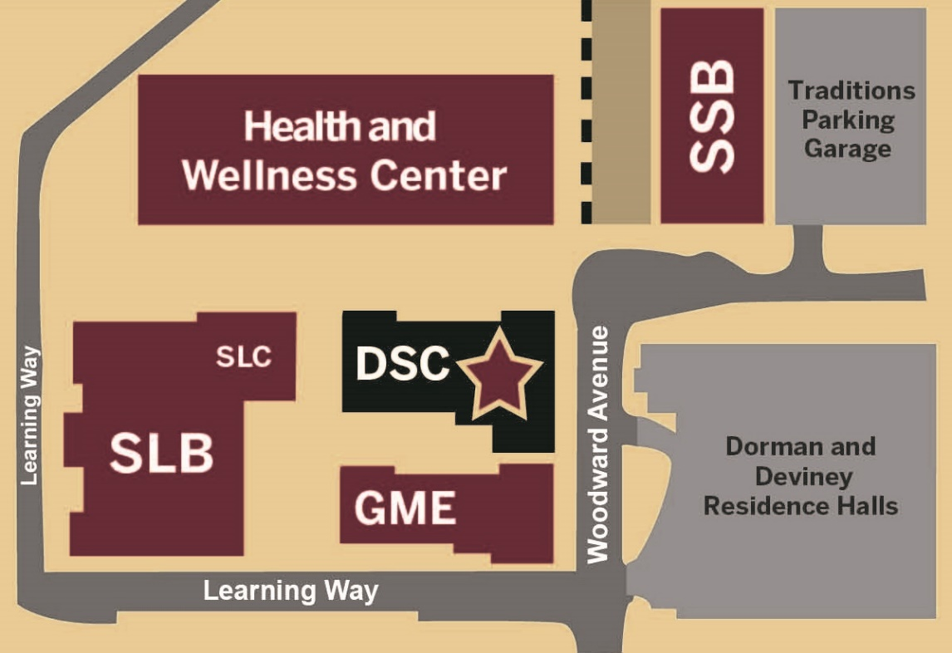
The Career Center
Located in the Dunlap Success Center at the corner of Learning Way and Woodward Avenue
career.fsu.edu

