Slide 1
Build Your Profile

Slide 2
Profile
First section that referred users see
Provides overview and creates strong first impression
Reflects your career goals appropriately
Tips:
Be clear and concise
Check for spelling, grammar, and punctuation

Slide 3
Edit Profile
Now that you’ve created a portfolio, you can edit and build your profile.

Slide 4
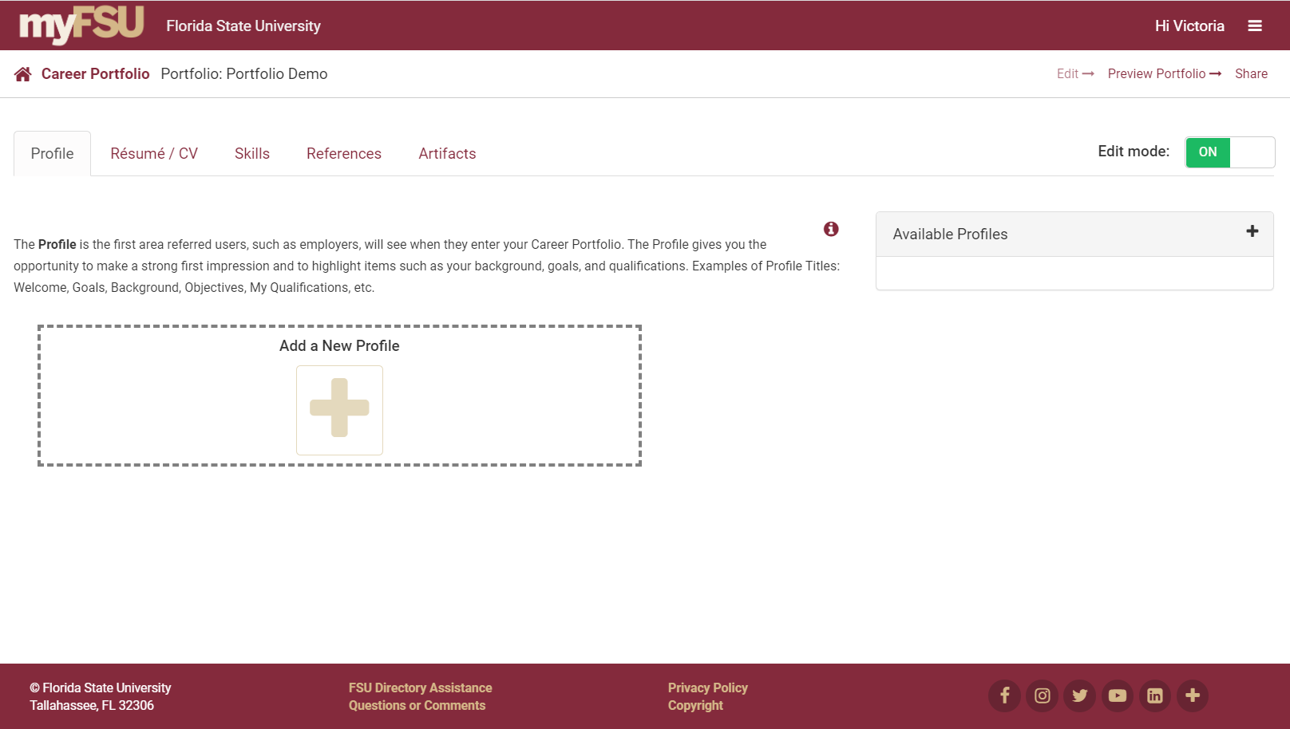
Add a New Profile

Slide 5
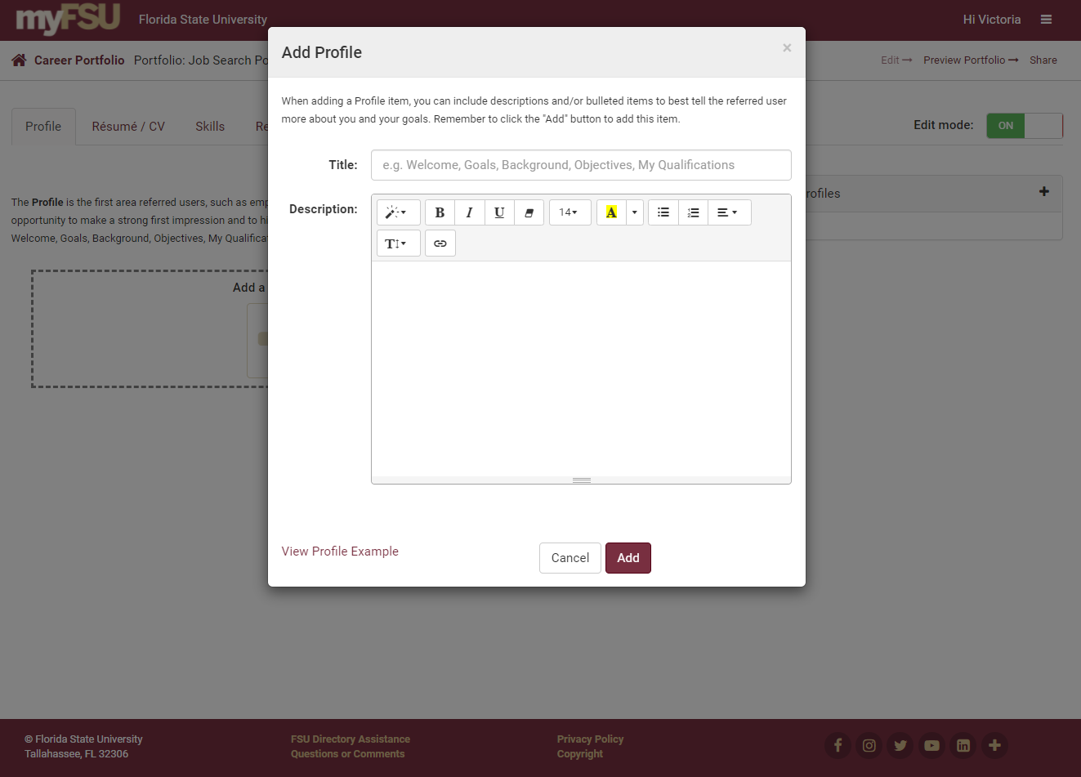

Slide 6
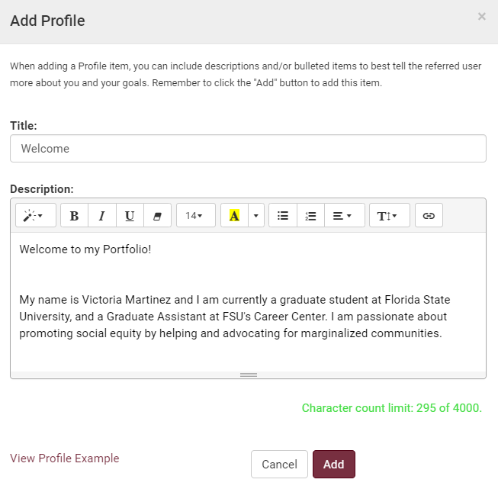
Customize Profile
Profile Title Samples: Welcome, Goals, Background, Objectives, My Qualifications, etc.

Slide 7
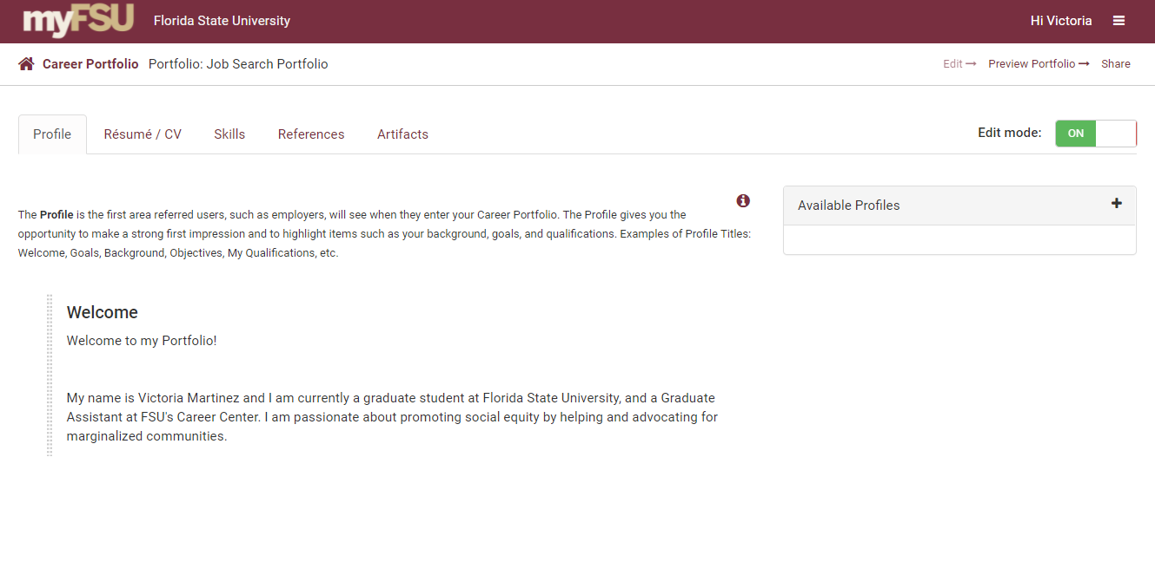
Customize Profile
Add more profiles to customize your portfolio.

Slide 8
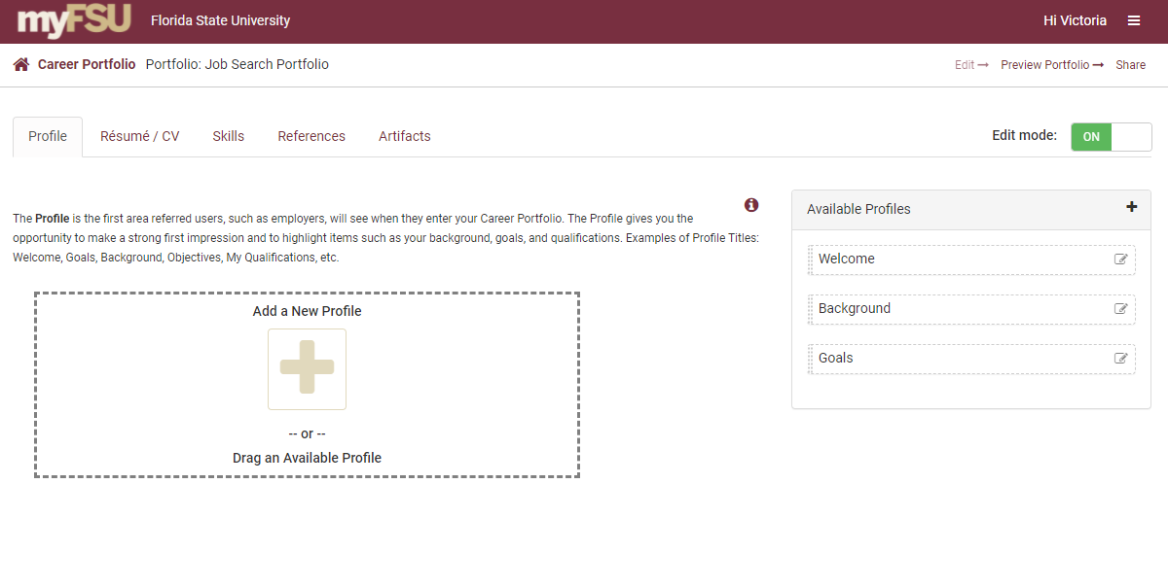
Adding Previous Profiles
Drag “Available Profiles” from your previously created portfolios to add them to your profile.

Slide 9
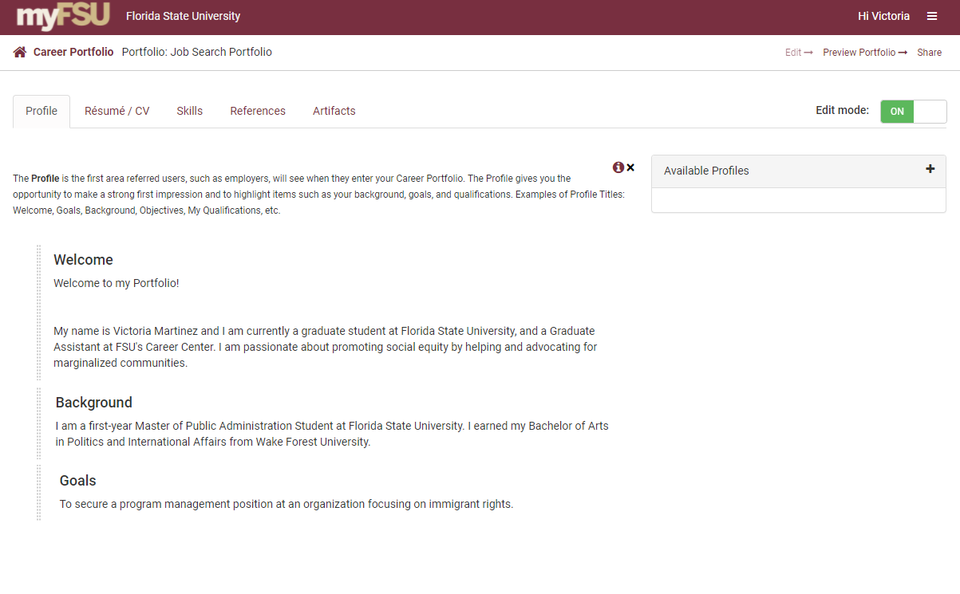
Reorder Your Profile
Reorder your profiles by clicking on and dragging them.

Slide 10
Preview Your Portfolio

Slide 11
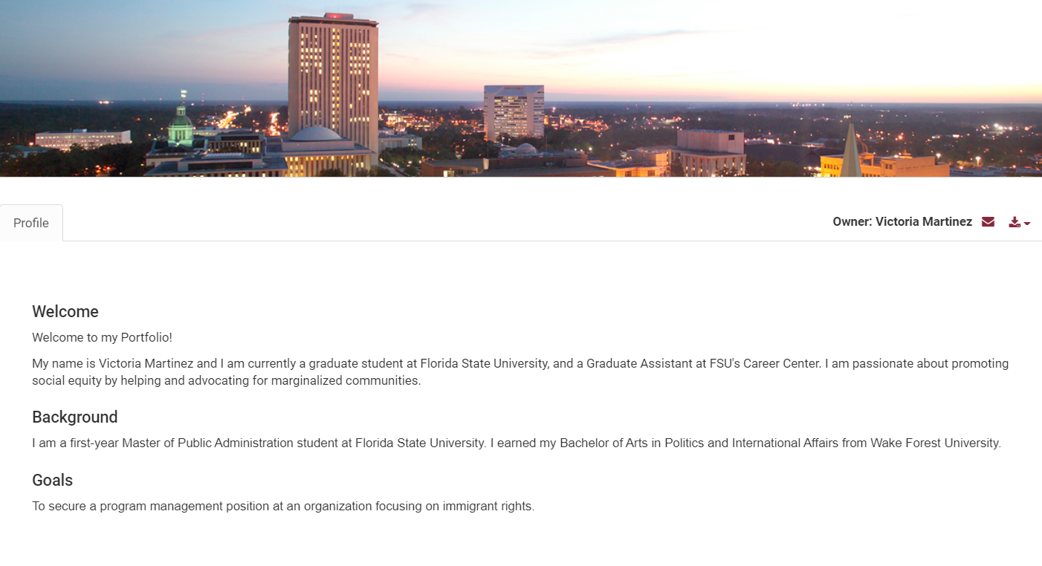
Preview of Your Portfolio

