Slide 1
Share Your Portfolio

Slide 2
Share Your Portfolio
Share your portfolio with potential employers
Allows you to give special access to others
Customize who sees what on your portfolio
See how many times your portfolio has been viewed
Share the link to your portfolio on your resume/CV and LinkedIn

Slide 3
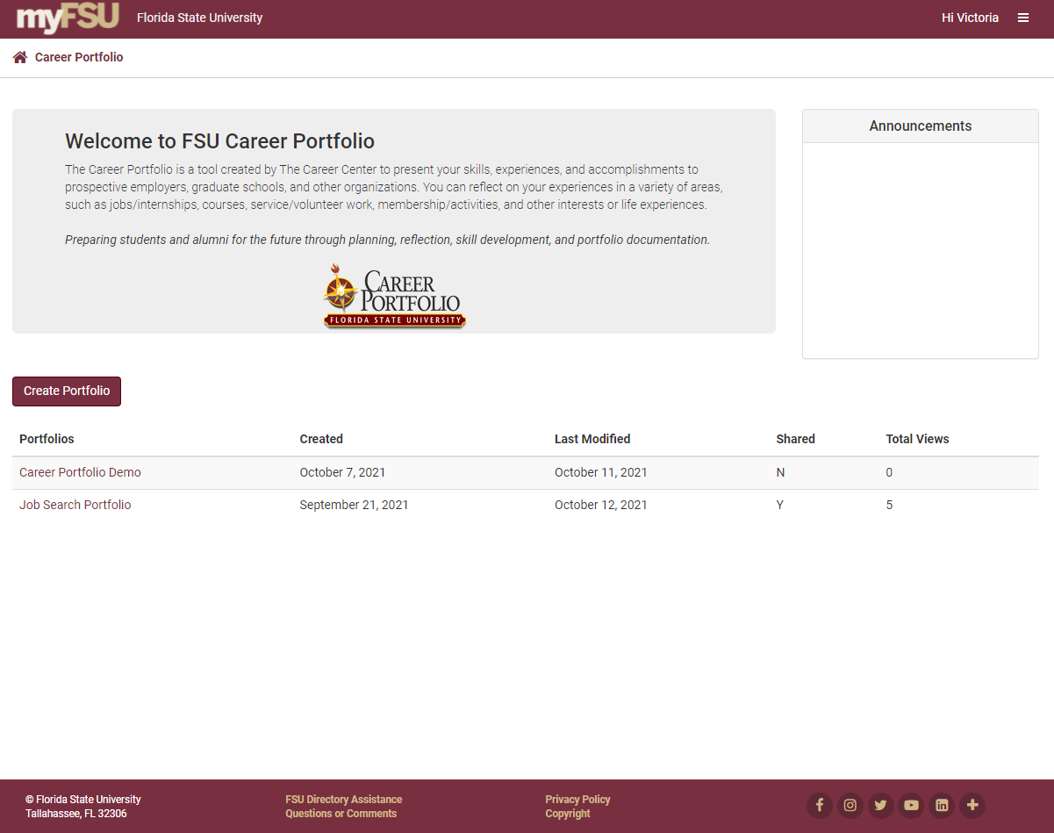
Select the Portfolio
Click on the Portfolio that you want to share

Slide 4
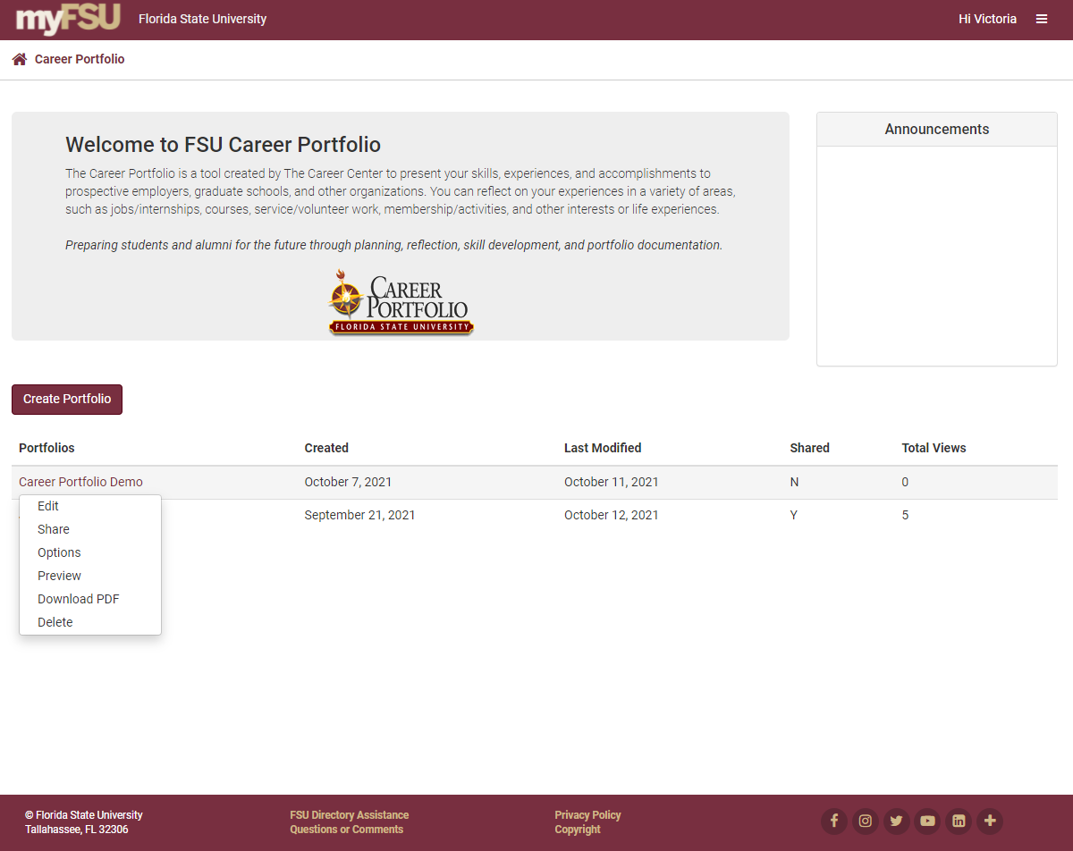

Slide 5
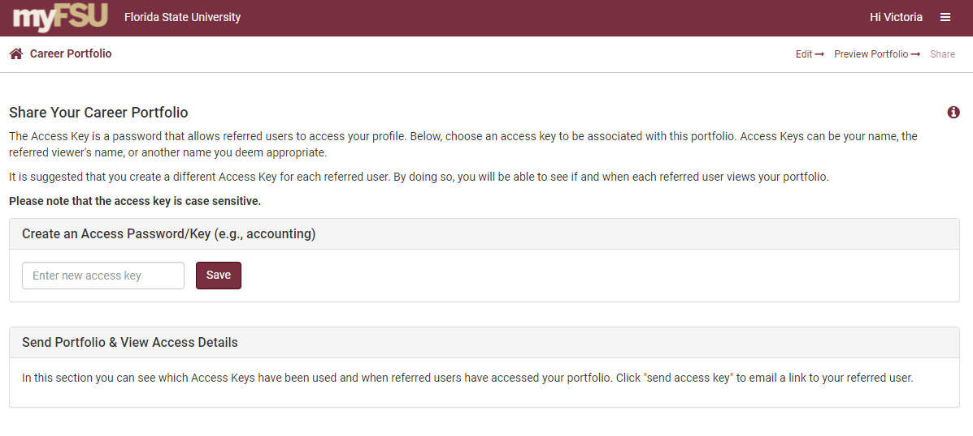
Create an Access Password

Slide 6
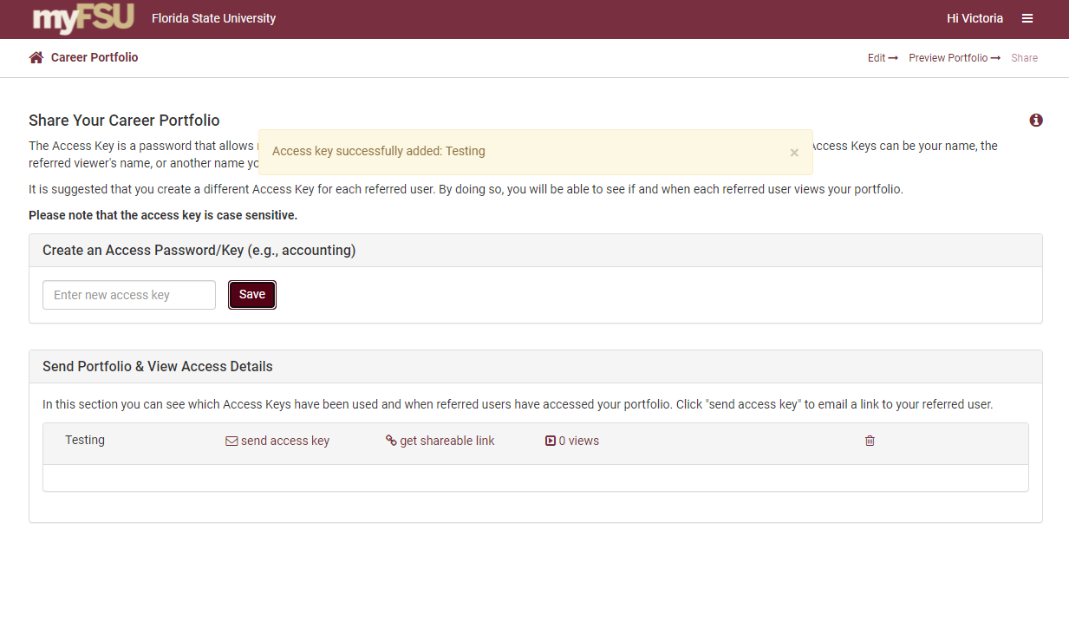
View an Access Password

Slide 7
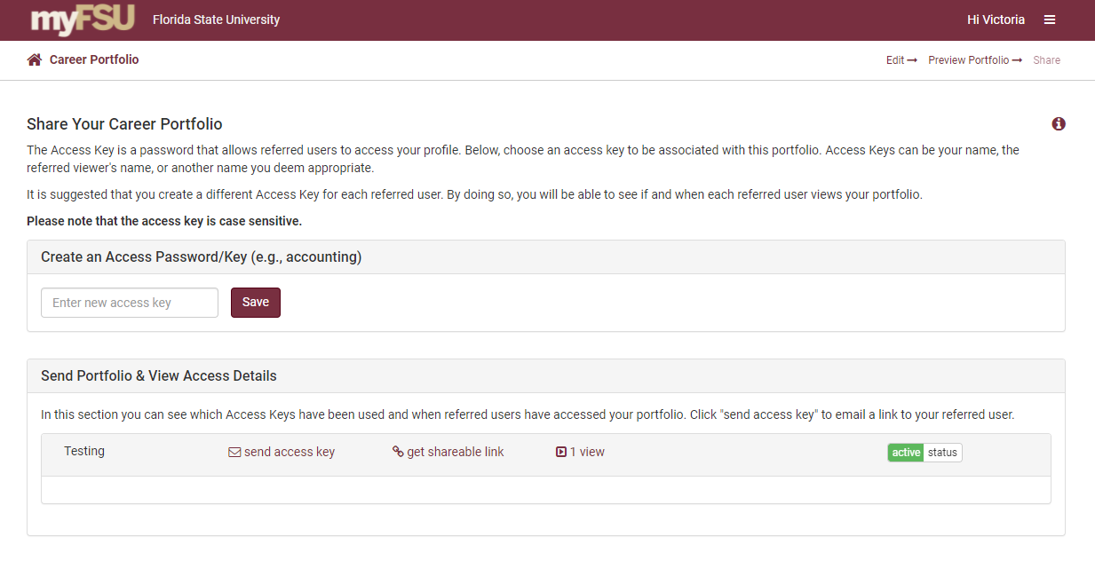
Send an Access Password

Slide 8
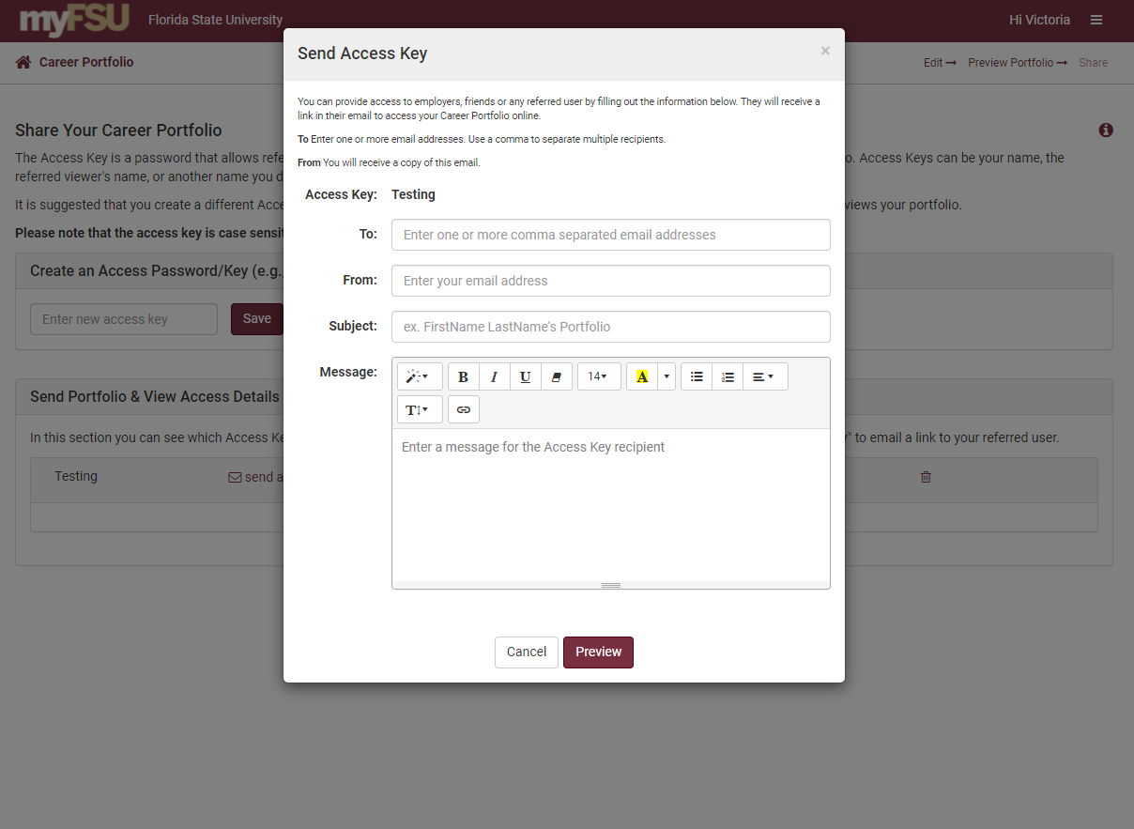

Slide 9
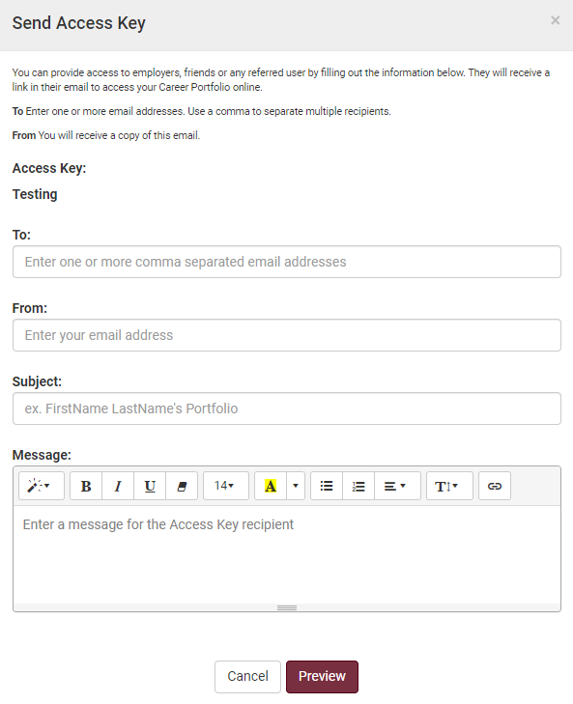
Edit an Access Password
Enter one or more email addresses to send the same access password
Customize the message, subject, and sender email address

Slide 10
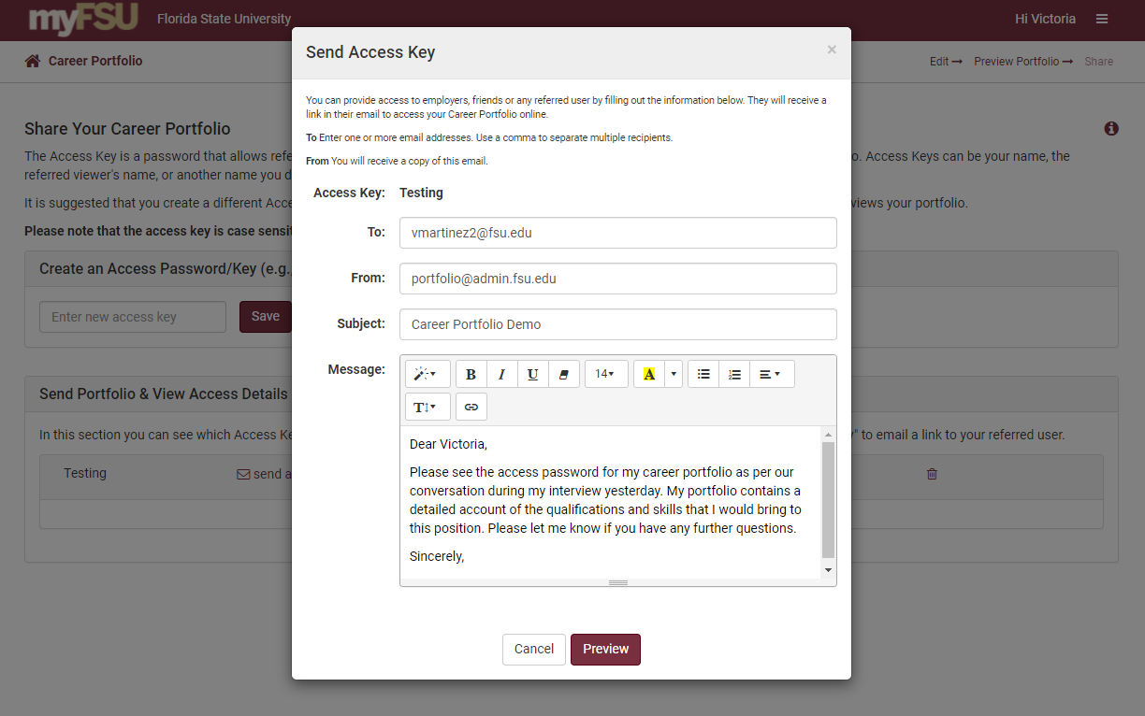
Preview Your Message

Slide 11
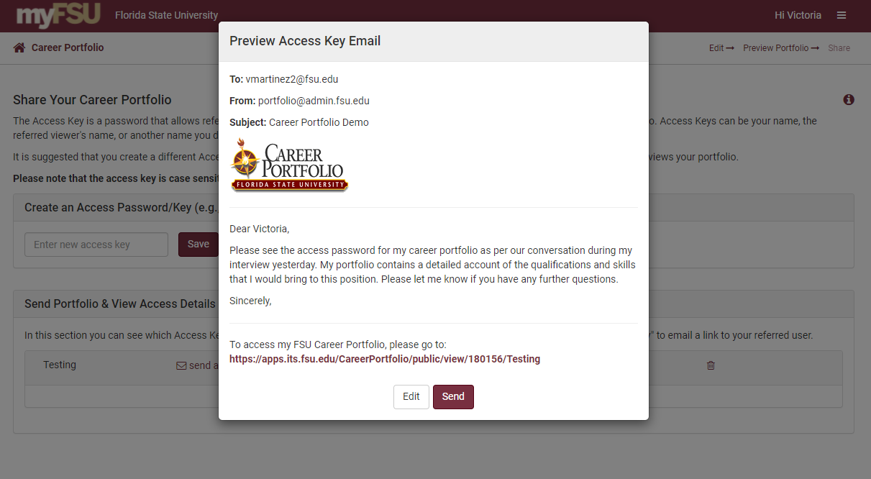
Edit or Send Your Message

Slide 12
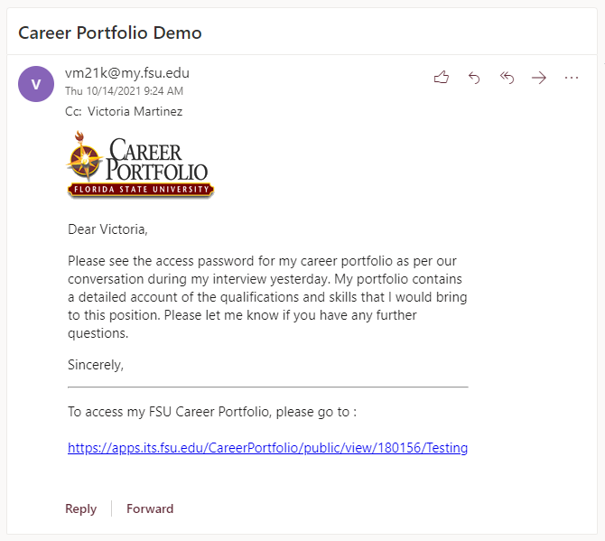
The Recipient’s Email
The email address you entered will receive an email with a link
The link will take that recipient to your Career Portfolio
You will receive a Confirmation Email with a copy of this email

Slide 13
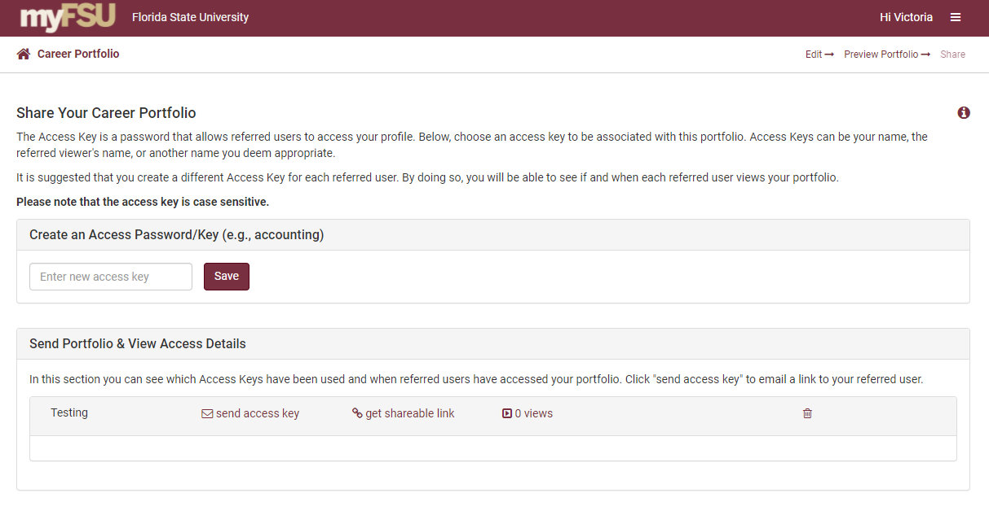
Get a Shareable Link

Slide 14
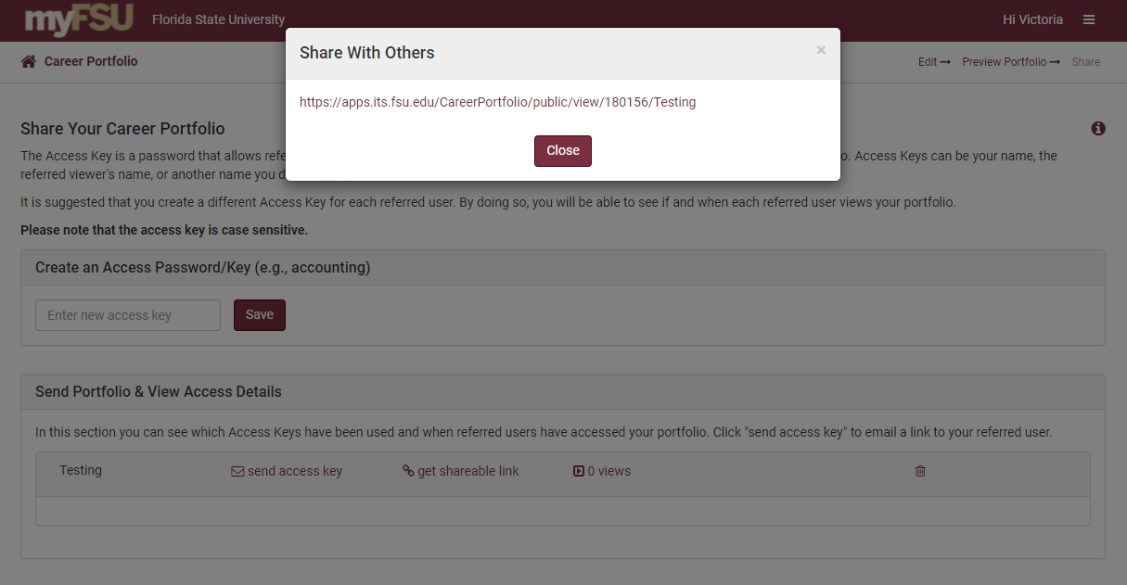
Copy and Paste Your Link

Slide 15
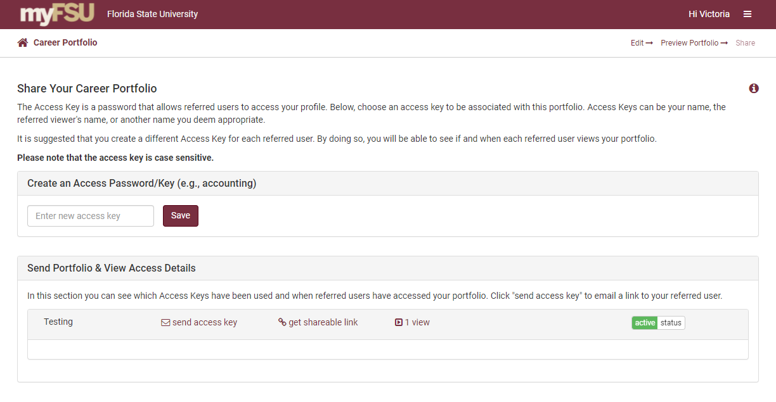
See How Many Views You Have

Slide 16
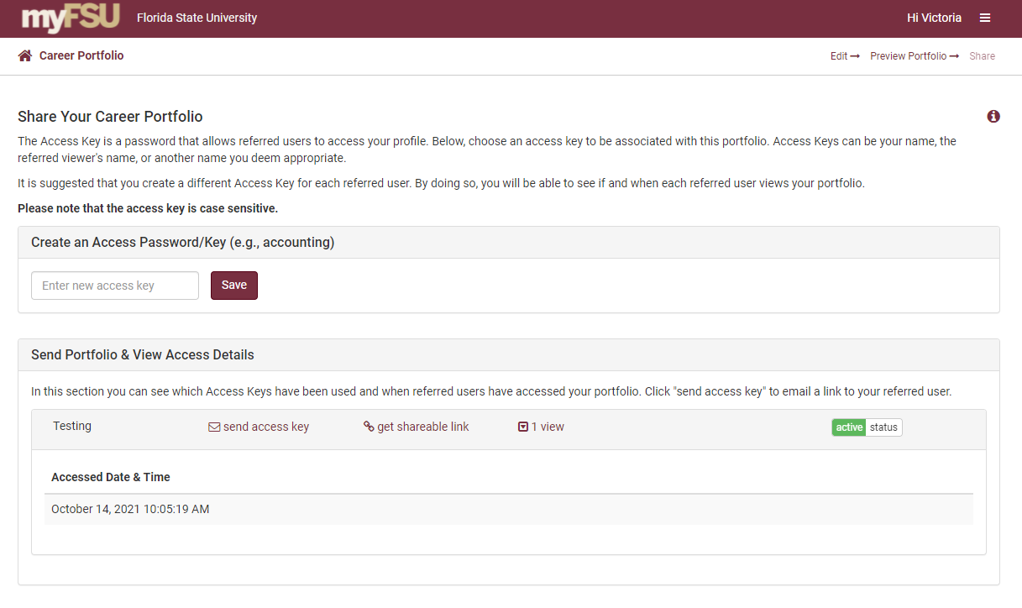
See When Your Profile Was Viewed

Slide 17
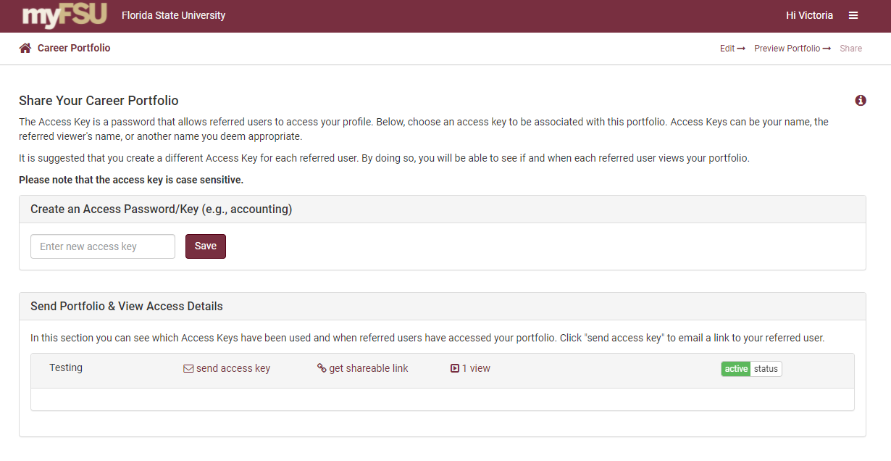
Turn Access On/Off

Slide 18
Main Menu

Slide 19
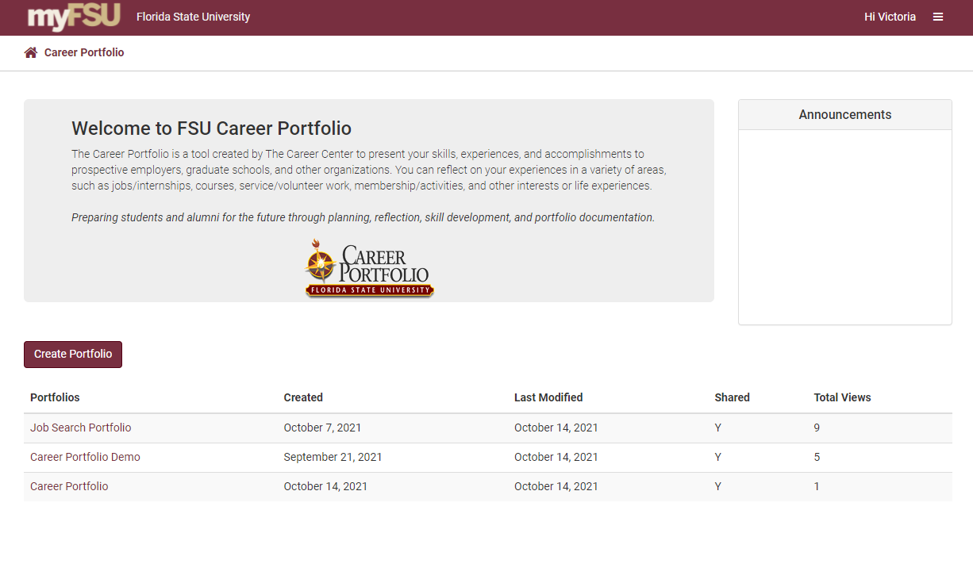
See View Count and Shared Status

